Slide 1
ExerCise #8
Lattices Review
Write your name and answer the following on a piece of paper
Recall that the set of English words, ranked by substring inclusion, forms a poset but NOT a lattice. Explain why and give an example
Reflexive: every word includes the substring of itself
Anti-symmetric: if two words include substrings of each other, they must be the same word
Transitive: if a is a substring b, and b is a substring of c, then a is a substring of c
Not a lattice: consider the English words a and he. They have no greatest lower bound

Slide 2
Administrivia and
Announcements

Slide 3
Abstract Interpretation
EECS 677: Software Security Evaluation
Drew Davidson

Slide 4

Last Time: Lattices
Review: Static Analysis
Described Formal Conditions to Guarantee Termination
Dataflow facts can be ordered into a complete lattice
Iterative application of a monotonic function can achieve a fixpoint
Some practical Limitations
No guarantee about how long the algorithm will run
Sadly out of luck if we don’t have a complete lattice
It’s a lattice!

Slide 5
Lecture Outline
Abstract Interpretation
LLVM (time permitting)

Slide 6

Analysis Precision
Abstract Interpretation
Precision / Efficiency Tradeoff
With a complete lattice we can, in theory, eventually terminate
The shallower the lattice, the faster the fixpoint
That’s not a very strong guarantee!
Choose to approximate the lattice

Slide 7

Analysis Precision
Abstract Interpretation
Precision / Efficiency Tradeoff
With a complete lattice we can, in theory, eventually terminate
The shallower the lattice, the faster the fixpoint
That’s not a very strong guarantee!
Choose to approximate the lattice

Slide 8

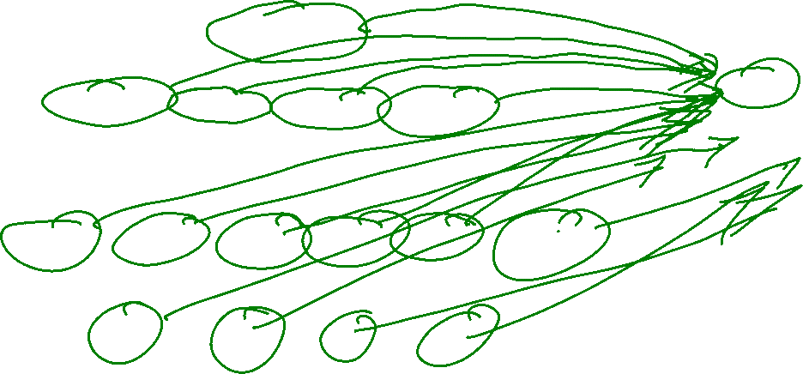
Let’s Consider A Very Approximate Lattice
Abstract Interpretation
Abstract Domain of Signs
{00,01,10,11}
{01,10,11}
{00,10,11}
num
{00,01,11}
{00,01,10}
pos
zero
neg
{00,01}
{01,10}
{00,10}
{00,11}
{01,11}
{10,11}
$$∅$$
{00}
{01}
{10}
{11}

Slide 9
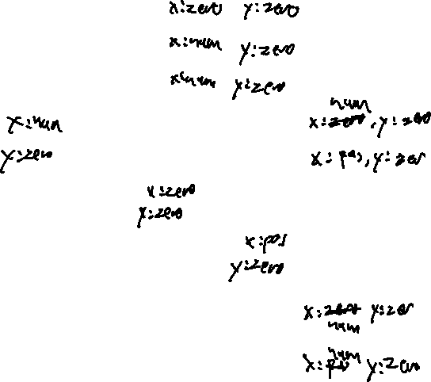
Analysis Precision
Abstract Interpretation
1. int x = 0;
2. int y = 0;
3. while (INPUT){
true
1. int x = 0;
2. int y = 0;
3. while (INPUT){
4. if (x > 0)
5. if (x < 0)
6. y = y / 0;
7. x++;
}
return;
4. if (x > 0){
true
5. if (x < 0){
false
false
true
false
6. y = y / 0;
7. x++
8. }
9. return;

Slide 10
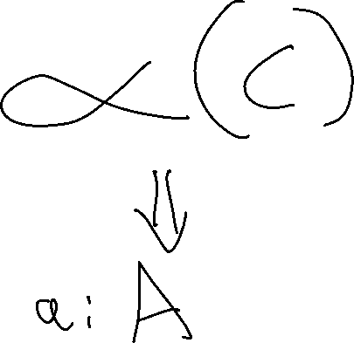
The Abstraction Function
Abstract Interpretation
From the Concrete Domain to the Abstract
α({0}) = | zero
α(S) = | if all values in S are greater than 0 then pos
 | else if all values in S are less than 0 then neg
 | else unk

Slide 11
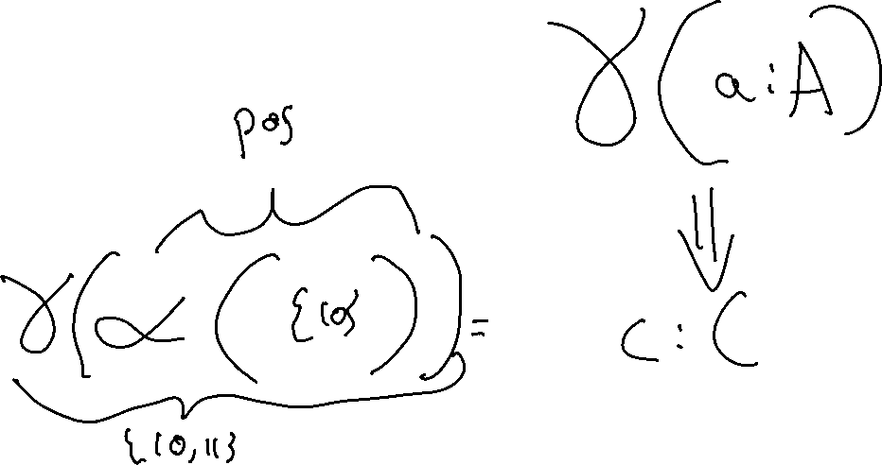
The ConCretization Function
Abstract Interpretation
From the Abstract Domain to the Concrete
γ(zero) = {0}
γ(pos) = {all positive ints}
γ(neg) = {all negative ints}
γ(num) = Int (i.e., all ints)

Slide 12

A Detour into formalization
Abstract Interpretation

Slide 13

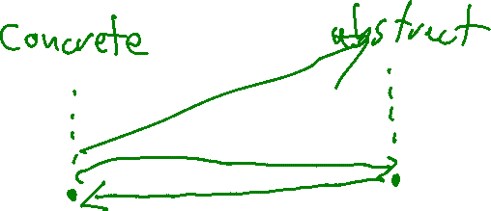
Galois Connection
Abstract Interpretation
A Galois connection is a pair of functions, α and γ between two partially ordered sets (C, ⊆) and (A, ≤), such that both of the following hold.
∀ a ∈ A, c ∈ C: α(c) ≤ a iff c ⊆ γ(a)
∀ a ∈ A: α(γ(a)) ≤ a

Slide 14

End Formalization Detour
Abstract Interpretation

Slide 15
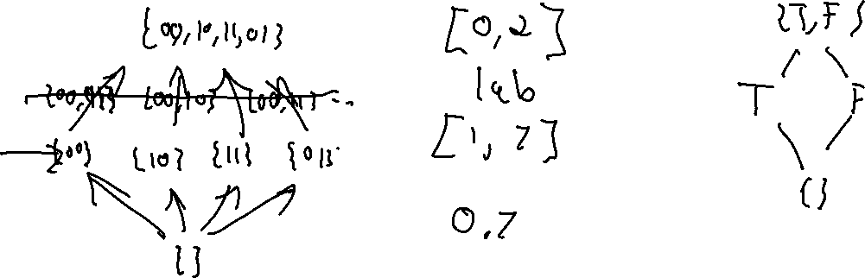
Abstract Domains in Practice
Static Analysis
Intervals
Property Existence
“Singleton Integer Sets”
You know the number, or you don’t
You know a concrete range
A property does or does not hold

Slide 16
Section Summary
Static Analysis
Static Analysis gives us an important guarantee
Anything that isn’t crystal clear to a static analysis tool probably isn’t clear to your fellow programmers, either. The classic hacker disdain for “bondage and discipline languages” is short-sighted – the needs of large, long-lived, multi-programmer projects are just different than the quick work you do for yourself.
- John Carmack's Static Code Analysis post
Completeness of bug finding / Soundness of verification
Thus far we’ve been using source code

Slide 17
Lecture Outline
Abstract Interpretation
LLVM
Bonus stage
unlocked!

Slide 18

Applying Static Analysis
Static Analysis
We Know the Theory of Static Analysis
But how do we apply that theory in practice?
Thus far we’ve been using source code as a target (that’s limited!)

Slide 19

LLVM
LLVM: Overview
The LLVM Project is a collection of modular and reusable compiler and toolchain technologies. Despite its name, LLVM has little to do with traditional virtual machines. The name "LLVM" itself is not an acronym; it is the full name of the project.
Is this the LLVM logo?

Slide 20
LLVM
LLVM: Overview
The LLVM Project is a collection of modular and reusable compiler and toolchain technologies. Despite its name, LLVM has little to do with traditional virtual machines. The name "LLVM" itself is not an acronym; it is the full name of the project.
No, it’s a Yu-gi-oh card!

Slide 21

LLVM
LLVM: OVerview
The LLVM Project is a collection of modular and reusable compiler and toolchain technologies. Despite its name, LLVM has little to do with traditional virtual machines. The name "LLVM" itself is not an acronym; it is the full name of the project.
This is the actual LLVM logo

Slide 22
LLVM: Why We Use It
LLVM: OVerview
Let’s consider two goals of software security evaluation
Discover vulnerabilities in “trusted” code
Discover attacks in “untrusted” code
Most useful for
this one

Slide 23
LLVM: Why We Use It
LLVM: OVerview
Genericity

Slide 24

LLVM: Why We Use It
LLVM: OVerview
Genericity
LLVM High-Level Architecture
Common
Middle-end
Front-end₁
Back-end₁
C
Analysis / Optimization₁
X64
Common
IR
Common
IR
Back-end₂
Front-end₂
Haskell
…
MIPS
…
…
Front-end_{n}
Analysis / Optimization_{k}
Back-end_{m}
Ruby
WASM

Slide 25
Section Summary
LLVM
LLVM Provides a good basis for analysis
Allows us to avoid a lot of the parsing / language specific details that we view as boilerplate
Gives us a good analysis target in llvm bitcode

Slide 26
Next Time
Begin looking at A program representation we can use for to build our own analyses

