Slide 1
Exercise #18
CFI Review
Write your name and answer the following on a piece of paper
What is the difference between the CFI protections implemented by LLVM and Microsoft’s Control Flow Guard?

Slide 2
Administrivia and
Announcements

Slide 3
Object-Oriented Call Graphs
EECS 677: Software Security Evaluation
Drew Davidson

Slide 4
Class Progress
Analysis Underlying our enforcement needs

Slide 5
Last Time: CFI
Review: Last Lecture
Limit the destination of indirect control transfer
Motivation
Important against return-oriented programming
Useful against other types of control-hijacking memory attacks as well
Implementation
Requires (over)approximate knowledge of control transfer targets
Interpose on a control transfer to

Slide 6

Overview
How do we figure out control transfer targets in the first place?

Slide 7
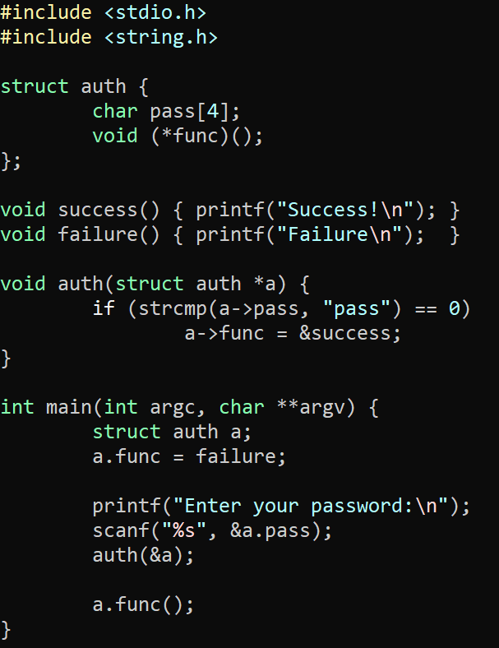
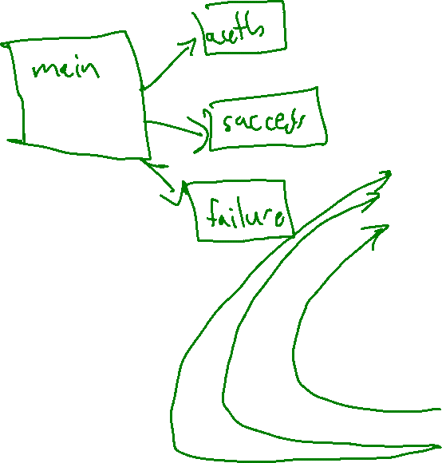
Recall our CFI motivating example
Call Graph Analysis

Slide 8
Lecture Outline
Call Graphs
Dynamic Dispatch
Algorithms

Slide 9
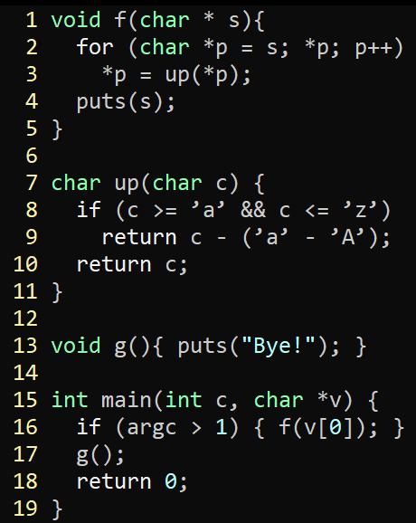
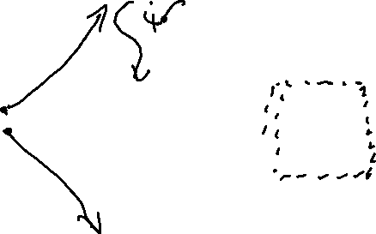
Call Graphs
A history of Computing
Directed Graph of functions
Simple Form:
- Node: function
- Edge: function call
f
3
Refined Form:
- Node: call site with function “block”
- Edge: function call
main
up
puts
16
17
g
13

Slide 10
Lecture Outline
Call Graphs
Dynamic Dispatch
Algorithms

Slide 11
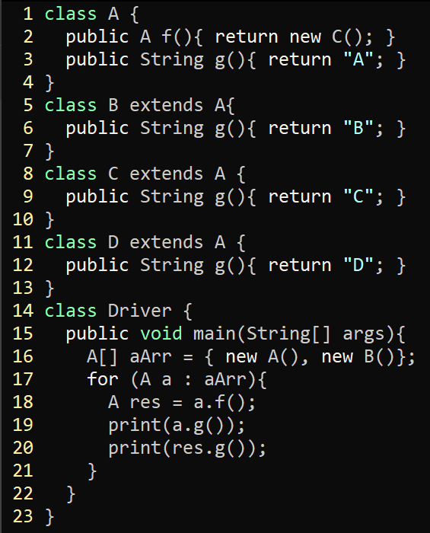

Dynamic Dispatch
A history of Computing
A.init
A.f
Driver.main
A.g
20
B.init
22
23
B.g
24
C.init
C.g
C.init
D.g

Slide 12

Dynamic Dispatch: Gets Complicated!
A history of Computing

Slide 13
Dynamic Dispatch: Gets Complicated!
A history of Computing
Direct Calls
Not so bad
Indirect Calls
Quite a bit harder: multiple targets possible!

Slide 14
Dynamic Dispatch: Gets Complicated!
A history of Computing
Direct Calls
Not so bad
Indirect Calls
Quite a bit harder: multiple targets possible!

Slide 15
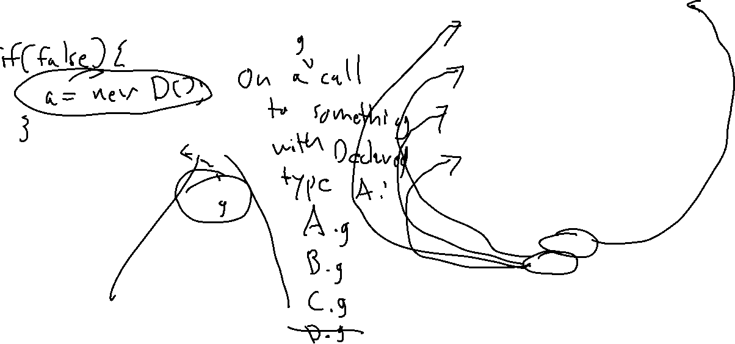
Class Hierarchy Analysis (CHA)
A history of Computing
Consider the Safe over-approximation
Treat call as declared type, or any subtype
Object
Driver
A
main
f
B
C
D
g
g
g

Slide 16

Rapid Type Analysis (RTA)
A history of Computing
Refinement over CHA
Consider only reachable code
Consider only initialized classes
Object
Driver
A
main
f
B
C
D
g
g
g

Slide 17
Rapid Type Analysis (RTA)
A history of Computing
Basic Idea: Refinement over CHA
Consider only reachable code
Consider only initialized classes
Consider only reachable code

Slide 18
Rapid Type Analysis (RTA)
A history of Computing
RTA = call graph of functions
CHA = call graph via class hierarchy analysis
W = worklist
W.push(main)
whie not W.empty:
M = pop W
T = allocated types in M
T = T U allocated types in RTA callers of M
foreach callsite(C) in M
if C is statically-dispatched:
add edge C to C’s static target
else:
M’ = methods called from M in CHA
M’ = M’ intersect functions declared in T or T-supertypes
add edge from M to each M’
W.pushAll(M’)

Slide 19

Rapid Type Analysis (RTA)
A history of Computing
An unsound analysis!
public static Object v;
public static void main(String[] args){
foo();
bar();
}
public static void foo(){
Object o = new A();
v = o;
}
public static void bar(){
v.toString();
}
RTA will not include an edge from bar to toString because neither bar or its parents (main) allocated any instance that toString could be called on

Slide 20
Rapid Type Analysis (RTA)
A history of Computing
An unsound analysis!
public static Object v;
public static void main(String[] args){
Object o = foo();
bar(o);
}
public static Object foo(){
return new A();
v = o;
}
public static void bar(Object o){
o.toString();
}
Call edge to A’s toString missing!
Neither bar or its callers (main) allocated a type of A

Slide 21
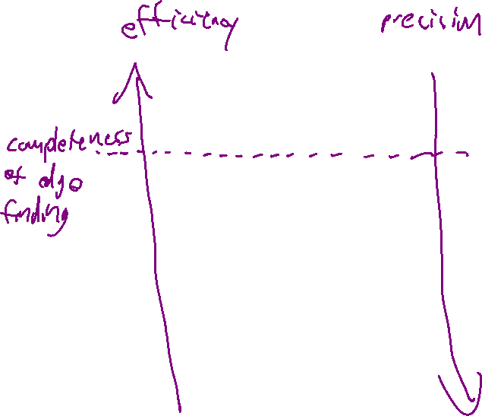
Beyond RTA
A history of Computing
Assumptions to strengthen analysis
Type safety?
CHA
Might not be a safe assumption
FTA adds the constraint that any method that reads from a field can inherit the field-compatible allocated types of any method that could write to that field.
RTA
MTA adds the constraint that types allocated in a method and then passed to a method through a parameter should be compatible with the called method’s parameter types. MTA also adds the constraint that the return type of each called method be added to the set of allocated types.
FTA
MTA
XTA
XTA: add both the constraints of MTA an FTA

Slide 22
Wrap-up

