Slide 1
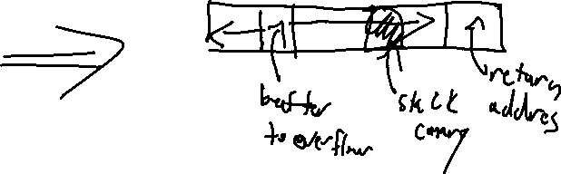
Exercise #17
Memory Attack Review
Write your name and answer the following on a piece of paper
Describe how a stack canary protects against return-oriented programming

Slide 2
Administrivia and Announcements
Second reading assigned
- The original paper on CFI
Basically halfway through the semester
- Time to check in on how things are going

Slide 3
Control-Flow Integrity
EECS 677: Software Security Evaluation
Drew Davidson

Slide 4
Topic Context
Contemplated A form of attack, left with a hint of defenses

Slide 5
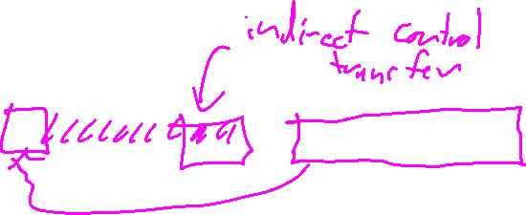
Last Time: Memory Attacks
Review: Last Lecture
Buffer Overflows
Code Injection
Return-oriented Programming
Exceed the boundary of a region of memory, start overwriting other program (meta)data
Overwrite a return address and jump to your own user-written buffer
Overwrite a return address and jump to “gadgets” of existing code
Program instructions (binary sequences)
Program data & metadata
User data
f0
ef
70
81
e1
53
9a
c0
0e
f5
b7
61
b4
fb
01
b3
51
30
8d
d0
03
cb
4b
89
30
e2
71
95
a6
ef
34
ba
47
6e
80
e5
3f

Slide 6

Overview
Keep the control flow “On Rails”

Slide 7
Lecture Outline
Motivation
Implementation considerations
Practical manifestations

Slide 8
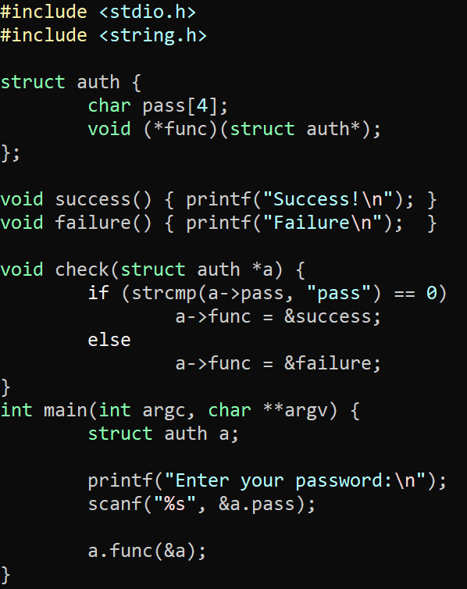
We know the Problem
motivation
Jumping where you shouldn’t
This certainly includes ROP
Might also involve other attacks

Slide 9
We know the Problem
motivation
Jumping where you shouldn’t
This certainly includes ROP
Might also involve other attacks
Look, no ret overwrite!

Slide 10
We know the Problem
motivation
Jumping where you shouldn’t
This certainly includes ROP
Might also involve other attacks
Look, no ret overwrite!

Slide 11
Lecture Outline
Motivation
Implementation considerations
Practical manifestations

Slide 12
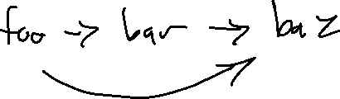
How to Implement?
Implementation Considerations
Naïve Approach:
Encode the entire CFG into the program text

Slide 13
Call Graph Analysis
Implementation Considerations
Naïve Approach:
Encode the entire CFG into the program text

Slide 14
How to Implement?
Implementation Considerations
Naïve Approach:
Encode the entire CFG into the program text
Issues:
Dynamic: overhead
Static: precision

Slide 15
How to Implement?
Implementation Considerations
Naïve Approach:
Encode the entire CFG into the program text
Issues:
Dynamic: overhead

Slide 16
How to Implement?
Implementation Considerations
Naïve Approach:
Encode the entire CFG into the program text
Issues:
Dynamic: overhead
Static: precision

Slide 17
Lecture Outline
Motivation
Implementation considerations
Practical manifestations

Slide 18
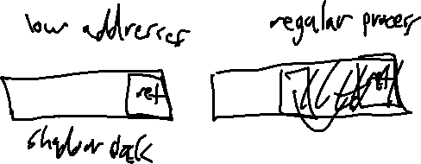
Intel CET
Practical Manifestations
Control-Flow Enhancement Technology
Requires recompilation of software to support
Requires hardware support (!)
Scope
1) Prevent ret overwriting with a shadow stack

Slide 19
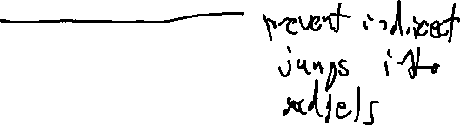
Intel CET
Practical Manifestations
Control-Flow Enhancement Technology
Requires recompilation of software to support
Requires hardware support (!)
Scope
1) Prevent ret overwriting with a shadow stack
2) Hardware modifications

Slide 20
Intel CET
Practical Manifestations
CET Hardware changes
Altered semantics of the CALL and JMP
Moves a processor state machine into the WAIT_FOR_ENDBRANCH state
In WAIT_FOR_ENDBRANCH, next instruction must be the ENDBRANCH instruction
Added a new instruction at control-transfer targets
The new ENDBRANCH instruction
Backwards compatible

Slide 21
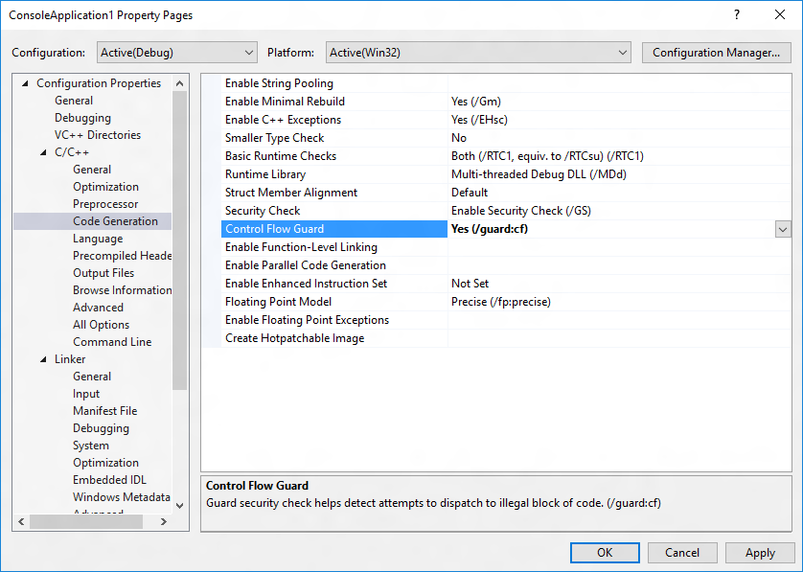
Microsoft Control Flow Guard
Practical Manifestations

Slide 22

Historical Detour
Practical Manifestations: MS Control-Flow Guard

Slide 23

Historical Detour
Practical Manifestations: MS Control-Flow Guard
Recall from last time…
ROP attacks considered harmful
How industry responded
MS CFG as a case study in a lot of interesting aspects of software security

Slide 24
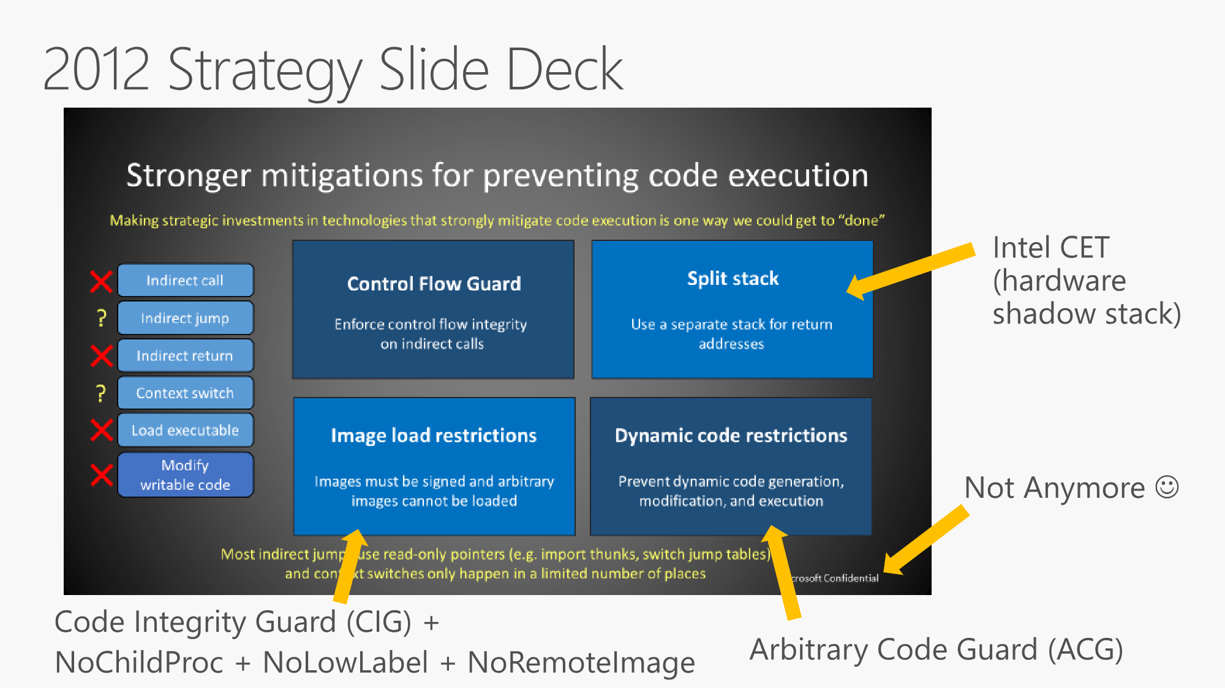
Historical Detour
Practical Manifestations: MS Control-Flow Guard
Source: https://github.com/Microsoft/MSRC-Security-Research/blob/master/presentations/
2018_02_OffensiveCon/The%20Evolution%20of%20CFI%20Attacks%20and%20Defenses.pdf

Slide 26
Historical Detour
Practical Manifestations: MS Control-Flow Guard
This is an interesting talk!
I’d recommend you watch it: https://www.youtube.com/watch?v=oOqpl-2rMTw
It comes with the historical burden of Control Flow guard
Widely-publicized issue that allowed it to be avoided

Slide 27
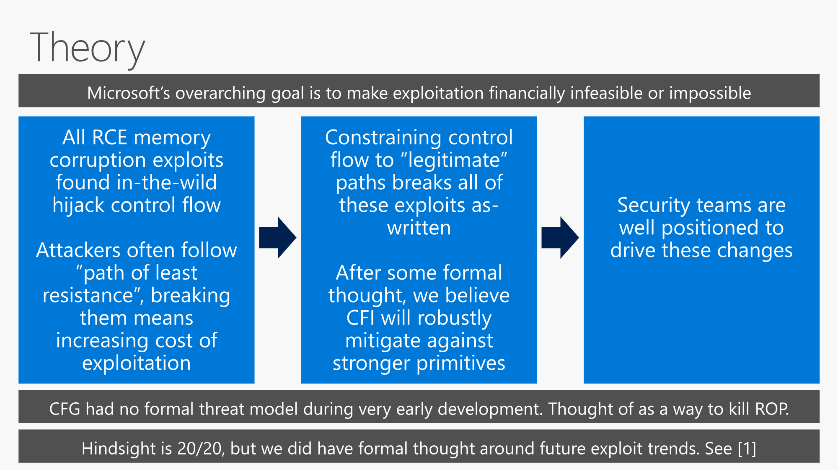

Slide 28
Historical Detour
Practical Manifestations: MS Control-Flow Guard
Control Flow guard has a historical burden
Widely-publicized issue that allowed it to be avoided
We’ll get to the actual workaround, but let’s talk about its impact

Slide 29
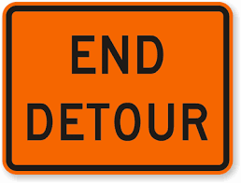
Historical Detour
Practical Manifestations: MS Control-Flow Guard

Slide 30
Control Flow Guard
Practical Manifestations
Details
Precision: call needs to be a valid function entry point
Enforcement: OS verifies indirect control transfer destinations via a table in protected memory
Protections
Protected destinations page in read-only memory
Read-only memory bit can be turned off by attacker ☹

Slide 31
Clang’s CFI
Practical Manifestations
Details
Precision: call needs to match type signature
Enforcement: compiler-inserted checks

Slide 32
Wrap-up

