Slide 1
Exercise #30
Symbolic Execution Review
Write your name and answer the following on a piece of paper
Draw out the complete symbolic execution tree for the following program. Nodes should be annotated with the path constraint and line number
01. int main(){
02. int c = getchar();
03. if (c > 2){
04. if (c < 5){
05. return 7;
06. } else {
07. return 0 / 1;
08. }
09. }
10. return 3;
11. }

Slide 2
Administrivia and
Announcements

Slide 3
Concolic Execution
EECS 677: Software Security Evaluation
Drew Davidson

Slide 4
Where We’re At
Dynamic Analysis
- generating test cases

Slide 5

Previously: Symbolic Execution
Outline / Overview
Advance Abstract States across the program
Split abstract states according to predicates to enhance coverage
Use an SMT Solver to determine if the path constraint is feasible
Sound and Complete modulo termination
Stealth caveat of testing as dynamic analysis as well
Symbolic Execution =/= Burning in Effigy

Slide 6

This Time: Enhancing Symbolic Execution
Outline / Overview
From state trees to test cases

Slide 7

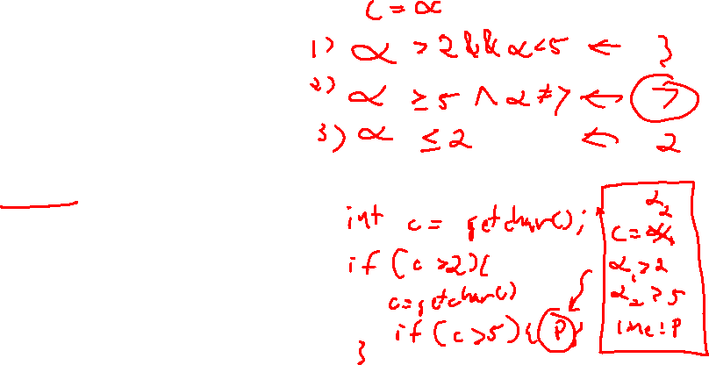
Generating Test Cases
Concolic execution
Wait a minute… We’re supposed to be building a test suite!
… instead, we generated a symbolic execution tree

Slide 8
Generating Test Cases
Concolic execution
Wait a minute… We’re supposed to be building a test suite!
… instead, we generated a symbolic execution tree
01. int main(){
02. int a = getchar();
03. int b = getchar();
04. if (a > 5){
05. return 1;
06. } else {
07. return 2;
08. }
09. if (b > 3){
10. return 3;
11. } else {
12. return 4;
13. }
14. }

Slide 9
Generating Test Cases
Concolic execution
Wait a minute… We’re supposed to be building a test suite!
… instead, we generated a symbolic execution tree
01. int main(){
02. int a = getchar();
03. int b = getchar();
04. if (a > 5){
05. return 1;
06. } else {
07. return 2;
08. }
09. if (b > 3){
10. return 3;
11. } else {
12. return 4;
13. }
14. }

Slide 10
From tree to tests
Concolic execution
Each state’s path constraint symbolizes a set of test cases
01. int main(){
02. int a = getchar();
03. int b = getchar();
04. if (a > 5){
05. return 1;
06. } else {
07. return 2;
08. }
09. if (b > 3){
10. return 3;
11. } else {
12. return 4;
13. }
14. }
Ask the SMT solver for a satisfying assignment

Slide 11
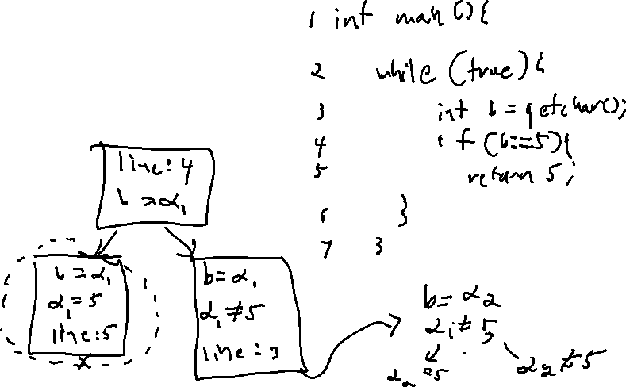
Termination
Outline / Overview
One advantage of symbolic execution:
Partial credit
We can guarantee termination at the expense of completeness
Quit after a certain threshold is met
- Size of the execution tree
- Wall clock time

Slide 12
State Pruning
Symbolic Execution
Termination Insight: A redundant state has redundant successors
* With proper environmental handling
01. int main(){
02. while (true) {
03. int b = getchar();
04. if (b > 5){
05. return 1;
06. }
07. }
08. }

Slide 13

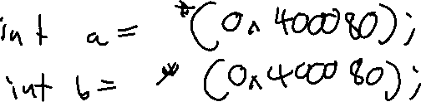
Research Direction: “Fie on Firmware”
Fuzzing
Symbolic Execution for “exotic” environments

Slide 14
State Pruning: Limitation
Outline / Overview
Serious programs likely have state space explosion
States are too complicated to prune.

Slide 15
State Pruning: Alternatives
Outline / Overview
State Prioritization
Akin to the fuzzing heuristics

Slide 16
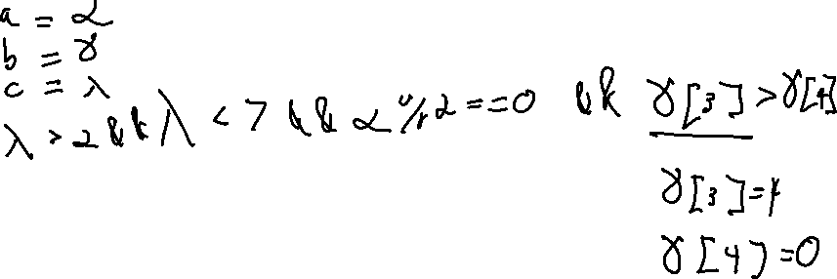
State Pruning: Alternatives
Outline / Overview
Concretization

Slide 17

Concolic Execution
Outline / Overview

Slide 18
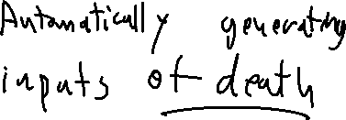
Concolic Execution
Outline / Overview
Benefits
Increased coverage (at the cost of completeness)
Can still pair with termination thresholds
Much easier to deal with model boundaries

Slide 19
Wrap-up
Symbolic execution
A simple, elegant idea

Slide 20
Recall: Test case generation
Symbolic Execution

Slide 21
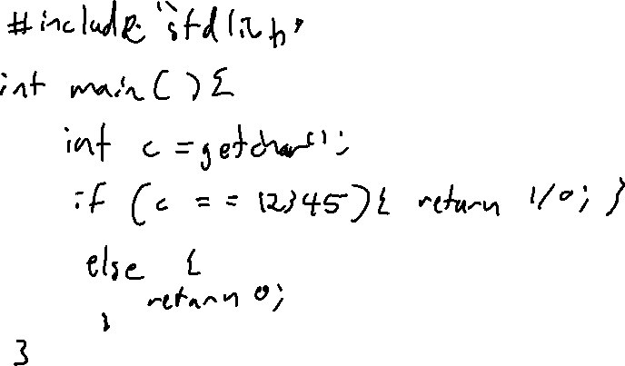
The problem of coverage
Symbolic Execution

Slide 22
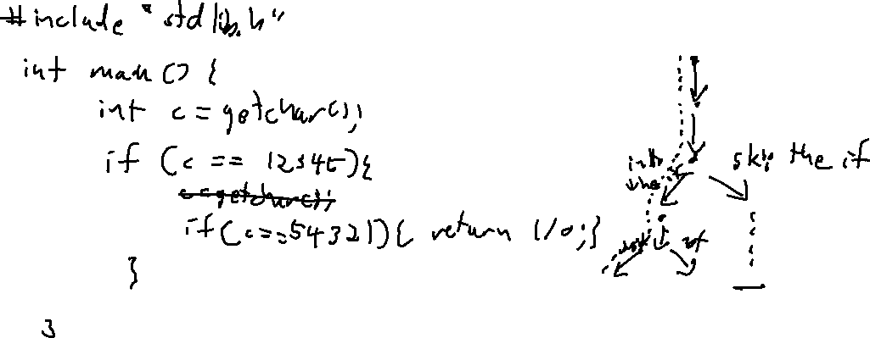
Predicates get in the way!
Symbolic Execution

Slide 23
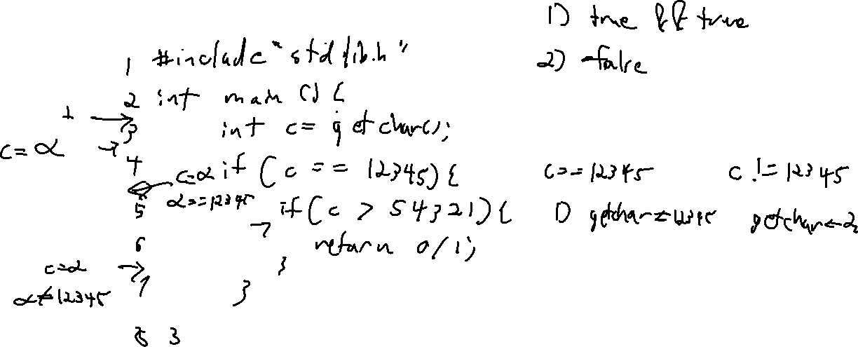
Eliminating Infeasible Paths
Symbolic Execution

Slide 24
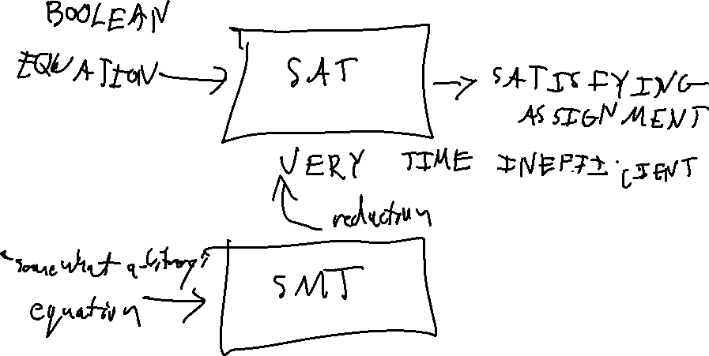
The magic of the solver
Symbolic Execution

Slide 25
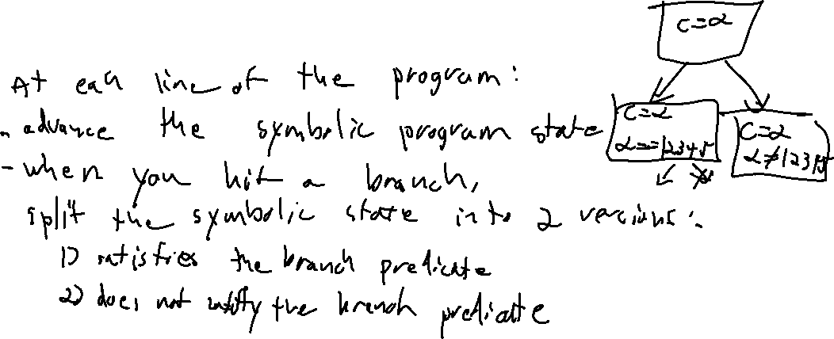
The symbolic execution Tree
Symbolic Execution

Slide 26
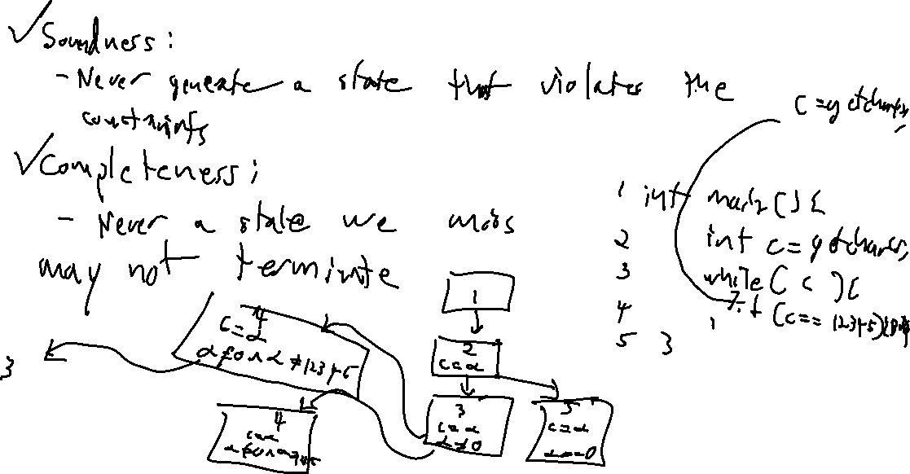
Soundness / Completeness
Symbolic Execution

