Slide 1
ExerCise #5
Static Analysis Review
Write your name and answer the following on a piece of paper
Show the instruction flowchart of the following function
void v(int a){
if (a < 2){
while (c < 3){
c++;
}
if (b > 3){
c = 12;
}
}
return;
}

Slide 2
Administrivia and
Announcements

Slide 3
Control Flow Graphs
EECS 677: Software Security Evaluation
Drew Davidson

Slide 4
Class Progress
Overviewed two Analysis Approaches:
Dynamic Analysis: Analysis that uses a run of the Program
Static Analysis: Analysis without running the program

Slide 5

Continue to Explore Static Analysis
Class Progress
Look into concrete forms of Static Analysis
Particularly interested in dataflow analysis for now
Building up the underlying abstractions / techniques to perform such analysis

Slide 6

Opportunities of Static Analysis
Class Progress
Finite Abstractions of Unbounded State Space
Unnecessary to supply a given program input
Summarize the behavior of the program under ANY input

Slide 7


Last Time: Static Analysis
Review: Static Analysis
Mentioned some static analysis Techniques
Syntactic Analysis
Dataflow Analysis
Model Checking
Started Building a Fundamental Unit of Static Analysis: the Basic Block
Sequence of code that executes… sequentially

Slide 8


Basic Blocks Boundaries
Review: Static Analysis
Two Distinguished Instructions in a Block (may be the same Instruction)
Leader: An instruction that begins the block
Terminator: An instruction that ends the block

Slide 9
Basic Blocks Boundaries
Review: Static Analysis
Two Distinguished Instructions in a Block (may be the same Instruction)
Leader: An instruction that begins the block
The first instruction in the procedure
The target of a jump
The instruction after an terminator
Terminator: An instruction that ends the block
The last instruction of the procedure
A jump (ifz, goto)
A call (We’ll use a special LINK edge)

Slide 10
Basic Blocks Example
Static Analysis: Control Flow Graphs
y = 0;
if ( g ) {
x = 1;
x = 2;
} else {
x = 3;
if (g2) {
x = y;
}
x = 4;
}
z = x;

Slide 11
Benefits of Basic Blocks
Static Analysis: Control Flow Graphs
An Additional Abstraction Layer
Leader: An instruction that begins the block
Loops
If-stmt
If-else
(head)
(head)
(head)
T
T
T
F
(True branch)
F
(body)
F
(True branch)
(False branch)
(after)
(after)
(after)

Slide 12
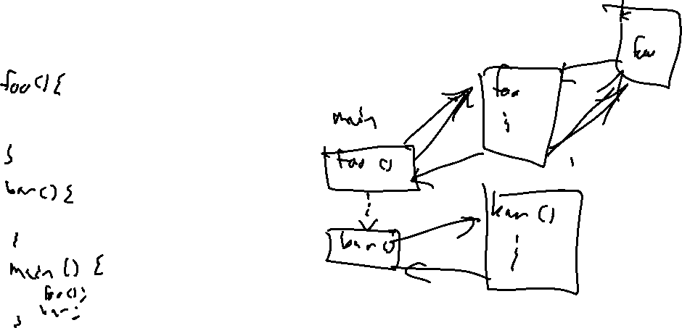
CFGs: A Per-Function Abstraction
Static Analysis: Control Flow Graphs
By Definition, a CFG never includes multiple Functions
Call instruction simply has a special “link” edge to its successor
CFG-Like analysis is possible on multiple functions, but requires special care to avoid infeasible paths

Slide 13

Lecture Outline
(Local) Dataflow analysis
Global dataflow analysis

Slide 14
DataFlow Analysis: Big Idea
dataflow Analysis
View Each Statement as a Data Transfer Function
Transform a program state into a new (updated) program state
Simple idea: concrete program state into a new concrete program state
state M
y has the value 1
Stmt₁: x = y ;
state M’
x has the value 1
y has the value 1

Slide 15


Composing Transfer Functions
dataflow Analysis
Statements Compose Naturally with each other*
state M
y has the value 1
Stmt₁: x = y ;
Stmt₂: z = x ;
For now, we’ll only think about
analysis within a BBL
state M’
x has the value 1
y has the value 1
z has the value 1

Slide 16
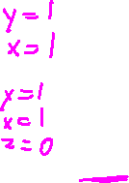
An Early Win
dataflow Analysis
Even with this Very Simple Concept, might be able to detect some issues
state M
y has the value 1
Stmt₁: x = y ;
Stmt₂: z = 0 ;
Stmt₃: p = 1 / z ;

Slide 17
Formalizing Transfer Functions
dataflow Analysis
If we want to Build an Automated (Local) Dataflow analysis, we need programmatic Precision
Need a semantics!
Some sort of specification of what a statement does
A statement is a memory state transformer
Representation mapping (large)
set of memory states to each other
Memory state M
Stmt₁: k += 1 ;
Depend somewhat on the analysis
Goals:
Memory state M’
Keep states manageable
Handle the uncertainty inherent in static analysis

Slide 18




Memory As Value SEts
dataflow Analysis
Let each memory Location correspond to a Set of Values it might Contain
We’re still kinda-dodging the
larger semantic questions here,
for now lets just say we’re using a
big ol’ if statement to define an operator
Define (informally) transfer functions as mapping elements of M to elements of M’
Memory state M
$$\left\langle k:\{1\}\right\rangle$$
$$\left\langle k:\{3,4\}\right\rangle$$
Stmt₁: k += 1 ;
Memory state M’
$$\left\langle k:\{2\}\right\rangle$$
$$\left\langle k:\{4,5\}\right\rangle$$

Slide 19
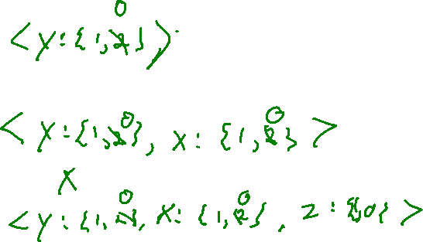
Composing Value SEts
dataflow Analysis
Stmt₁: x = y ;
Stmt₂: z = 0 ;
Stmt₃: p = 1 / z ;

Slide 20
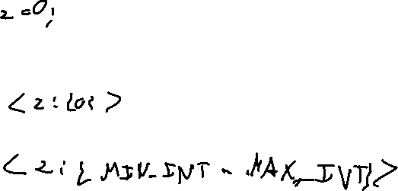
Modelling Uncertainty
dataflow Analysis
We can now handle opaque data somewhat cleanly
Stmt₁: x = y ;
Stmt₁: x = y ;
Stmt₂: z = USER_INPUT ;
Stmt₂: z = global ;
Stmt₃: p = 1 / z ;
Stmt₃: p = 1 / z ;

Slide 21
Lecture Outline
(Local) Dataflow analysis
Global dataflow analysis

Slide 22

Composing Blocks
Dataflow: Transfer Functions
Value-Set Model of memory implies an easy way to extend beyond Local Analysis
01. int x = 2;
02. if ( g ){
03. x = x - 1;
04. if ( g2 ){
05. x = x – 1;
06. }
07. }
08. return 1 / x;

Slide 23
Composing Blocks
Global Dataflow Analysis
Value-Set Model of memory implies an easy way to extend beyond Local Analysis
01. int x = 2;
02. if ( g ){
03. x = x - 1;
04. if ( g2 ){
05. x = x – 1;
06. }
07. }
08. return 1 / x;

Slide 24
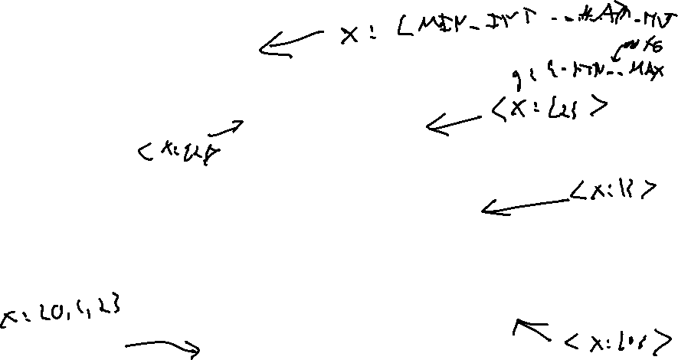
Chaotic Iteration
Global Dataflow Analysis
01. int x = 2;
02. if ( g ){
In what order do we process blocks?
03. x = x – 1;
04. if ( g2 ){
01. int x = 2;
02. if ( g ){
03. x = x - 1;
04. if ( g2 ){
05. x = x – 1;
06. }
07. }
08. return 1 / x;
05. x = x -1;
06. }
07. }
08. return 1 / x;

Slide 25

Trouble on the Horizon
Global Dataflow Analysis
Loops

Slide 26
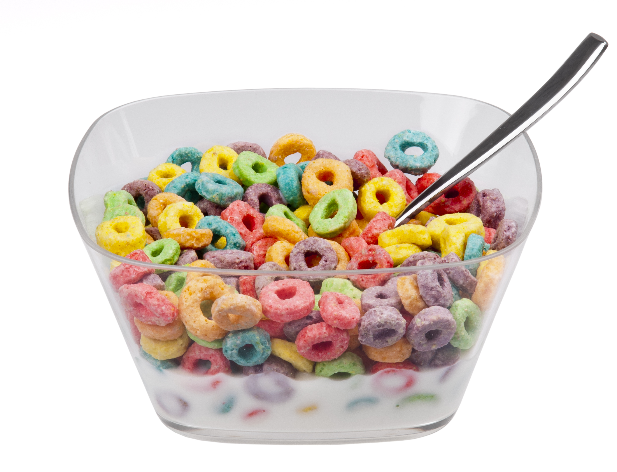
Loops Are Tough to Handle!
Global Dataflow Analysis
Issues with Loops
Generate lots of paths
Cyclic data dependency
Oh, brother! You may have some loops

Slide 27
Lecture END!
Local Dataflow analysis
Global Dataflow analysis

