Slide 1
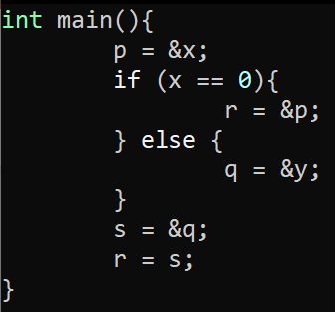
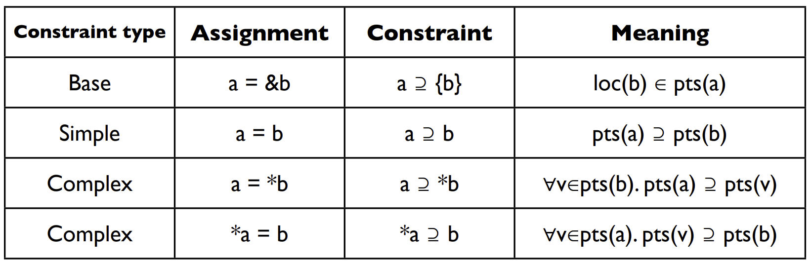
Exercise #21
Points-To Analysis Review
Write your name and answer the following on a piece of paper
Draw the points-to relation from Andersen’s analysis on the following function
p := &x
r := &p
q := &y
s := &q
r := s

Slide 2
Administrivia and
Announcements

Slide 3
Dependence Relations
EECS 677: Software Security Evaluation
Drew Davidson

Slide 4
Class Progress
Analysis Underlying our enforcement/Evaluation needs

Slide 5

Last Time: Points-To Analysis
Review: Last Lecture
Consider Where each pointer might point
Efficiency vs Precision
Dataflow facts as points-to sets
Andersen’s algorithm:
  Flow-insensitive
  Worst-case cubic time
Steensgard’s algorithm:
  Flow-insensitive
  Near-linear time

Slide 6
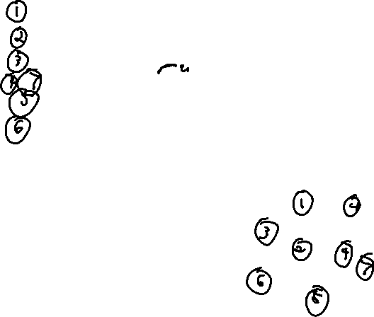
Last Time: Andersen’s Algorithm
Review: Last Lecture
In Practice
Program
Constraints
Initial
Final
Step 1
List pointer-related operations
Step 2
Induce set of subset constraints
Step 3
Solve system of constraints
p = &a
p = &b
m =&p;
r = *m;
q = &c;
m = &q
p ⊇ {a}
p ⊇ {b}
m ⊇ {p}
r ⊇ *m
q ⊇ {c}
m ⊇ {q}
pts(a) = { }
pts(b) = { }
pts(m) = { }
pts(p) = { }
pts(q) = { } pts(r) = { }
pts(a) = { }
pts(b) = { }
pts(m) = { p, q }
pts(p) = { a, b }
pts(q) = { c }
pts(r) = { a, b, c }
Reachability formulation
Step 1
List pointer-related operations
Step 2
Saturate points-to graph
Step 3
Compute node reachability
a
p
r
m
b
q
c

Slide 7

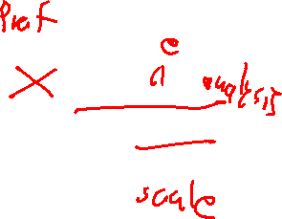
Last Time: Andersen’s Algorithm
Review: Last Lecture
In Practice
Step 1
List pointer-related operations
Step 2
Induce set of subset constraints
Step 3
Solve system of constraints
Reachability formulation
Step 1
List pointer-related operations
Step 2
Saturate points-to graph
Step 3
Compute node reachability

Slide 8
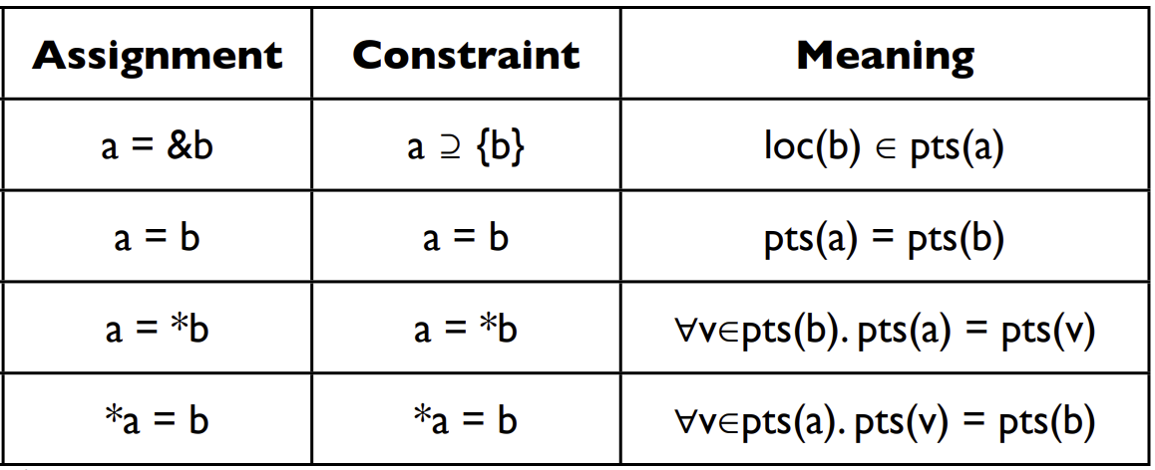
Last Time: SteenGard’s Algorithm
Review: Last Lecture
Andersen’s
In Practice
Step 1
List pointer-related operations
Step 2
Induce set of subset constraints
Step 3
Solve system of constraints
equality
Reachability formulation
Step 1
List pointer-related operations
Step 2
Saturate points-to graph
Step 3
Compute node reachability
Steengaard’s
1-out

Slide 9
Last Time: SteenGard’s Algorithm
Review: Last Lecture
Andersen’s
In Practice
Step 1
List pointer-related operations
Step 2
Induce set of equality constraints
Step 3
Solve system of constraints
Reachability formulation
Step 1
List pointer-related operations
Step 2
Saturate 1-out points-to graph
Step 3
Compute node reachability
Steengaard’s

Slide 10
Last Time: SteenGard’s Algorithm
Review: Last Lecture
p = &a
p
a
In Practice
Step 1
List pointer-related operations
Step 2
Induce set of equality constraints
Step 3
Solve system of constraints
p = &b
p
a,b
m = &p
m
p
a,b
Reachability formulation
r = *m
Step 1
List pointer-related operations
Step 2
Saturate 1-out points-to graph
Step 3
Compute node reachability
m
p
a,b
r
q = &c
m
p
a,b
r
q
c
m = &q
m
p,q
a,b,c
r

Slide 11
This Lecture
Focusing our analysis on particular program aspects of interest

Slide 12
Lecture Outline
Dependence relations
Control dependence graphs (CDGs)

Slide 13

Why does statement X Do Y?
Dependence Relations
Often interested in a subset of program behavior
What “influenced” statement X?
What did statement X “influence”?
Useful in a variety of contexts
Consider a pointer… what might make it null?
Assisting Scalabilty
Don’t get lost in details unrelated to my pointer / bug

Slide 14

Applications
Dependence Relations
Proactive
What causes my program to crashing?
Does this statement leak data?
Reactive
Zoom in on a suspicious operation

Slide 15
Lecture Outline
Dependence relations
Control Dependence
Data Dependence

Slide 16
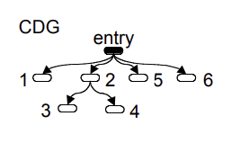
Example
Dependence Relations
Consider the following program
1: READ i;
2: if ( i == 1)
3: PRINT “hi!”
else
4: i = 1;
5: PRINT i;
6: end
Under what circumstances are various lines executed?
Print statement at line 3: control-dependent on line 2
Print statement at line 5: control-dependent on entry to function
Capture these insights in a Data structure
The control dependence graph

Slide 17
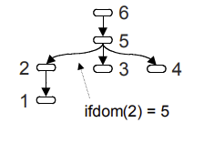

Building the CDG
Dependence Relations
Intuition on Control Dependence
1: READ i;
2: if ( i == 1)
3: PRINT “hi!”
else
4: i = 1;
5: PRINT i;
6: end
What is the closest statement are you guaranteed to execute?
Postdomination
A Statement Y postdominates X ⇔ every path from X is guaranteed to go through Y, denoted X in PDOM(Y)
Intuitively, X is “destined” to meet Y
A Statement Y immediately postdominates X ⇔ X in PDOM(Y) and there is no intervening postdominator, denoted X in IPDOM(Y)

Slide 18
Building the CDG
Dependence Relations
(Immediate) Forward Dominators
1: READ i;
2: if ( i == 1)
3: PRINT “hi!”
else
4: i = 1;
5: PRINT i;
6: end
X IN IPDOM(Y) ⇔ Y in IFDOM(X)
2 in IPDOM 5
5 in IFDOM 2

Slide 19
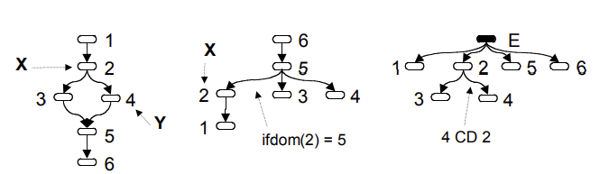
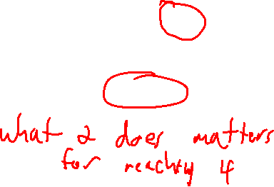
Building the CDG
Dependence Relations
Y is control dependent on X ⇔ there is a path in the CFG from X to Y that doesn’t contain the immediate forward dominator of X
1: READ i;
2: if ( i == 1)
3: PRINT “hi!”
else
4: i = 1;
5: PRINT i;
6: end

Slide 20
Lecture Outline
Dependence relations
Control Dependence
Data Dependence

Slide 21
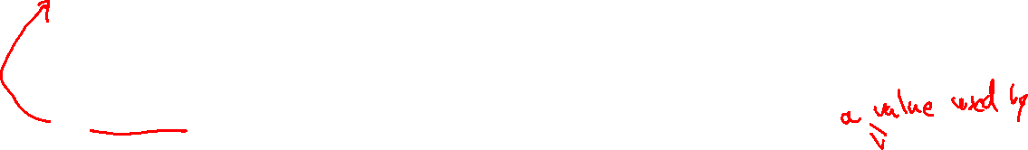
Data Dependence
Dependence Relations
Influence is more than control, it’s also what values mattered to your behavior
1: READ i;
2: if ( i == 1)
3: PRINT “hi!”
else
4: i = 1;
5: PRINT i;
6: end
Note here: 1 might have set 5, but it’s not control dependent!

Slide 22
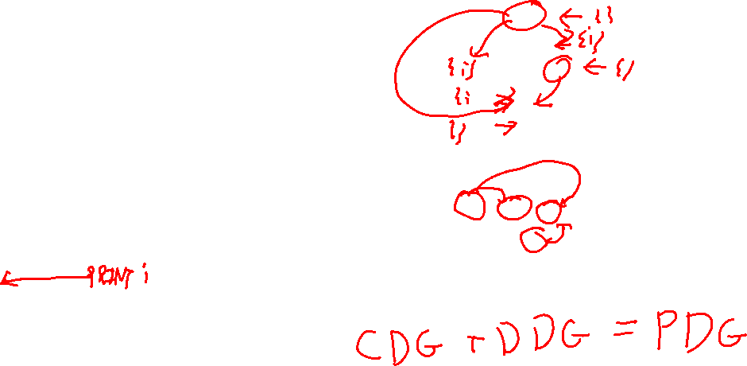
The Data Dependence Graph
Dependence Relations
Depiction of the reaching definitions of each statement
1: READ i;
2: if ( i == 1)
3: PRINT “hi!”
else
4: i = 1;
5: PRINT i;
6: end

Slide 23
Next Time
Dependence Relations
Consider the Program Slice
Forward Slice: the portions of the program a given statement influences
Backwards Slice: the portions of the program influenced by a give statement

Slide 24
Wrap-up

