Slide 1
ExerCise #3
Computability Review
Write your name and answer the following on a piece of paper
Briefly describe how you might create a sound analysis that detects null pointer errors. Your analysis should be non-trivial (i.e. it should detect at least SOME true positives)

Slide 2
Analysis Categories
EECS 677: Software Security Evaluation
Drew Davidson

Slide 3
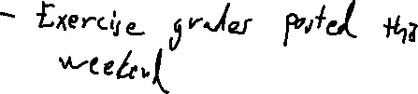
Administrivia and
Announcements

Slide 4
Class Progress
To Explore Security Analysis, we’re getting a grounding in Program analysis
many (all?) Program misbehaviors have security Implications

Slide 5

Last Time: Computability
Review: Computability
Theoretical Limit of Analysis: Rice’s Theorem
Analysis cannot be perfect
We can bound the type of imperfection:
  Soundness (no Type I errors)
  Completeness (no Type II errors)
provably
im

Slide 6
Lecture Outline
Consequences of Rice’s Theorem
Categorizing Analyses
  Dynamic
  Static

Slide 7

Building an Analysis
Consequences of Rice’s Theorem
Analysis doesn’t demand perfection
Fertile grounds for exploring different techniques

Slide 8

Practical Analysis Considerations
Consequences of Rice’s Theorem
We’ll explore some of the ways an analysis may be structured
Also spare a thought for assessing the quality and appropriateness of an analysis

Slide 9
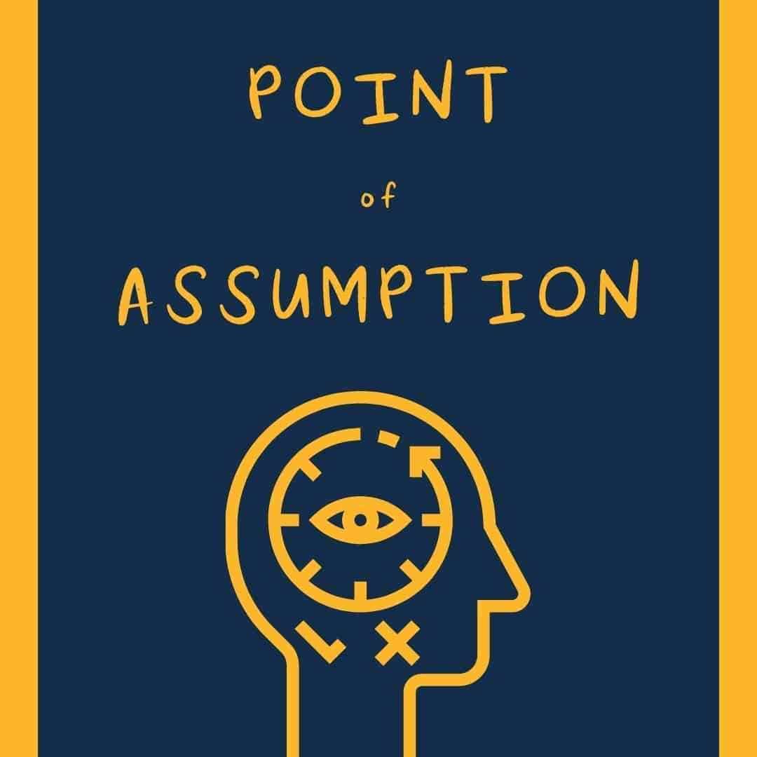
Guarantees With Caveats
Consequences of Rice’s Theorem
Soundness/completeness aren’t the whole story on analysis quality
They are still super nice to have!
Often useful to have a guarantee under some assumption

Slide 10

Partial Correctness
Consequences of Rice’s Theorem
Definition: An algorithm is partially correct if it only returns correct answers
Definition allows for sometimes not returning an answer!

Slide 11
Lecture OUtline
Consequences of Rice’s Theorem
Categorizing Analyses
  Dynamic
  Static

Slide 12
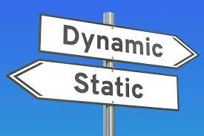
Static vs Dynamic Analysis
Categorizing AnalySEs
One distinction in analysis is how the analysis treats the target
Static analysis – Operates without running the program
Dynamic analysis - Operates with running the program

Slide 13

Analysis Method vs Errors
Categorizing Analyses
It’s natural to consider the types of compromises of each analysis method
Static analysis
  Often builds a model of the program, makes inferences on that model
  Tends to make completeness easier
  Scalability concerns for large programs
Dynamic analysis
  Often performs the analysis by straight up running the program, observing behavior
  Tends to make soundness easier
  Coverage problems

Slide 14
Some Forms of Dynamic Analysis
CATEGORIZING ANALYSES
Testing
Fuzzing
Symbolic Execution

Slide 15

Testing
CATEGORIZING ANALYSIS
What happens when we do <this>?

Slide 16

Testing
CATEGORIZING ANALYSIS
What happens when we do <this>?

Slide 17
Classic Limitations of Testing
CATEGORIZING ANALYSIS
It’s hard to predict what might go wrong (presumably you’d have fixed it in this first place)

Slide 18

“FiXing” Testing
CATEGORIZING ANALYSIS
It’s hard to predict what might go wrong (presumably you’d have fixed it in this first place)
Could try to make a more intentional correspondence (TDD)
Could try to leverage tools (Fuzzing)

Slide 19
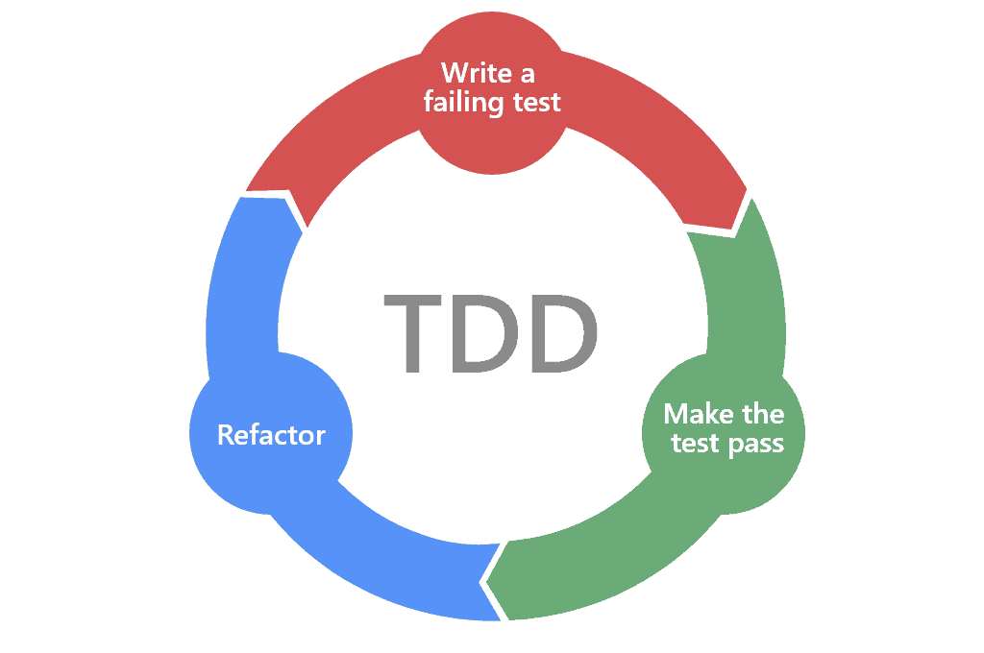
Test-Driven Development
CATEGORIZING ANALYSIS
1. Write a test case (expecting it to fail)
2. Implement enough functionality to pass the test case
3. Fix up the program
(repeat)

Slide 20

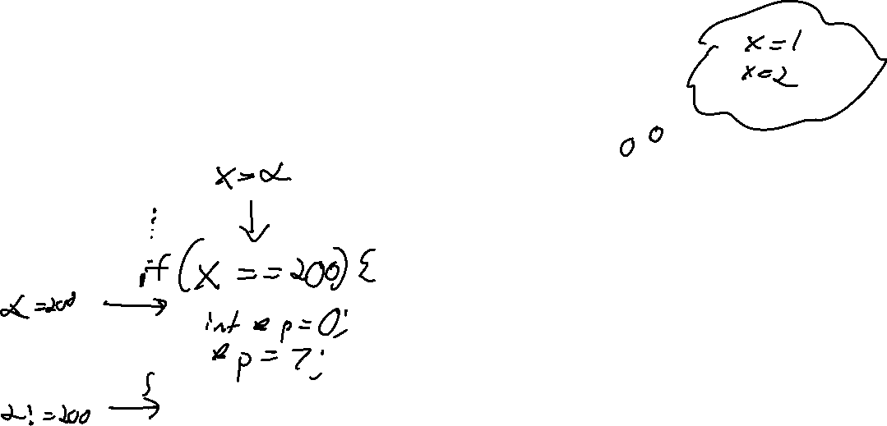
Fuzzing
CATEGORIZING ANALYSIS
Automatically creating test cases

Slide 21
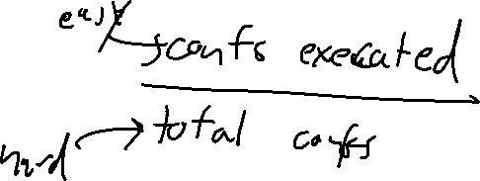
How Good IS A Dynamic Analysis?
CATEGORIZING ANALYSIS
At least in theory, an analysis can be measured in terms of how much of the state space is explored
Since the dynamic analysis is executing one configuration at a time, we know how many states we’re exploring
What is much harder to determine is the total number of distinct configurations
State space: the collection of
all possible configurations
of a program

Slide 22
Coverage Metrics
CATEGORIZING ANALYSIS
int f(bool b) {
Obj * o = null;
int v = 2;
if (b) {
o = new Obj ();
v = rand_int();
}
if (v == 2){
o->setInvalid()
}
return o->property();
}
Line coverage
Branch coverage
Path coverage

Slide 23
Lecture Outline
Consequences of Rice’s Theorem
Categorizing Analyses
  Dynamic
  Static

Slide 24
Some Forms of STATIC Analysis
CATEGORIZING ANALYSES
Syntax Analysis
Dataflow Analysis
Abstract Interpretation

Slide 25
Syntax Analysis
Categorizing Analyses
Some troubling behavior of a program may be discoverable via simply observing syntactic structure

Slide 26
Analysis SPecificity
CATEGORIZING ANALYSIS
int f(bool b) {
Obj * o = null;
int v = 2;
if (b) {
o = new Obj ();
v = rand_int();
}
if (v == 2){
o->setInvalid()
}
return o->property();
}
Flow Sensitive

Slide 27
Analysis SPecificity
CATEGORIZING ANALYSIS
int f(bool b) {
Obj * o = null;
int v = 2;
if (b) {
o = new Obj ();
v = rand_int();
}
if (v == 2){
o->setInvalid()
}
return o->property();
}
Path Sensitive

Slide 28
Abstract Interpretation
Categorizing Analyses
(Over)approximate the state of the program
(Over)approximate the domain of values

Slide 29
Abstract Interpretation
Categorizing Analyses
(Over)approximate the state of the program
(Over)approximate the domain of values
Anything that isn’t crystal clear to a static analysis tool probably isn’t clear to your fellow programmers, either. The classic hacker disdain for “bondage and discipline languages” is short-sighted – the needs of large, long-lived, multi-programmer projects are just different than the quick work you do for yourself
- John Carmack

Slide 30
Overview Done!
Categorizing Analyses
We’ll cover many of these techniques (and more!)
Next up:
Looking at the kinds of program flaws that can cause problems
Start looking at toolsets to build our analyses

Slide 31
Lecture END!
Consequences of Rice’s Theorem
Categorizing Analyses
  Dynamic
  Static

Slide 33
Anything that isn’t crystal clear to a static analysis tool probably isn’t clear to your fellow programmers, either. The classic hacker disdain for “bondage and discipline languages” is short-sighted – the needs of large, long-lived, multi-programmer projects are just different than the quick work you do for yourself.John Carmack's Static Code Analysis post

