Slide 1
Exercise #13
Information Flow Review
Write your name and answer the following on a piece of paper
Give an example of a (pseudocode) program with an information flow that may be considered to violate integrity. Explain why the program violates integrity.

Slide 2
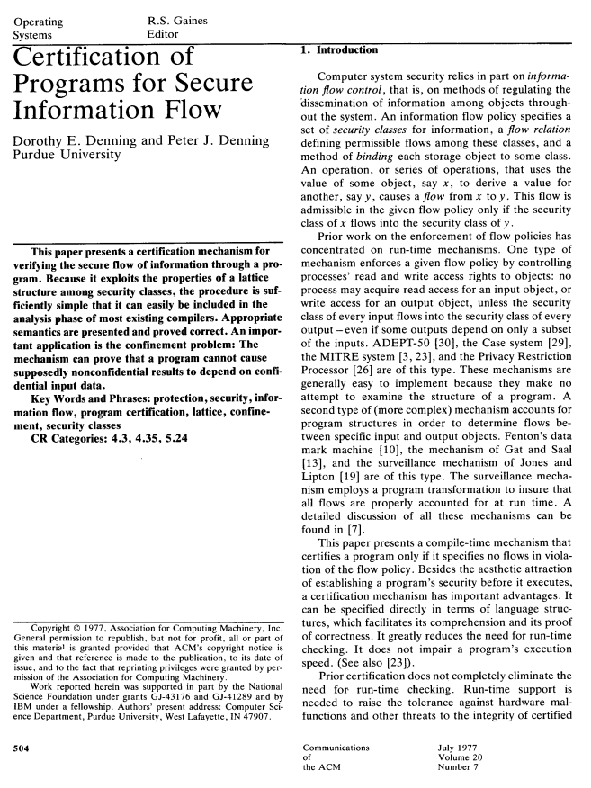
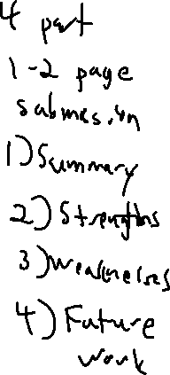
Administrivia and Announcements
Let’s read a paper!

Slide 3
Class Progress
Detecting information leaks before the program runs
Good fit for static analysis!

Slide 4

Last Time: Information Flow
Review: Last Lecture
An application of static dataflow tracking
Formulation of confidentiality and integrity properties as dataflow properties
Source: Originator of tagged data
Sink: Consumer of tagged data
Manifestations
Confidentiality
– Sources: functions that read “secret” resources
– Sinks: functions that write to “untrusted” places
Integrity
– Sources: functions that read “untrusted” places
– Sinks: functions that write to “sensitive” resources

Slide 5
Practical Information Flow
EECS 677: Software Security Evaluation
Drew Davidson

Slide 6

Overview
Let’s say we want to implement the dataflow idea
How would you actually do it?

Slide 7
Lecture Outline
Source/Sink Identification
Sneaky flows
Sanitization

Slide 8
Analysis Deployment
Practical Considerations
This class is concerned with two incarnations of secure software evaluation:
Proactive SSE – Keep code that you are writing from misbehaving
Reactive SSE – Keep code that you’ve received from misbehaving
Good news:
Pretty straightforward case for the proactive incarnation – deploy analysis as part of compilation (or CI/CD) workflow
Plausible case for the reactive incarnation – raise a binary program to IR

Slide 9
Further Considerations
Practical Considerations
Let’s consider some of the practical aspects of getting the analysis to do some good
Source / Sink Identification – Where might flows start and end?
Sneaky behavior – How do we deal with code that wants to sneak past analysis?

Slide 10
Source/Sink Identification
practical Considerations
How do we know what should be a source and a sink?
Mind that semantic gap!
Idea #1 – Programmer annotations
Idea #2 – Build annotations into the system
Idea #3 – something something inferencing handwave

Slide 11
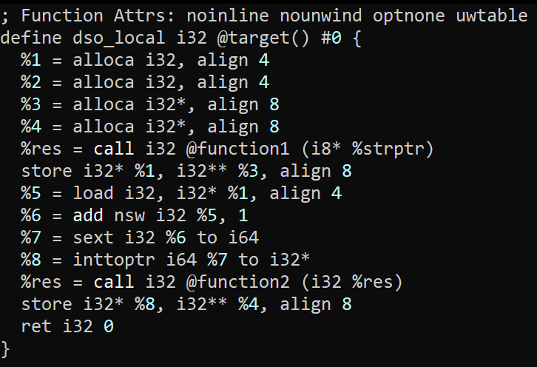
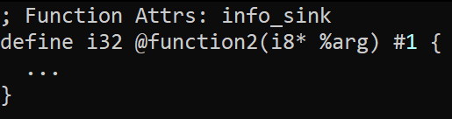
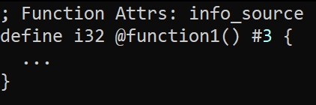

Programmer Annotations
practical Considerations – source/Sink Identification
Basic Idea
Ask the programmer to say what’s a source and sink
Auxiliary file of information
Inline annotations within the program

Slide 12
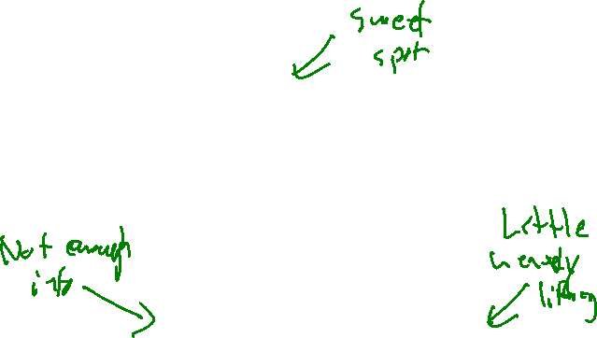
Programmer Annotations
practical Considerations – source/Sink Identification
The utility of programmer effort
A frequent struggle in analysis
Issues of human intervention
Ultimately, we’re trying to solve a limitation of human behavior
Analysis Utility
Incorrect annotations
Laziness
Reactive SSE goes out the window
Analyst Effort
A totally-made-up conceptual graph

Slide 13

Built-In “Annotations”
practical Considerations – source/Sink Identification
Enrich the system with notions of behavior
Platform developer bakes capabilities into the system
Analysis developer retrofits annotations into the analysis engine
Issues of Semantic Gap again
Can be quite hard to predict what becomes security-relevant
Analysis engine needs to be kept in lockstep with the system

Slide 14
Inferencing
practical Considerations – source/Sink Identification
You could try to automatically discover “Sourcelike” and “Sinklike” functions
Maybe we can detect UI asking for credit card?
Maybe we can write an analysis that looks for even more fundamental core behavior?
Machine learning??
?!?!
?!?!?!?!?!?!?!?!?!?!?!?!?!?!?!?!?!?!

Slide 15

Case Study: Android Permissions
practical Considerations – source/Sink Identification
Mobile phones sure collect a lot of private information!
Maybe that information rises to the level of confidentiality?
Maybe this is a good application of an information flow analysis?

Slide 16
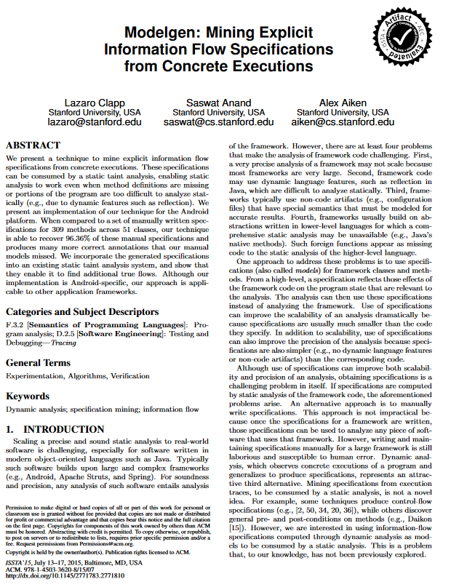
Case Study: Android Permissions
practical Considerations – source/Sink Identification
Hybrid case of Built-In annotations
System has a built-in capability model
Surprisingly hard to map those capabilities to system functions
Modelgen
- Manually annotate capabilities as sources or sinks
- Do a dynamic analysis of the Android system to discover capabilities uses
- Do a static dataflow analysis of the Android system to discover capabilities uses

Slide 17
Lecture Outline
Source/Sink Identification
Sneaky flows
Sanitization

Slide 18
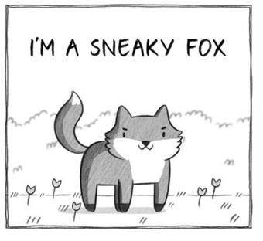
Sneaky Flows
practical Considerations – Sneaky Flows
Might an adversary attempt to avoid detection?
The proliferation of tools for Android analysis gives them an obvious incentive

Slide 19
Sneaky Flows
practical Considerations – Sneaky Flows
Implicit flows

Slide 20
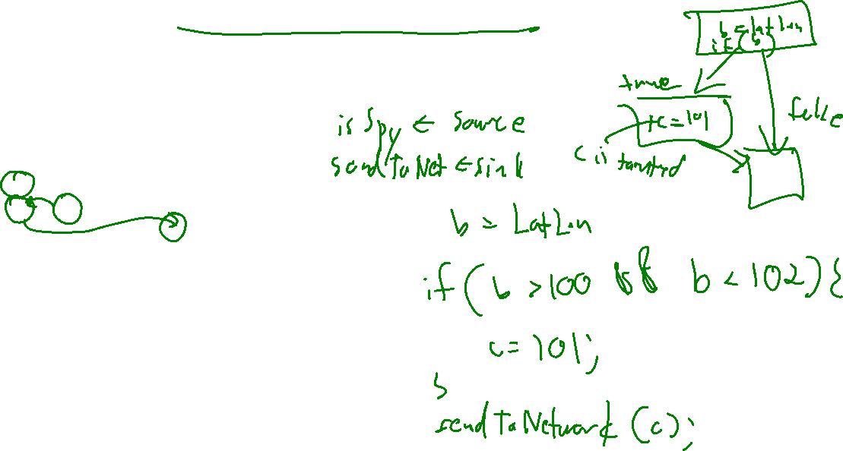
Control Dependencies
practical Considerations – Sneaky Flows
bool b;
bool c;
b = isActuallyAnEvilSpy()
c = b;
sendToNetwork(c);
bool b = isActuallyAnEvilSpy()
bool c;
if (b == true){
c = true;
} else {
c = false;
}
sendToNetwork(c);

Slide 21
Lecture Outline
Source/Sink Identification
Sneaky flows
Precision / Sanitization

Slide 22
Granularity of analysis
Practical Considerations – Precision/Sanitization
Data is Complex!
What happens when a field of a struct is tainted?
What happens when an index of an array is tainted?

Slide 23

Sanitization
Practical Considerations – Precision/Sanitization
We also want to provide some exceptions to the flow rules
i.e. tainted data is encrypted

Slide 24
Wrap-up

Slide 25
Next Time
How do we fix Our Leaky programs?

