Slide 1
Exercise #25
Linting Review
Write your name and answer the following on a piece of paper
Give an example of a legal program in C that a linter would nevertheless flag

Slide 2
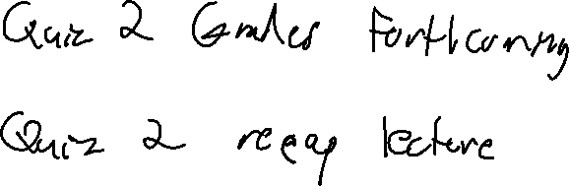
Administrivia and
Announcements

Slide 3
Program Instrumentation
EECS 677: Software Security Evaluation
Drew Davidson

Slide 4

Last Time: Linting
Review: Last Lecture
Removing the “Stray Fibers” of a program
Analyze common “anti-patterns” that are likely to cause issues (security and otherwise)
Notable analysis tools
Lint – The original analysis tool
Splint – Security analysis tool

Slide 5
Class Progress
Moving on to Dynamic analysis
More heuristic by nature

Slide 6

Limits of Static Analysis
Program Instrumentation: Basic Idea
Practical Issues
- Unsoundness of bug finding / incompleteness of program verification
- Scalability
- Significant engineering effort

Slide 7


Revising Dynamic Analysis
Program Instrumentation: Basic Idea
Giving up on Guarantees
- Finding bugs (even “low-hanging fruit”) is useful!
Advantages
- Simplest form: testing

Slide 8
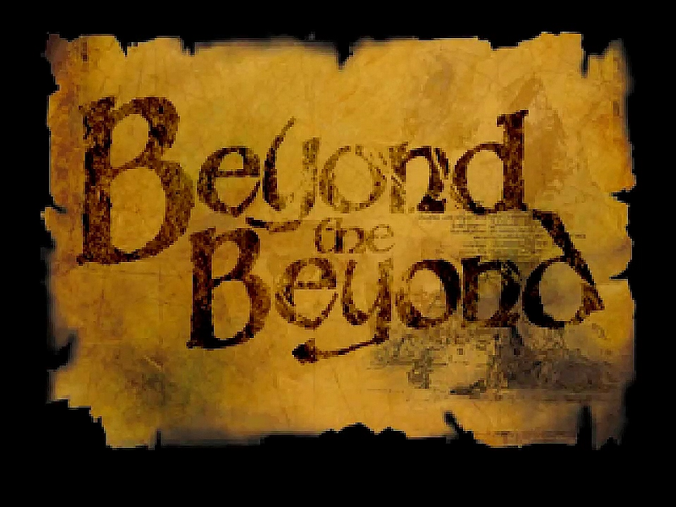
Beyond Testing
Program Instrumentation: Basic Idea
Limitations of “Plain” Testing
- Property may not be immediately observable from output alone
- The circumstances under which the issue occurs may not be obvious

Slide 9
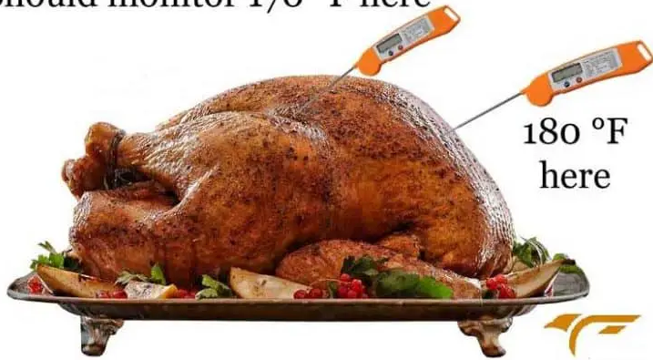
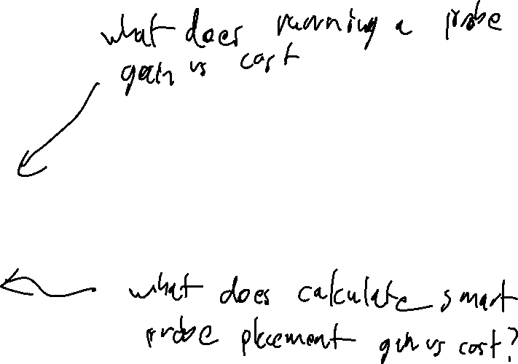
Inserting program Probes
Program Instrumentation: Basic Idea
Insert checks / Reports into the analysis target
Addresses both of the previous issues – can report upon program state and even program path
Many Programming languages have exploitable constructs
Programming constructs that do not operate as intended under unforeseen circumstances
A new concern – The efficiency of the (Instrumented) program
Potential slowdown on each program path
Lack of Holistic Information
Somewhat limited by the information the probes can report

Slide 10

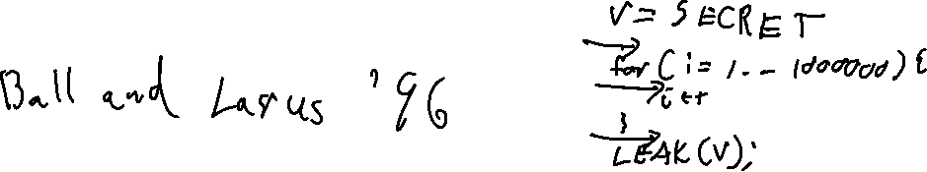
Example: Control PRofiling
Program Instrumentation: Basic Idea
Counting How many times certain behaviors of the program are exercised
Why is this useful?
(Placing sanitizers)
This actually turns out to be a little bit tricky!
Actually turns out to be a little bit tricky!
We’ll describe some of the issues / solution as per Ball and Larus, ‘96

Slide 11
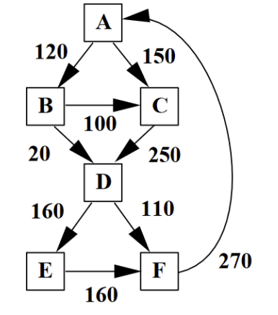

Branch Frequency
Program Instrumentation: Approach
Naïve Approach: Instrument probes at each edge
Inefficient!
We don’t really need an A -> B counter
(it’s the sum of the B-> C and B -> D counters)

Slide 12
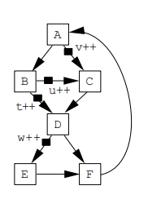
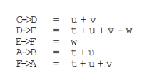
Example: Coverage / Frequency
Program Instrumentation: Approach
example of instrumentation: Counting Execution Frequency
(Placing sanitizers)
Why is this useful?
Let’s first consider inserting edge counters
Inefficient!
We don’t really need an A -> B counter
(it’s the sum of the B-> C and B -> D counters)

Slide 13
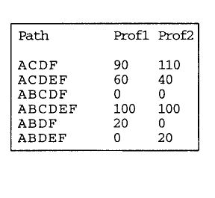
Path Frequency
Program Instrumentation: Approach
Naïve Implementation: Sum up Edge Counters

Slide 14
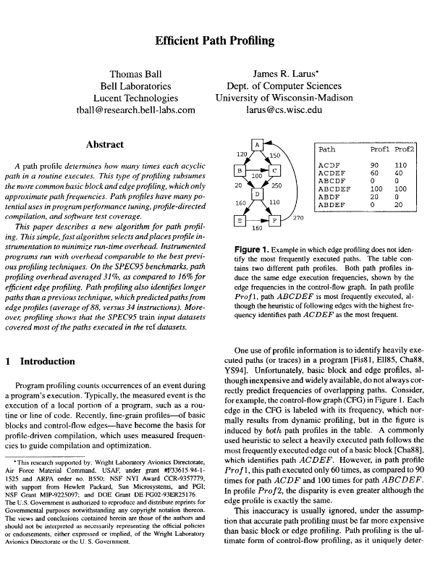
Efficient Path and Branch Counters
Program Instrumentation: Approach
Ball and Larus ‘96
Intuition:
- Assign integer values to edges such that no two paths
compute the same path sum (Section 3.2). – Select edges to instrument using a spanning tree

Slide 15
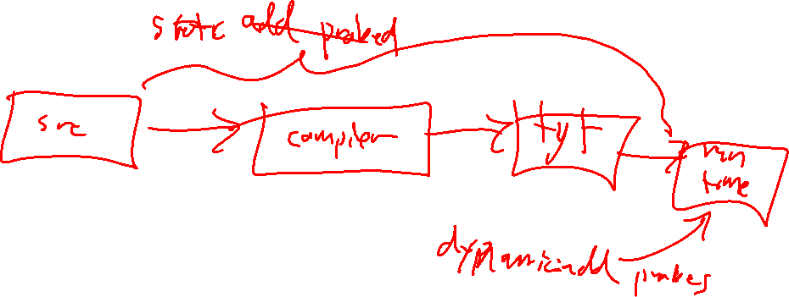
Instrumentation Approaches
Program Instrumentation: Approach
Static Instrumentation
Dynamic Instrumentation
Add probes before the program is run (i.e. rewrite the program executable)
Probe while the program is run (i.e. insert probes just-in-time or as part of the environment)

Slide 16
Dynamic Instrumentation Tools
Program Instrumentation: Approach
Frequently Involve a custom runtime
Add probes before the program is run (i.e. rewrite the program executable)
Examples
Intel PIN
GDB

Slide 17
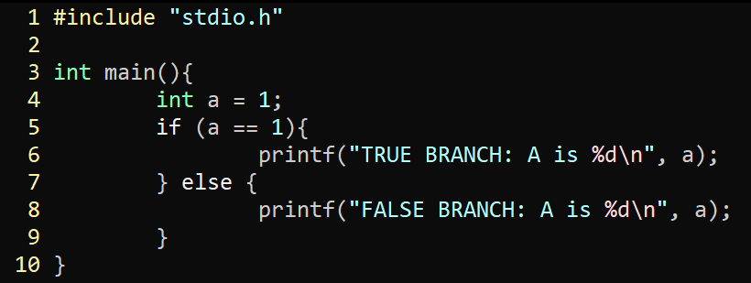
Dynamic Instrumentation Example: GDB
Program Instrumentation: Approach
gcc -O0 –g prog.c –o prog
gdb prog
b 5
set variable a = 3
n

Slide 18
Wrap-up
We’ve Described 2 forms of altering the Program
More heuristic by nature

