Slide 1
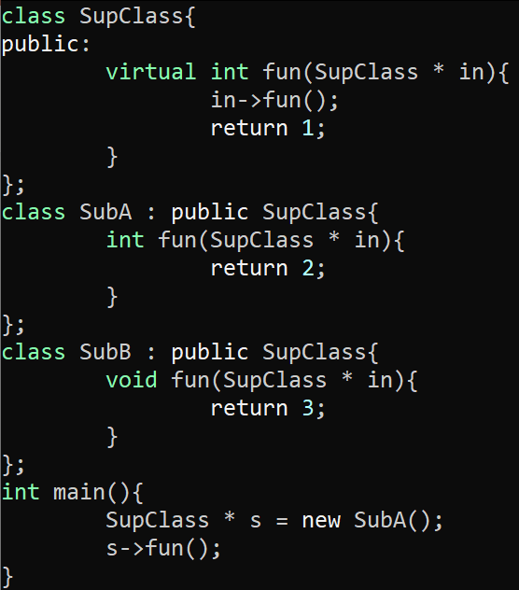
Exercise #19
Call Graphs Review
Write your name and answer the following on a piece of paper
Draw the callgraph that CHA would produce for the following program:
int

Slide 2
Administrivia and
Announcements

Slide 3
Interprocedural Analysis
EECS 677: Software Security Evaluation
Drew Davidson

Slide 4
Class Progress
Exploring AnalysEs Underlying our Evaluation/enforcement needs
Intraprocedural analysis: Within a function
Interprocedural analysis: Between functions

Slide 5

Last Time: Call Graphs
Review: Last Lecture
Determine where a (possibly indirect) call might go
Motivation
Powers some forms of CFI
Implementation
Consider ALL functions
Consider functions in the “cone” (CHA)
Consider functions in the cone that might be used (RTA, MTA, FTA, XTA)

Slide 6
Overview
We’ve seen the necessity of multi-function analysis in real-world programs
Time to consider how it is done

Slide 7
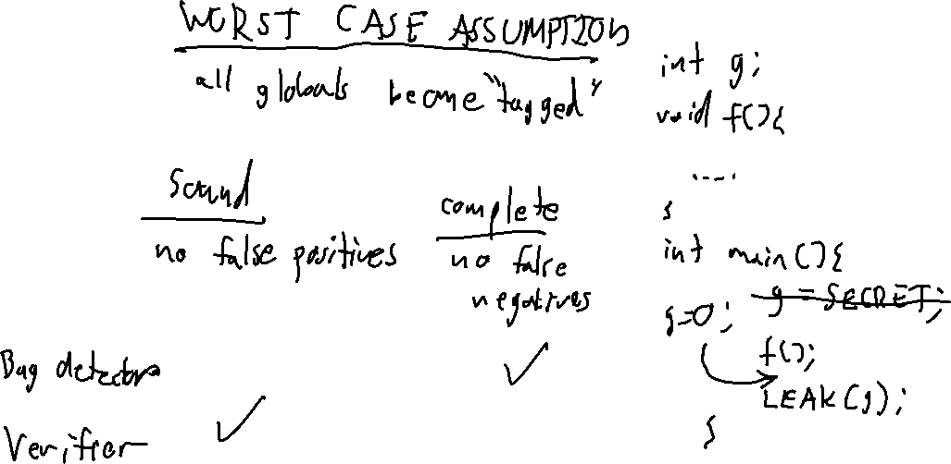

Slide 8
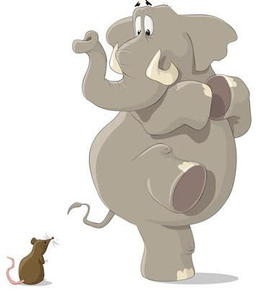
worst-Case Assumptions
Naïve Approach
Create Simple, “Safe” Over-Approximation
What constitutes “being safe” depends on your analysis
Example 1, confidentiality: Assume a function call tags all reachable data as confidential
Example 2, integrity: Assume a function call tags all reachable data as untrusted

Slide 9
Justification
Naïve Approach
Our general philosophy: “Do no harm” guarantees
Recall our notions of soundness and completeness:
- Sound: no false positives (“tells no lie”)
- Complete: no false negatives (“omits no truth”)
Anything that can go wrong will go wrong
- Murphy’s Law
“Being safe” Requires formulating analysis goal
bug hunting:
- Report buggy programs
- Safe means complete analysis
program verification:
- Report clean programs
- Safe means sound analysis

Slide 10
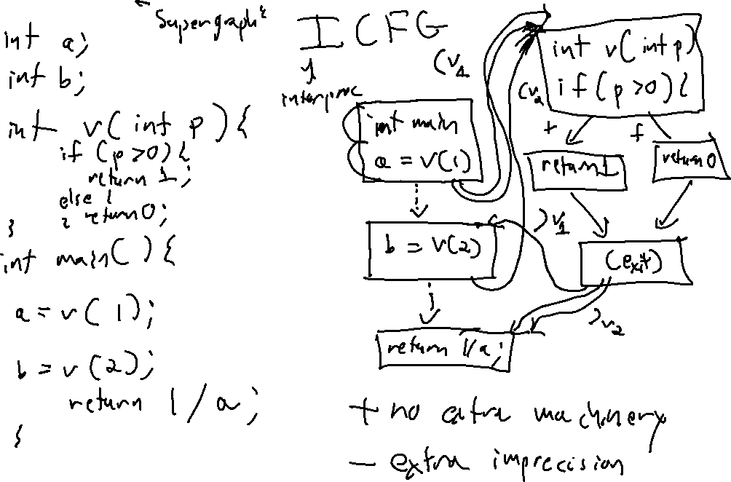

Slide 11
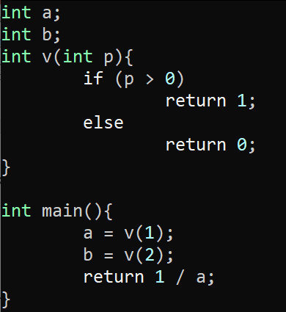
Stitch together CFGs
Supergraphs
Use the ICFG (aka “supergraph”)
Interprocedural control flow graph
Benefits
- No extra machinery required
Detriments
- Extra imprecision
int main(){
a = v(1);
int v(int p){
if (p > 0)
v = v(2);
return 1;
return 0;
return 1 / a;
(exit)

Slide 12
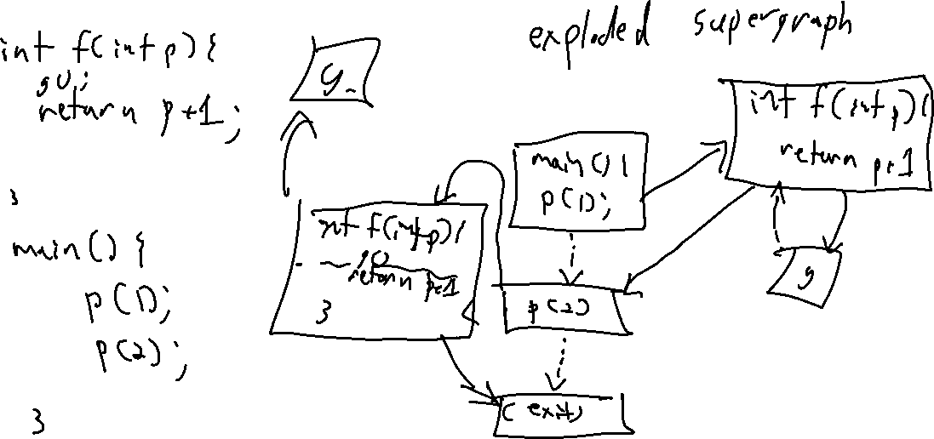

Slide 13
Stitch together CFGs
Supergraphs
The Exploded Supergraph
Make a copy of the callee for each call site
int main(){
a = v(1);
int v(int p){
if (p > 0)
int v(int p){
if (p > 0)
return 1;
return 0;
v = v(2);
return 1;
return 0;
(exit)
return 1 / a;
(exit)

Slide 14
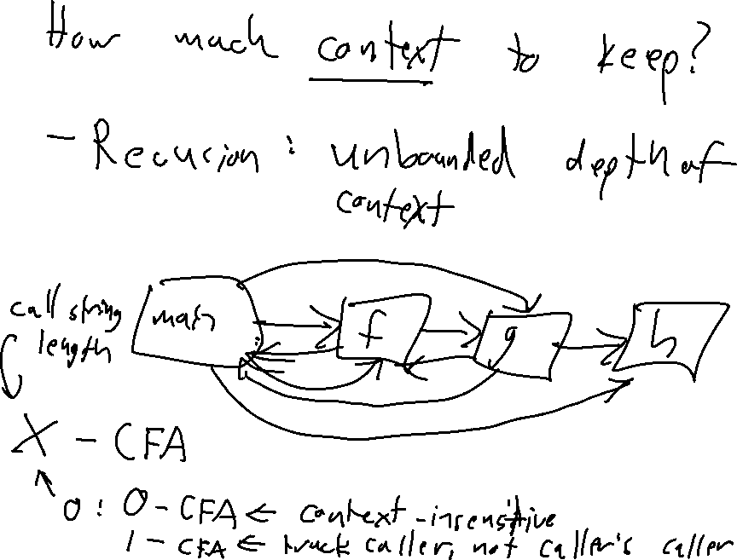

Slide 15
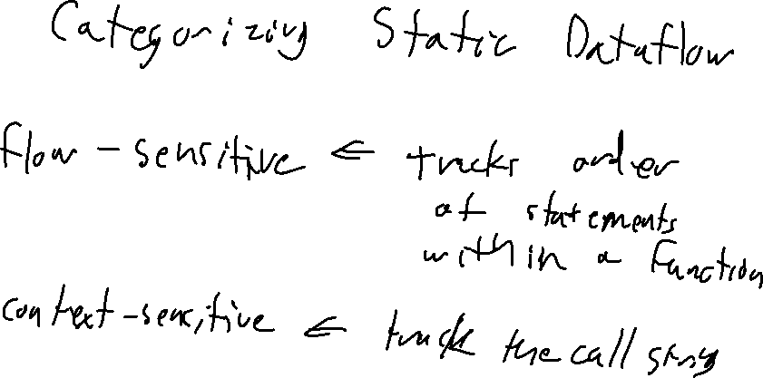

Slide 16
Call Strings
Supergraphs
Provide a way to specify degree of context
Recursion: Unbounded depth of context
Call string depth
X-CFA, where X is the length of the call string
- 0-CFA: Context-insensitive
- 1-CFA: Tracker caller (but not caller’s caller)
Another way to tune static analysis
Flow-sensitive: Unbounded depth of context
Context-sensitive: Track the call string
main
f
g
h

Slide 17
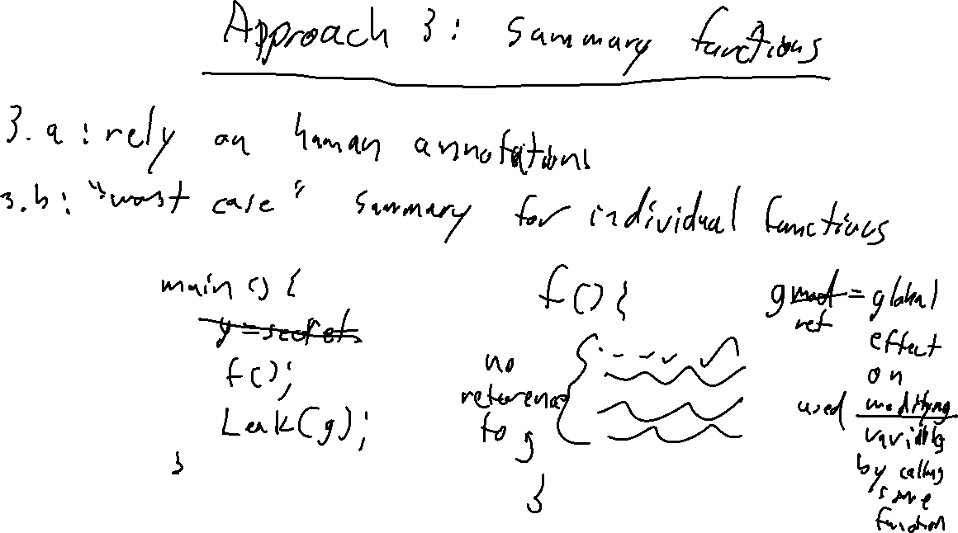

Slide 18
summary Functions
Supergraphs
Big Idea
Summarize callee analysis (rather than include it in the analysis)
Manual Manifestation
Ask the user to provide information
Automatic Manifestation
Create a lightweight inference
One version: GMOD and GREF
- What variables are (transitively) modified as a result of a function call?
- What variables are (transitively) referenced as a result of a function call?

Slide 19
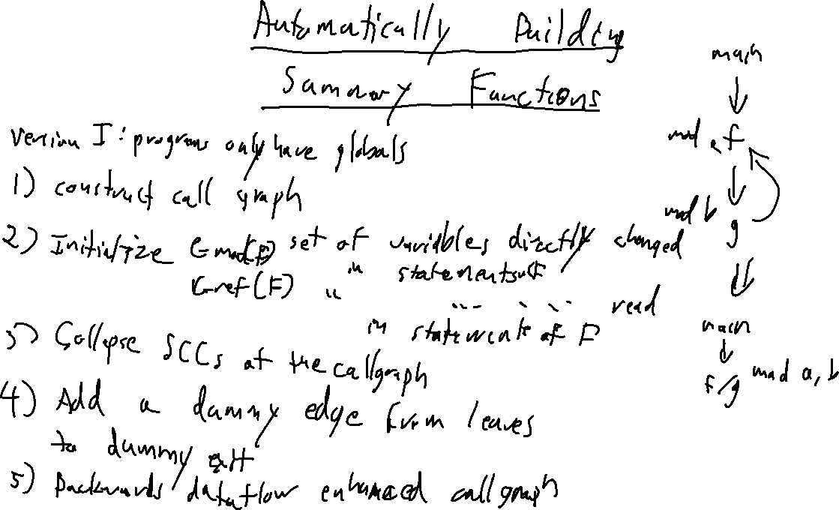

Slide 20
GMOD and GREF
Supergraphs
Version 1: Globals Only
Step 1: Construct Call Graph, normalize program assignments
Step 2: Initialize GMod and Gref
- GMod: initialize to variables on the LHS of assignments
- Gref: initialize to variabels on the RHS of statements
Step 3: Collapse SCCs
Step 4: Add a dummy edge from leaves to dummy exit
Step 5: Do a backwards dataflow on the augmented callgraph
main
main
main
f
f
f
g
h
g/k
h
g/k
h
(exit)
k

