Slide 1








ExerCise #7
Dataflow Saturation Review
Write your name and answer the following on a piece of paper
Assume a value-set dataflow analysis starting at BBL 7, then BBL 4-6, then BBL 3, then BBL 1-2. Give the value sets at the top of each block after 1 round of analysis?
BBL1-2 in: <x: { } , y: { }, g: { }>
$→$ <x: { } , y: { }, g: { }>
1. int x = 0;
2. int y = 2;
BBL1-2 out: <x: { } , y: { }, g: { }>
$→$ <x: { 0 } , y: { 2 }, g: { }>
BBL3 in: <x: { } , y: { }, g: { }>
$→$ <x: { } , y: { 0 }, g: { }>
3. while (INPUT){
BBL3 out: <x: { } , y: { }, g: { }>
$→$ <x: { } , y: { 0 }, g: { }>
true
false
4. g = 1 / y;
5. y = 0;
6. }
BBL4-6 in: <x: { } , y: { }, g: { }>
$→$ <x: { } , y: { }, g: { }>
BBL4-6 out: <x: { } , y: { }, g: { }>
$→$ <x: { } , y: { 0 }, g: { }>
BBL7 in: <x: { } , y: { }, g: { }>
$→$ <x: { } , y: { }, g: { }>
7. return;
BBL7 out: <x: { } , y: { }, g: { }>
$→$ <x: { } , y: { }, g: { }>

Slide 2

Administrivia and
Announcements

Slide 3
Formalizing Dataflow
EECS 677: Software Security Evaluation
Drew Davidson

Slide 4
Class Progress
Exploring Static analysis
Finished enough intuition that we can perform a basic analysis

Slide 5
Last Time: Saturation
Review: Static Analysis
Extending our basic dataflow to loops
No obvious start-point for analysis (circular dependence)
No obvious end-point (can’t necessarily do with a single pass)
Chaotic iteration
Run the algorithm until it hits a fixpoint
Reaching Fixpoints Faster
Intuitively: add some extra over-approximation
Perform an operation until it
stops making progress

Slide 6
Lecture Outline
Dataflow Frameworks
Abstract Interpretation

Slide 7
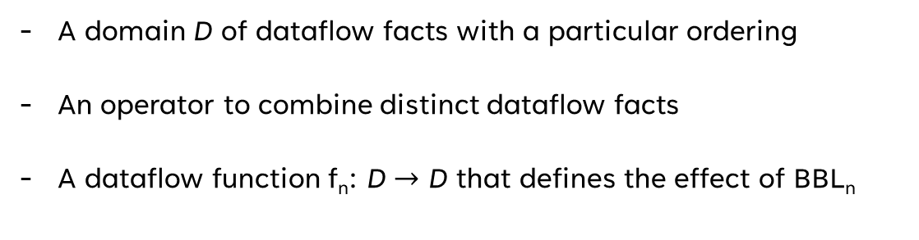
Formalizing Termination
Dataflow Frameworks
Our value-set analyses (appeared to) have some nice properties
Guaranteed termination
Completeness in values found
A couple of conditions happened to occur:
Claims
A domain D of dataflow facts with a particular ordering
An operator to combine distinct dataflow facts
A dataflow function f_{n}: D $→$ D that defines the effect of BBL_{n}
Sets of possible integer values
Bold Claims
Union over value-sets
Composition of the individual instruction transfer functions

Slide 8
Formalizing Termination
Dataflow Frameworks
{00,01,10,11}
Value-Set “Rank”
(2-bit computer)
{01,10,11}
{00,10,11}
{00,01,11}
{00,01,10}
{00,01}
{01,10}
{00,10}
{00,11}
{01,11}
{10,11}
{00}
{01}
{10}
{11}

Slide 9
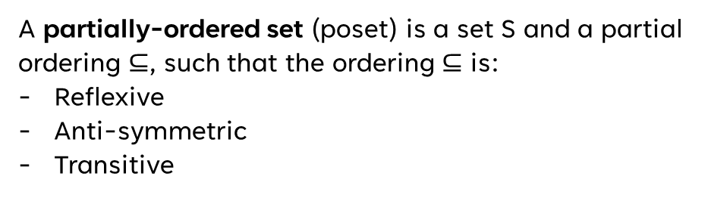

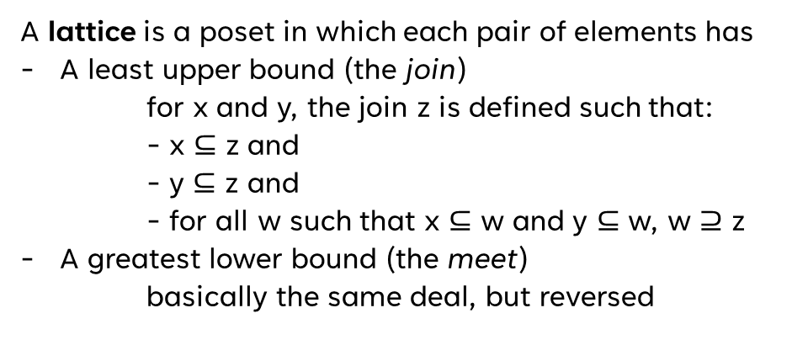

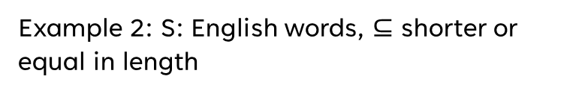

Domain Needs
Dataflow Frameworks
Some Basic Definitions
A partially-ordered set (poset) is a set S and a partial ordering $⊆$, such that the ordering $⊆$ is:
Reflexive
Anti-symmetric
Transitive
Example 1: S: English words, $⊆$ substring
Poset:
Lattice:
Example 2: S: English words, $⊆$ shorter or equal in length
A lattice is a poset in which each pair of elements has
A least upper bound (the join)
  for x and y, the join z is defined such that:
  - x $⊆$ z and
  - y $⊆$ z and
  - for all w such that x $⊆$ w and y $⊆$ w, w $⊇$ z
A greatest lower bound (the meet)
basically the same deal, but reversed
Poset:
Lattice:
Example 3: S: integers, $⊆$ as lte
Poset:
Lattice:
No upper bound
lower than z
z is actually an upper bound
Example 4: S: integers, $⊆$ as lt
Poset:
Lattice:
A complete lattice is a lattice in which all subsets have a meet and join
Example 5: S: set of all sets of letters, $⊆$ is subset
Poset:
Lattice:

Slide 10

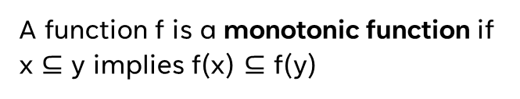
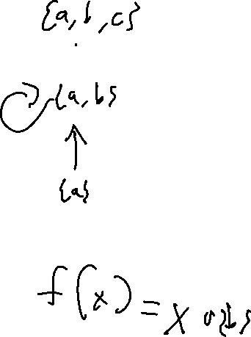
Function NEEDs
Dataflow Frameworks
Some Basic Definitions
A function f is a monotonic function if x $⊆$ y implies f(x) $⊆$ f(y)
An element z is a fixpoint of f iff z = f(z)

Slide 11

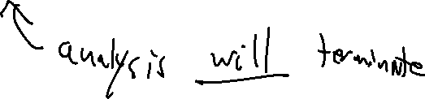
Why Does this Matter?
Dataflow Frameworks
Every finite lattice
is complete
Practical Upshot
If L is a complete lattice and f is monotonic, then f has a greatest fixpoint and a least fixpoint
If L has no infinite ascending chains, the least fixpoint can be computed by iterative application of f

Slide 12

Why Does this Matter?
Dataflow Frameworks
Making the Theory Work for Us
A complete lattice with no infinite chains can be solved via iteration
Catches
Sometimes our domain DOESN’T have these properties
Sometimes the iteration is too lengthy

Slide 13
Lecture Outline
Dataflow Frameworks
Abstract Interpretation

Slide 14

Analysis Precision
Abstract Interpretation
Precision / Efficiency Tradeoff
With a complete lattice we can, in theory, eventually terminate
The shallower the lattice, the faster the fixpoint
That’s not a very strong guarantee!
Choose to approximate the lattice

