Slide 1
Exercise #24
SSDLC Review
Write your name and answer the following on a piece of paper
At what point in the software development life cycle should threat modelling begin?

Slide 2
Administrivia and
Announcements
Preparing for Quiz 2
Review session Wednesday at 7:00 – 9:00 (tentative)
We have to talk about Quiz 1
A tale of two classes…
EECS 677:
EECS 700:
Highest grade: 50/50
Highest grade: 50/50
Lowest grade: 25/50
Lowest grade: 8/50
Average grade: ~84%
Average grade: ~53%
Median grade: ~89%
Median grade: ~50%

Slide 3
Linting
EECS 677: Software Security Evaluation
Drew Davidson

Slide 4
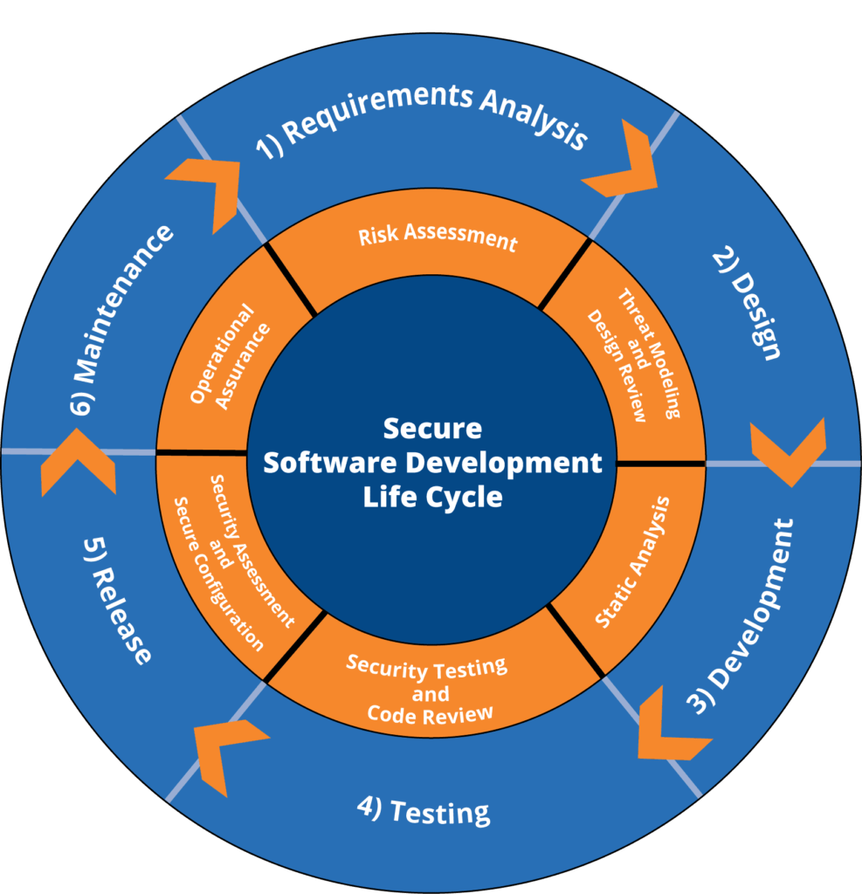
Last Time: SSDLC
Review: Last Lecture
Corresponding Security Tasks for the Software Development Lifecycle
Requirement Analysis – Risk Assessment and Threat models
Design – Security Design Review
Development – Automated Code Analysis
Testing – Security Testing and Code Review
Maintenance and Evolution – Security Assessment and Configuration

Slide 5
Class Progress
Handling the “Softer SIde” of Security evaluation
We’ve described some of the high-level best-practices, let’s talk about tool support

Slide 6
Lecture Outline
Background / Context
Linting
Anti-Patterns
Splint

Slide 7

Sad Fact: It’s easy to write insecure Code
Linting: Background/Context
Many Programming languages have exploitable constructs
Programming constructs that do not operate as intended under unforeseen circumstances
Artistic depiction of C programming

Slide 8

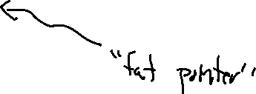
Recall: Security v Usability
Linting Overview
Mainstream PL Philosophy prioritizes speed and simplicity
C could do more checking, but it doesn’t
- Bounds checking
- Type safety

Slide 9
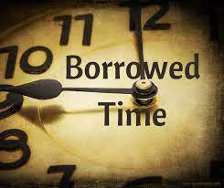
Recall: Security v Usability
Linting Overview
Expectations of efficiency and performance are hard to quit!
Disallowing unsafe behavior means going back on what’s already been accomplished
- Rewrite legacy code
- Give up on some performance

Slide 10
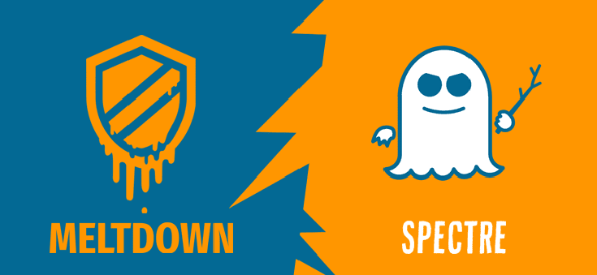
Case Study: Meltdown and Spectre
Linting Overview
The problem: Branch Predictors and speculative Execution
Impact: leaking secrets
The Solution: Mediate Speculative Execution
Early Fix performance:
OS Bench:
Intel Xeon 84~87%
AMD EPYC 91~94%.

Slide 11
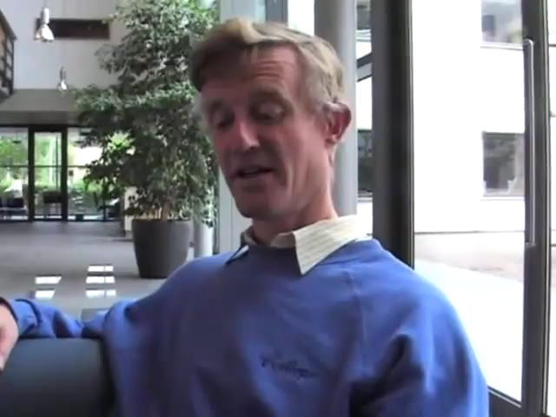
Recall: Security v Usability
Linting Overview
Waiting for better tools
Some feel that the whole of imperative programming is inherently unsafe

Slide 12
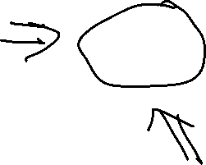
Recall: Security v Usability
Linting Overview

Slide 13
Lecture Outline
Background / Context
Linting
Anti-Patterns
Splint

Slide 14

Heuristic tools for an imperfect World
Linting: OVerview
Try not to shoot yourself in the foot
Highlight the stuff you probably shouldn’t be doing in the first place

Slide 15
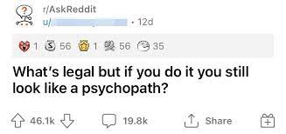
Catch “Anti-Patterns”
Human Factors of Security
common language-Legal pain-points
Code that is highly situational, or simply shouldn’t be legal in hindsight

Slide 16
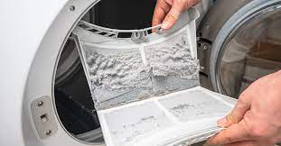
History: Johnson, 1978
Human Factors of Security
Created a program called “lint”
Aided in the development of YACC
Originally internal to Bell Labs, eventually open-sourced
Name Inspired by Dryer Lint Traps
Capture the “loose fibers” that come off the program
Leave the whole of the program intact

Slide 17
Production Linters
Linting
More Modern tools
cppcheck – open-source linter
cpplint – Google’s in-house (open-source) linter
flake8 – python linter
Also ensures adherence to style guide:
https://google.github.io/styleguide/cppguide.html
Good reminder that coding is still a human process

Slide 18
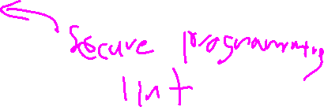
Lecture Outline
Background / Context
Linting
Anti-Patterns
Splint

Slide 19
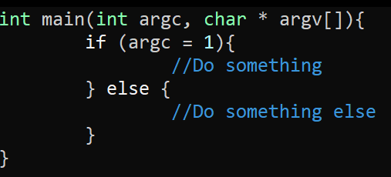
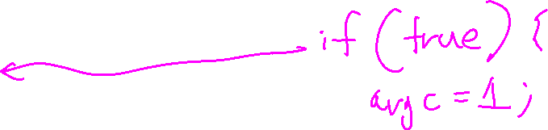
Assignment in predicate
Linting

Slide 20
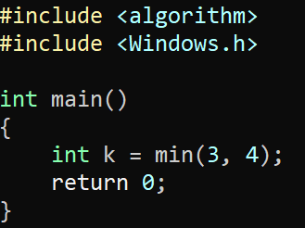
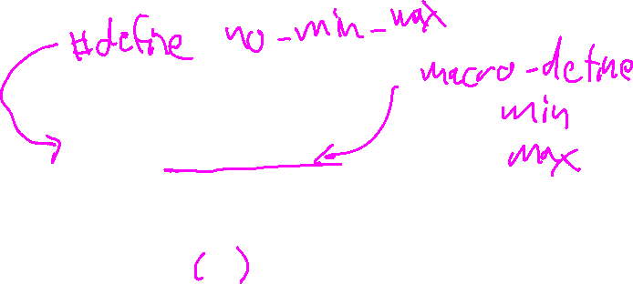
Macro Pollution
Linting

Slide 21
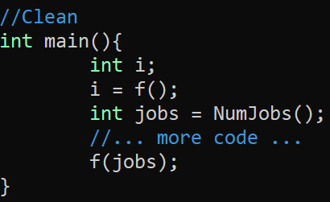
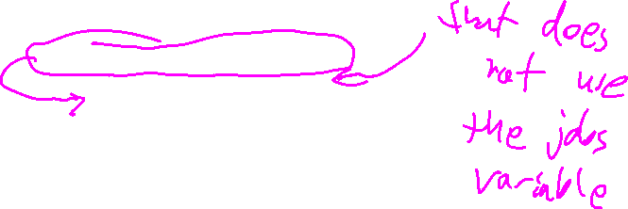
Separating Initialization from USE
Linting

Slide 22
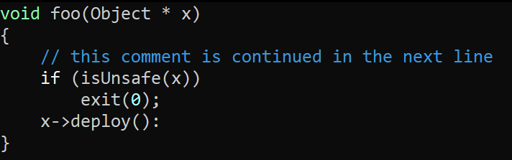
Separating Initialization from USE
Linting

Slide 23
Line Continuation Weirdness
Linting

Slide 24
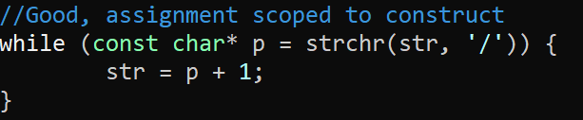
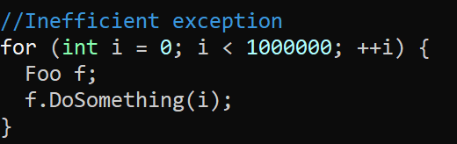
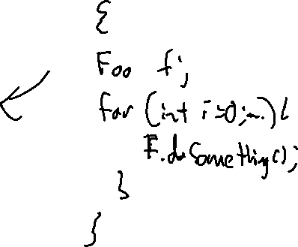
Scoped Initialization
Linting

Slide 25
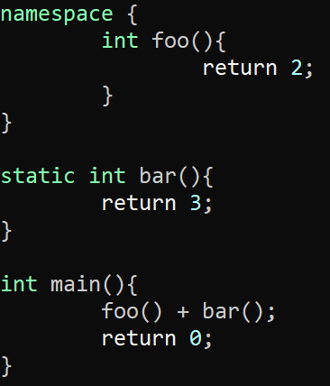
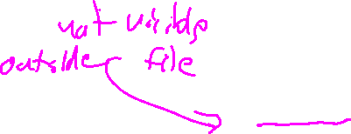
Namespacing (Good)
Linting

Slide 26
Heuristic tools for an imperfect World
Linting: OVerview
Try not to shoot yourself in the foot
Highlight the stuff you probably shouldn’t be doing in the first place

Slide 27
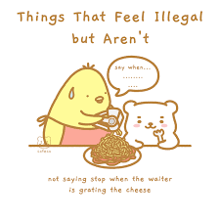
Recall: Security v Usability
Linting Overview
Many Programming languages have exploitable constructs
Capture the “loose fibers” that come off the program
Leave the whole of the program intact

