Slide 1
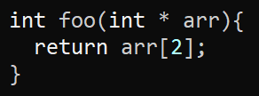
Exercise #11
LLVM MEMORY Review
Write your name and answer the following on a piece of paper
Write an LLVM IR function that takes a pointer to an array of ints and returns the element at index 2

Slide 2
Administrivia and Announcements

Slide 3
LLVM calls
EECS 677: Software Security Evaluation
Drew Davidson

Slide 4
Class Progress
We’re Basically ready to do static Analysis

Slide 5
Last Time: LLVM MEMORY
Review: Last Lecture
Described LLVM’s Concept of Named Memory
No mathematical relationship between distinct named memory items
Guaranteed mathematical relation WITHIN named memory items (as exploited by GEP)
Declaring memory
Local memory:
%ptrL = alloca i32, align 4
Global memory:
@ptrG = global i32 2, align 4
(Global) constant: Guaranteed mathematical relation
@ptrC = constant i32 2, align 4
%ptrLarr = alloca [8 x i32], align 4
%ptrGstruct = global i32 {i32, i8}, align 4
@ptrCstructs = constant [2 x {i8, i32}]
[{i8, i32} {i8 1, i32 2}, {i8, i32}{ i8 3, i32 4} ] ,
align 4

Slide 6
Last Time: LLVM MEMORY
Review: Last Lecture
Declaring memory
Local memory:
%ptrL = alloca i32, align 4
Global memory:
@ptrG = global i32 2, align 4
(Global) constant: Guaranteed mathematical relation
@ptrC = constant i32 2, align 4
%ptrLarr = alloca [8 x i32], align 4
%ptrGstruct = global i32 {i32, i8}, align 4
@ptrCstructs = constant [2 x {i8, i32}]
[{i8, i32} {i8 1, i32 2}, {i8, i32}{ i8 3, i32 4} ] ,
align 4
Accessing memory
Store scalar:
store i32 1, i32* %ptrL
Global memory:
%reg = load i32, i32* @ptrG
Load index of aggregate type
%eltPtr = getelementptr [2 x {i8, i32}],
[2 x {i8, i32}]* @ptrCstructs, i64 0, i64 0, i32 1
%res = load i32, i32* %ret

Slide 7
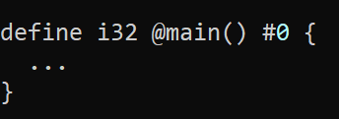

Follow-up What is the #0 here?
Review: Last Lecture
It’s an alias for an attribute list

Slide 8
Lecture Outline
A little more GEP intuition
Function calls

Slide 9
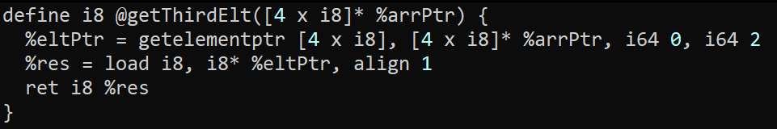
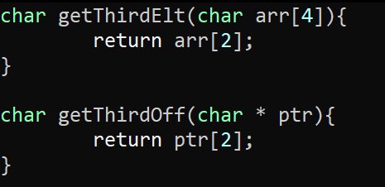
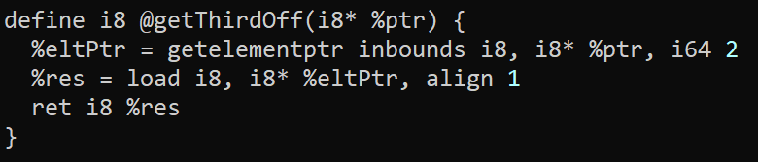
Some time with GEP
LLVM Bitcode

Slide 10
GetElementPtr
LLVM Bitcode

Slide 11

Writing “Interesting” Programs
LLVM Bitcode
We can now write Turing complete programs
But these programs are very Boring!
We need to interact with external functionality

Slide 12
LLVM Calls
LLVM Bitcode
General syntax
call <callee sig> <function name> ( <argList> )
%res = call i32(i32,i32) @max (i32 1, i32 2)
Somewhat surprisingly, does not (always) require the full function signature of the callee!
Constrained Syntax
call <return type> <function name> ( <argList> )
%res = call i32 @max (i32 1, i32 2)
The general syntax IS required if a function has varargs
%len = call i32 (i8*, ...) @printf(i8* %strPtr, i32 123)

Slide 13
LLVM External Calls
LLVM Bitcode
Example
%len = call i32 (i8*, ...) @printf(i8* %strPtr, i32 123)

Slide 14
LLVM AtoI
LLVM Bitcode
To the Terminal!

Slide 15
LLVM PRINTF
LLVM Bitcode
To the Terminal!

Slide 16
RUNNING THE LLVM TOOLS: CLANG
LLVM Bitcode
clang -S -emit-llvm foo.c -o foo.ll -disable-O0-optnone

Slide 17
RUNNING THE LLVM TOOLS: OPT
LLVM Bitcode
opt -dot-cfg foo.ll -disable-output

Slide 18
Wrap-up

Slide 19
Next Time
WRITING AN ANALYSIS

