Slide 1
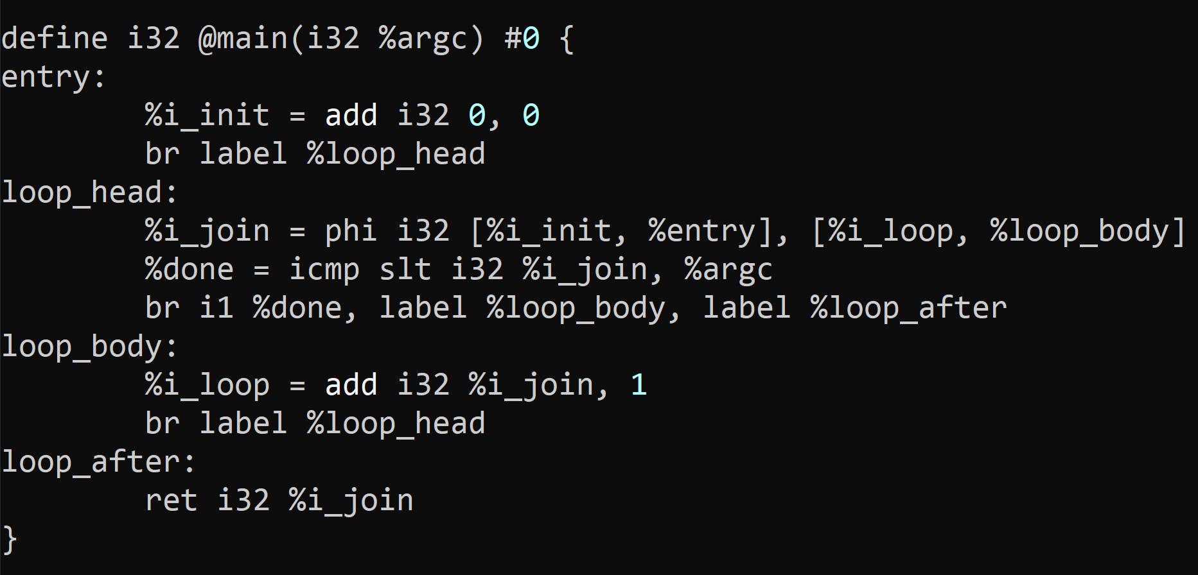
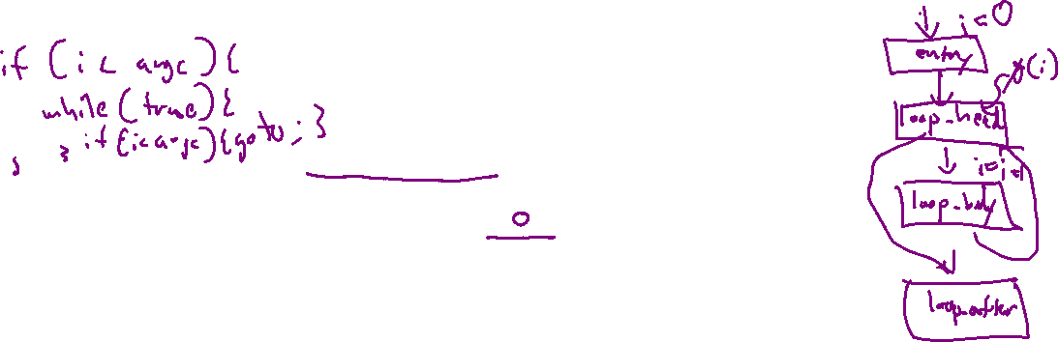
Exercise #10
LLVM Register Operation Reviews
Write your name and answer the following on a piece of paper
Write out the corresponding LLVM bitcode program for the following:
int main(int argc){
int i = 0;
while (i < argc){
i = i + 1;
}
return i;
}

Slide 2
Administrivia and
Announcements
We have to talk about cheating

Slide 3
LLVM BITCODE Memory
EECS 677: Software Security Evaluation
Drew Davidson

Slide 4
Class Progress
We’re Gearing up to build our own program analyses
We have the theory for dataflow
Working through a good program representation

Slide 5
Last Time: LLVM BitCode & Registers
Review: Last Lecture
Low-Level Language
Targets an abstract machine
Uses a system of (infinite) named registers to perform computation
Registers must be in SSA format

Slide 6
Lecture Outline
LLVM Memory
Load/Store
The dreaded GEP

Slide 7

LLVM MEMORY
LLVM Bitcode
Encodes the Concepts of Local and Global memory
Local memory: within a function activation
Global memory: static in the data section
Notably absent: heap memory
With infinite registers,
Why have local memory?
Because we might take the address of a local
int main(){
int a;
int * p;
p = &a;
}

Slide 8
LLVM MEMORY: Allocation
LLVM Bitcode
Allocating Global Memory
@glb1 = global i32 2, align 4
@cnst2 = constant i32 3, align 4
Allocating Local Memory
%reg = alloca i32, align 4

Slide 9
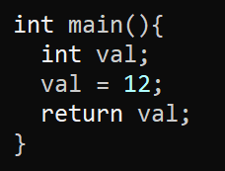
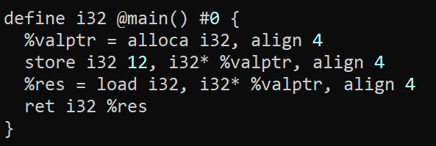
LLVM MEMORY: Load and STORE
LLVM Bitcode
Store
store <srcType> <srcOpd>, <dstType> <dstOpd>, align <align>
store i32 1 , i32* %var1ptr, align 4
Load
<dstOpd> = load <dstType>, <srcType> <srcOpd>, align <align>
%reg = load i32, i32* %var1ptr, align 4

Slide 10
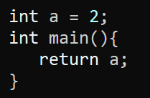
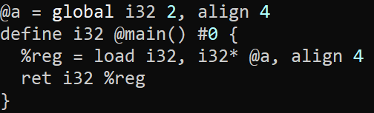
LLVM MEMORY: Global Memory Example
LLVM Bitcode

Slide 11
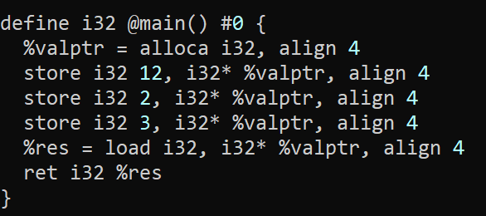

LLVM MEMORY: LoOK, NO SSA!
LLVM Bitcode
The VALUE OF the register doesn’t change
The VALUE AT the register is what changes!

Slide 12

LLVM MEMORY: LoOK, NO SSA!
LLVM Bitcode
%valptr:
0x4080
Address
0x4080
Address
0x4081
Address
0x4080
Address
0x4081
00
00
00
34

Slide 13
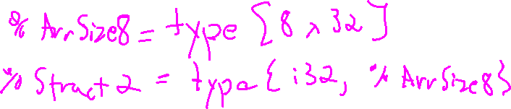
LLVM MEMORY: Aggregate Types
LLVM Bitcode
Recall that bitcode is a Typed language
Declare an aggregate type (think struct)
Allocate an array
%Point = type { i32, i32 }
%arrayptr = alloca [8 x i32], align 16
Allocate an aggregate type
%ptr = alloca %Point, align 4

Slide 14

LLVM MEMORY: Accessing Aggregate memory
LLVM Bitcode
At this point, we need to discuss how to read an array index or Field
There is a powerful, but somewhat complicated instruction to do it, called getelementptr (GEP)
GEP never actually reads memory, it just computes what the offset from a base location would be

Slide 15
Lecture Outline
LLVM Memory
Load/Store
The dreaded GEP

Slide 16

GetElementPtr
LLVM Bitcode
Here is the Basic format of a GEP
<result> = getelementptr <ty>, ptr <ptrval>{, [inrange] <ty> <idx>}*
Here is a snippet of the documentation of the syntax:
The first argument is always a type used as the basis for the calculations. The second argument is always a pointer or a vector of pointers, and is the base address to start from. The remaining arguments are indices that indicate which of the elements of the aggregate object are indexed. The interpretation of each index is dependent on the type being indexed into. The first index always indexes the pointer value given as the second argument, the second index indexes a value of the type pointed to (not necessarily the value directly pointed to, since the first index can be non-zero), etc. The first type indexed into must be a pointer value, subsequent types can be arrays, vectors, and structs. Note that subsequent types being indexed into can never be pointers, since that would require loading the pointer before continuing calculation.

Slide 17

GetElementPtr
LLVM Bitcode
Let me (maybe?) Simplify this a bit with a constrained version of GEP
<result> = getelementptr <ty_{res}>, <ty_{srcobj}> <srcobj>, <ptrtype> <siblingidx>, [<ptrtype> <fieldidx>]+
Here is my explanation of this version of GEP:
Get a pointer of type <ty_{res}> by…
- starting from the base address srcobj
- jumping over siblingidx siblings
- jumping over fieldidx children

Slide 18
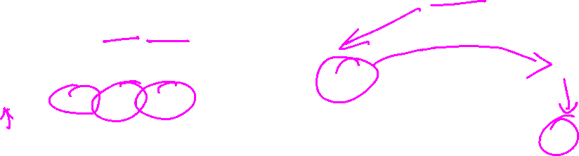
GetElementPtr: Pictorially
LLVM Bitcode
Can be helpful to walk through memory as a tree
%t1 = type { A, B, C }
ptr_n1
%t2 = type [ 2 x %t1 ]
@ptr_n1 = global %t2 [ { a0, b0, c0 }, { a1, b1, c1} ]
n1
ptr_n2 =
getelementptr %t2* ptr_n1, i64 0, i64 0
n2
n3
ptr_b1 =
getelementptr %t2* ptr_n2, i64 1, i64 1
a₀
b₀
c₀
a₁
b₁
c₁

Slide 19
Wrap-up

Slide 20
Next Time
A couple more bitcode features
Describe the first project

