Slide 1
Exercise #9
Abstract Interpretation Review
Write your name and answer the following on a piece of paper
Describe the purpose of using an abstract domain for dataflow analysis

Slide 2
Administrivia and
Announcements
Exam 1 is Wednesday
- Topic list linked and updated on https://analysis.cool
Carmack lecture is Friday
- Video linked on https://analysis.cool
Please sign up for Piazza if you haven’t Already!
- Video linked on https://analysis.cool

Slide 3
LLVM BITCODE
EECS 677: Software Security Evaluation
Drew Davidson

Slide 4
Class Progress
Exploring Static analysis
Finished enough intuition that we can perform a basic analysis
Time to explore our Analysis target format

Slide 5

Last Time: Abstract Interpretation
Review: Last Lecture
Precision / Efficiency Tradeoff
num
- Overapproximate the domain
- Rebuild the transfer functions
pos
zero
neg
$$∅$$

Slide 6
Last Time: LLVM
Review: Last Lecture
A set of Program Manipulation tools built around a “mid-level” abstract instruction set
- Called an intermediate representation (IR) because it sits between source code and executable
- High level enough to avoid architecture lock-in
- Low level enough to optimize / provide explicit operational details
Common
Middle-end
Front-end₁
Back-end₁
C
X64
Common
IR
Common
IR
Back-end₂
Front-end₂
Analysis
Haskell
…
MIPS
…
Optimization
Back-end_{m}
Front-end_{n}
WASM
Ruby

Slide 7
Lecture Outline
LLVM Bitcode Format
Very simple examples
SSA Format

Slide 8

LLVM’s “Universal IR”
LLVM Bitcode
Bit-Code Language Design Goals
An in-memory compiler IR
Bit-code
An on-disk program representation
A human readable assembly language
A Compiler’s Representation
Relatively generic
Relatively easy to analyze

Slide 9


Bitcode Structure
LLVM Bitcode
Nested Structure
Modules
Individual translation unit (can be a whole program)
Functions
Invokable execution units
Global variables (globals)
Regions of statically-allocated memory
modules
Local variables
Regions of dynamically-allocated memory
functions
globals
Instructions
Data transformers
locals
instructions
registers
Registers
Data transformers

Slide 10

An Abstract Computer
LLVM Bitcode
No real computer runs bitcode natively*
Abstract representation of memory
Highly-explicit instructions
*Without some additional translation software

Slide 11

LLVM’S Abstract Memory
LLVM Bitcode
Named Memory Objects
No explicit layout between objects
Sized field within the object
Highly-explicit instructions
Abstract registers
Infinite number of registers

Slide 12

example-Driven Learning
LLVM Bitcode
Before we get too lost in the details, let’s explore bit-code with an example
Example

Slide 13
Lecture Outline
LLVM Bitcode Format
Very simple examples
SSA Format

Slide 14
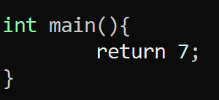
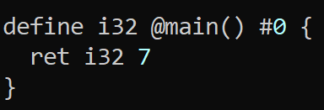

An Example Program
LLVM Bitcode
Source code
Basically-equivalent bit-code

Slide 15
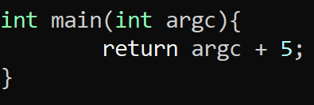
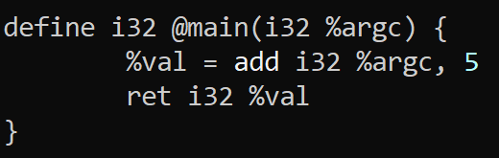
An Example Program - Math
LLVM Bitcode
Source code
Basically-equivalent bit-code
% precedes a register name
No nested operations!

Slide 16
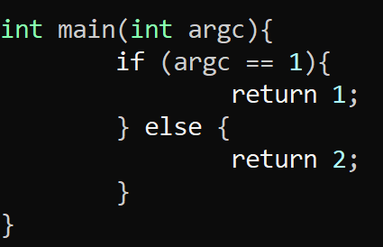
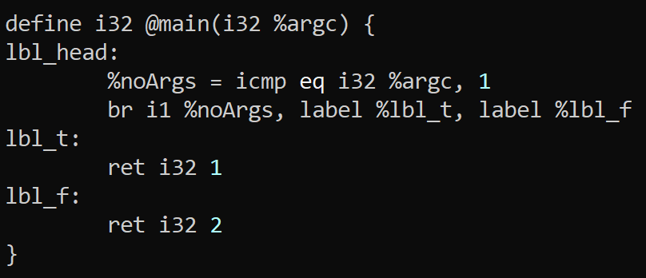
An Example Program - Jumps
LLVM Bitcode
Source code
Basically-equivalent bit-code
All blocks must end in a terminator instruction

Slide 17
simple Instruction Set
LLVM Bitcode – Very Simple Examples
Math
Comparison
The add instruction for addition
The mul instruction for multiplication
The sub instruction for subtraction
The div instruction for division
The icmp <kind> for integer comparison
Where kind is…
eq: equal
ne: not equal
ugt: unsigned greater than
uge: unsigned greater or equal
ult: unsigned less than
ule: unsigned less or equal
sgt: signed greater than
sge: signed greater or equal
slt: signed less than
sle: signed less or equal
Control Flow
The br instruction for branching
Predicate + multiple targets for conditional branch
No predicate + 1 target for unconditional branch

Slide 18

Running BITCODE Programs
LLVM Bitcode – Very Simple Examples
LLVM Programs
LLI – A runtime environment for bit-code programs!

Slide 19
Section Summary
LLVM Bitcode – Very Simple Examples
We can write Simple programs using the instructions given
We can write Run simple programs using LLI

Slide 20
Lecture Outline
LLVM Bitcode Format
Very simple examples
Format Constraints - SSA

Slide 21
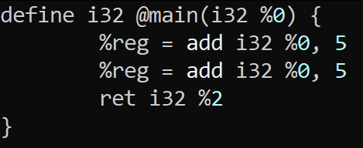
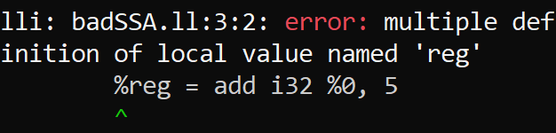
an Incorrect Program
LLVM Bitcode –Format Constraints: SSA
This program is invalid!
The register %reg is not
is not in SSA form

Slide 22

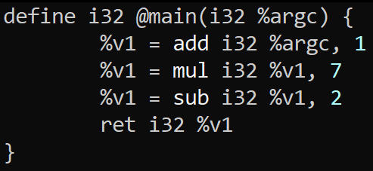
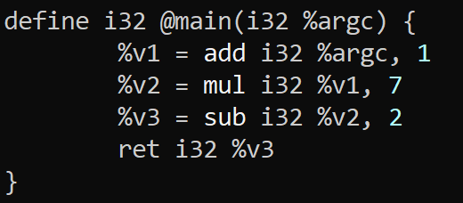

SSA FOrm
LLVM Bitcode –Format Constraints: SSA
In static single assignment form, a variable (here, register) may be assigned in at most one program point

Slide 23
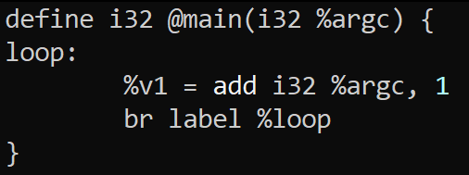
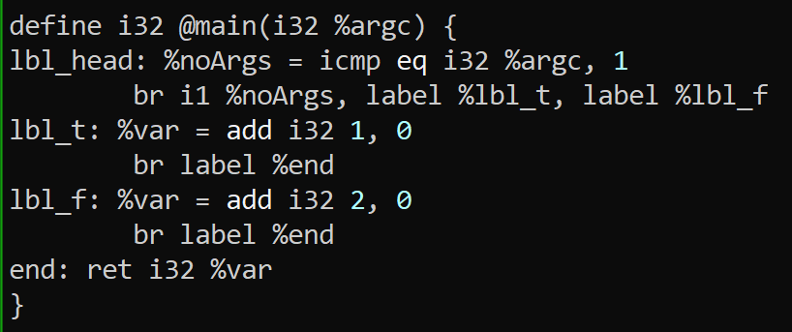

SSA FOrm
LLVM Bitcode –Format Constraints: SSA
In static single assignment form, a variable (here, register) may be assigned in at most one program point
Is this program in SSA form?
Is this program in SSA form?

Slide 24
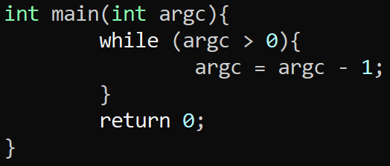
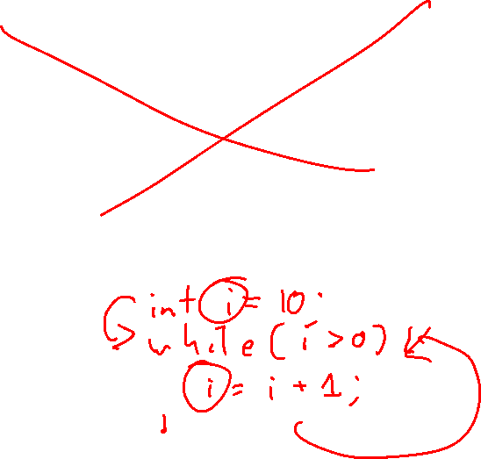
PHI Functions
LLVM Bitcode –Format Constraints: SSA
The concepts we have so far prevent some basic programs from being written
Fortunately, there is an instruction for
exactly these cases:
%res = phi <type> [val₁, bbl₁], [val₂, bbl₂], … [val_{n}, bbl_{n}]
Set %res to val_{i} if the block was entered from bbl_{i}

Slide 25
Section Summary
Static Analysis
LLVM Constrains how values can be set
One solution is to use PHI instructions to unify disparate values

Slide 26
Wrap-up

Slide 27
Homework 1
Due Friday, 9/15
Write an LLVM program that iteratively computes the K^{th} Fibonacci Number where K is the arg Count to the program

Slide 28
Next Time
Look at some more complex LLVM examples
Start looking at manipulating memory:
- Pointers / Ref+DEREF
- Structures / Arrays

