Slide 1
Exercise #16
SIDE Channel Review
Write your name and answer the following on a piece of paper
What is an advantage over an inline reference monitor over a reference monitor built into the OS? What about vice versa?

Slide 2
Administrivia and Announcements

Slide 3
History of memory attacks
EECS 677: Software Security Evaluation
Drew Davidson

Slide 4
Class Progress
Describing some Classes of Attacks and Defenses

Slide 5
Last Time: Reference Monitors
Review: Last Lecture
Live tracking of adherence to a safety policy
Kernelized reference monitor: Add policy enforcement in the underlying trusted computing base, policies strictly over system events
Wrapper reference monitor: Add a new enforcement layer that mediates system actions
Inline reference monitor: add probes (and potentially enforcement) into the body of the program itself

Slide 6

Overview
Preventing bad stuff from happening in a program
Program

Slide 7
How do “BAD” programs run?
A History of subversion
Reactive Concerns
Social engineering
“Flaws” in system installation policies
Proactive Concerns
The program accidentally does damage
The program contains a vulnerability

Slide 8
How do “BAD” programs run?
A History of subversion
Reactive Concerns
Social engineering
“Flaws” in system installation policies
We’re concerned about all these threats
Proactive Concerns
The program accidentally does damage
The program contains a vulnerability
Let’s focus on this one
for now

Slide 9
Lecture Outline
A history of computers
A history of subversion
Defenses

Slide 10
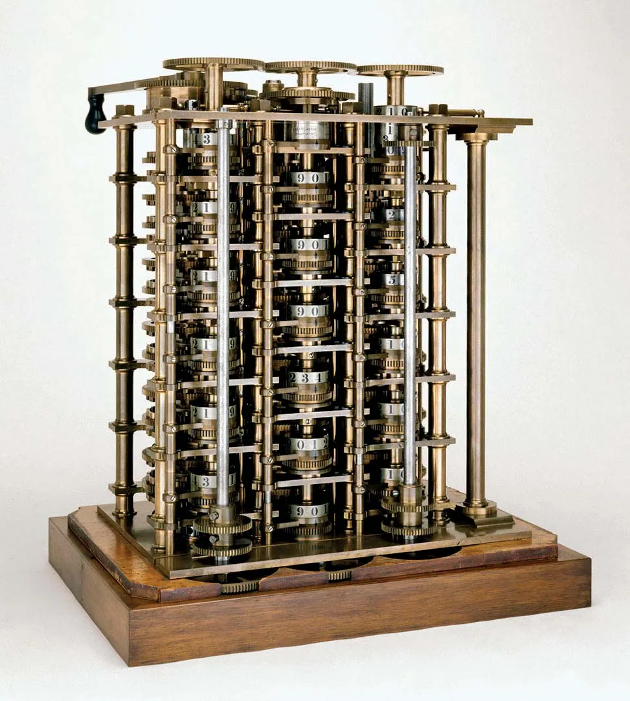
Data and Code
A history of Computing
Consider the History of Computation
The earliest devices recognized as computers were built to perform some specific type of computation

Slide 11
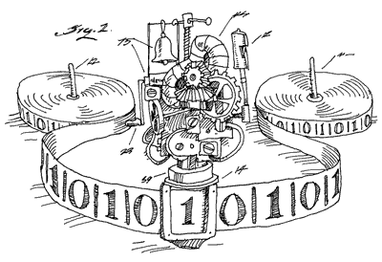
Data and Code
A history of Computing
Consider the History of Computation
The earliest devices recognized as computers were built to perform some specific type of computation
Algorithmic Purpose specified by hardware
Consider the theory analogy: a Turing Machine to compute a Fibonnaci Sequence
- Fibonnaci computation encoded into the state machine
- Input number encoded into the tape at start
- Output number encoded onto the tape at halt

Slide 12
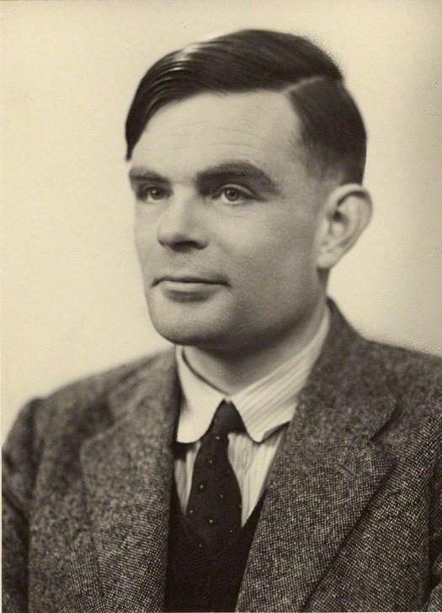
Data and Code
A history of Computing
A major paradigm shift: The Universal Computation Machine
The hardware contains generally-useful instructions
A particular algorithm is encoded in terms of those instructions
The Theory: The Universal Turing Machine
Consider the theory analogy: a Turing Machine that computes any function
- “Instruction set” encoded into the state machine
- Desired algorithm encoded into the tape at start
- Input to the algorithm encoded into the tape at start as well
- Output number encoded onto the tape at halt

Slide 13
Data and Code
A history of Computing
A major paradigm shift: The Universal Computation Machine
Numbers as stored voltage levels
The hardware contains generally-useful instructions
A particular algorithm is encoded in terms of those instructions
Symbols as numbers
The Theory: The Universal Turing Machine
Consider the theory analogy: a Turing Machine that computes any function
- “Instruction set” encoded into the state machine
- Desired algorithm encoded into the tape at start
- Input to the algorithm encoded into the tape at start as well
- Output number encoded onto the tape at halt
Operations as symbols

Slide 14
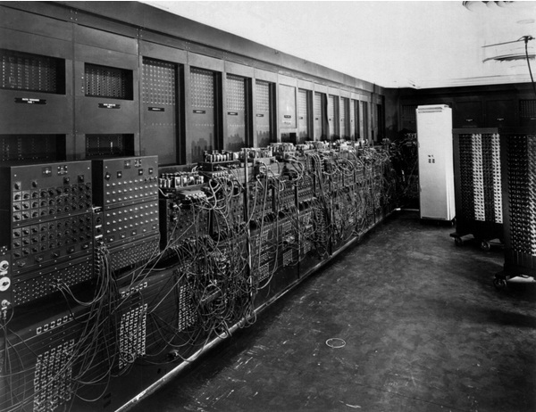
Data and Code
A history of Computing
Numbers as stored voltage levels
Symbols as numbers
Operations as symbols
Code is data

Slide 15
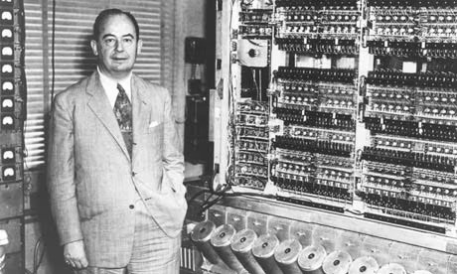
Data and Code
A history of Computing
The Von Neumann architecture
Another big idea: Code and data share memory
Code is data

Slide 16
Data and Code
A history of Computing
The Von Neumann architecture
Another big idea: Code and data share memory
Good news!
Programs can write code just like any other form of data
Bad news!
Code is data

Slide 17
Lecture Outline
A history of computers
A history of subversion
Defenses

Slide 18
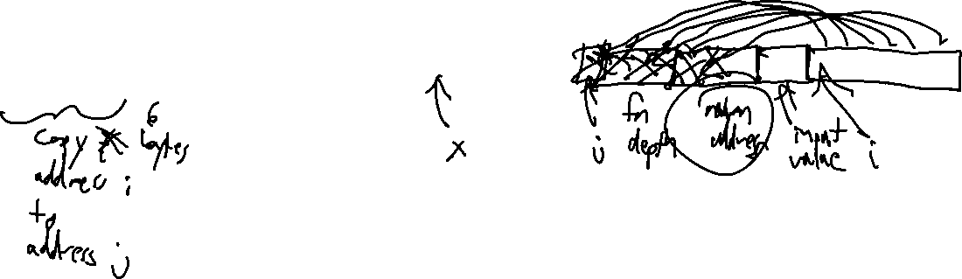
Buffer Overflows
A history of Subversion
A Simplified view of Program memory
Program instructions (binary sequences)
Program data & metadata
User data
f0ef7081e1539ac00ef5b761b4fb01b351308dd003cb4b8930e27195a6ef34ba476e80e53f2af0

Slide 19
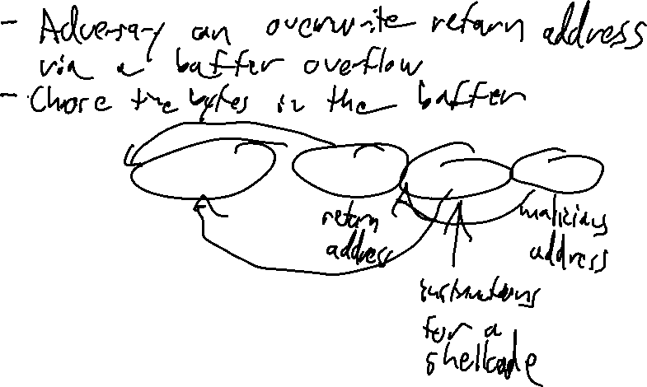
Code Injection
A history of Subversion
Treating User Data as Code
Program instructions (binary sequences)
Program data & metadata
User data
f0ef7081e1539ac00ef5b761b4fb01b351308dd003cb4b8930e27195a6ef34ba476e80e53f2af0
Time to panic?
Not so fast

Slide 20

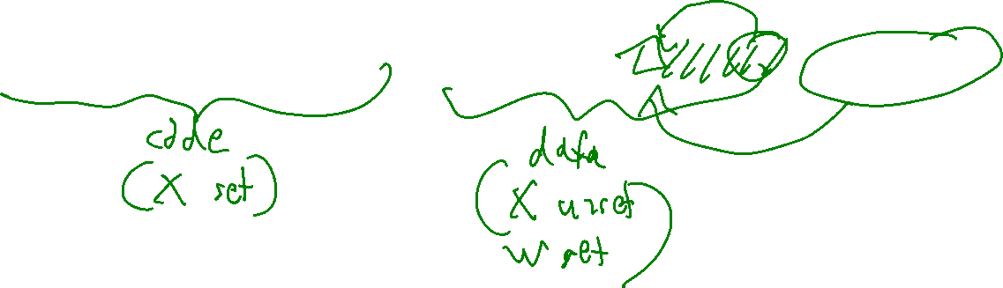
Defeating Code Injection: W$⊗$X
A history of Subversion
Separate ALL user data from code
New rule for EVERY byte of process memory:
A byte can be writeable OR executable but never both
Program instructions (binary sequences)
Program data & metadata
User data
f0ef7081e1539ac00ef5b761b4fb01b351308dd003cb4b8930e27195a6ef34ba476e80e53f2af0

Slide 21
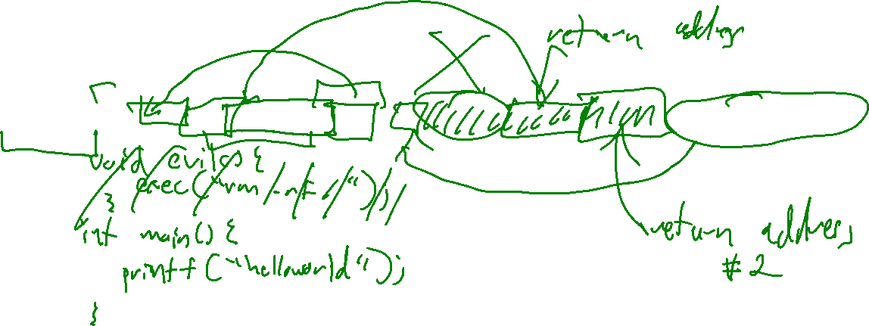
Return-Oriented Programming
A history of Subversion
Recall that code has an underlying binary (numeric) representation
Adversary still controls (at least) one control transfer
Write into an address
Program instructions (binary sequences)
Program data & metadata
User data
f0ef7081e1539ac00ef5b761b4fb01b351308dd003cb4b8930e27195a6ef34ba476e80e53f2af0
Time to panic?
Maybe not…

Slide 22
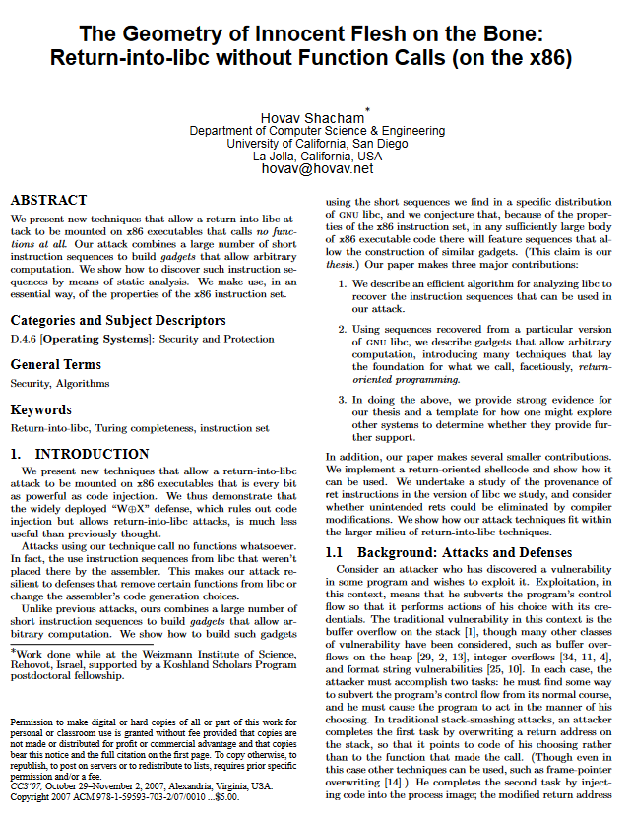
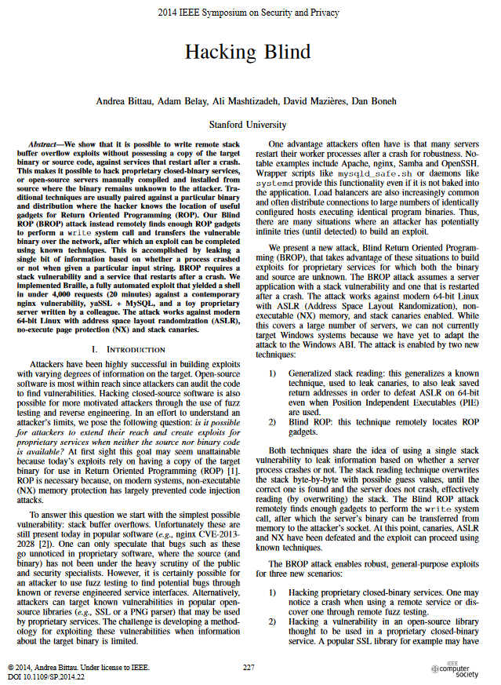
ROP Challenges
A history of Subversion
The practicality of this attack may seem limited
Are (sub)sequences present in process code to do the attack?
Are the (sub)sequences placed in predictable positions?

Slide 23
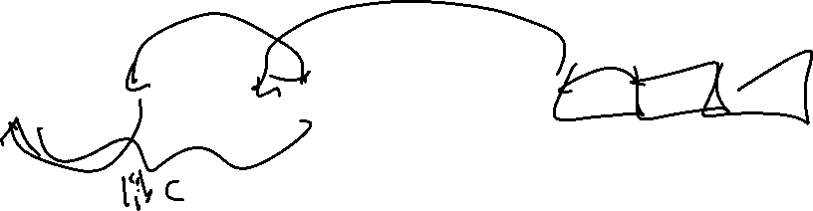
Return Into LIBC
A history of Subversion
Recall that code has an underlying binary (numeric) representation
Program instructions (binary sequences)
Program data & metadata
User data
f0ef7081e1539ac00ef5b761b4fb01b351308dd003cb4b8930e27195a6ef34ba476e80e53f2af0
Time to panic?

Slide 24
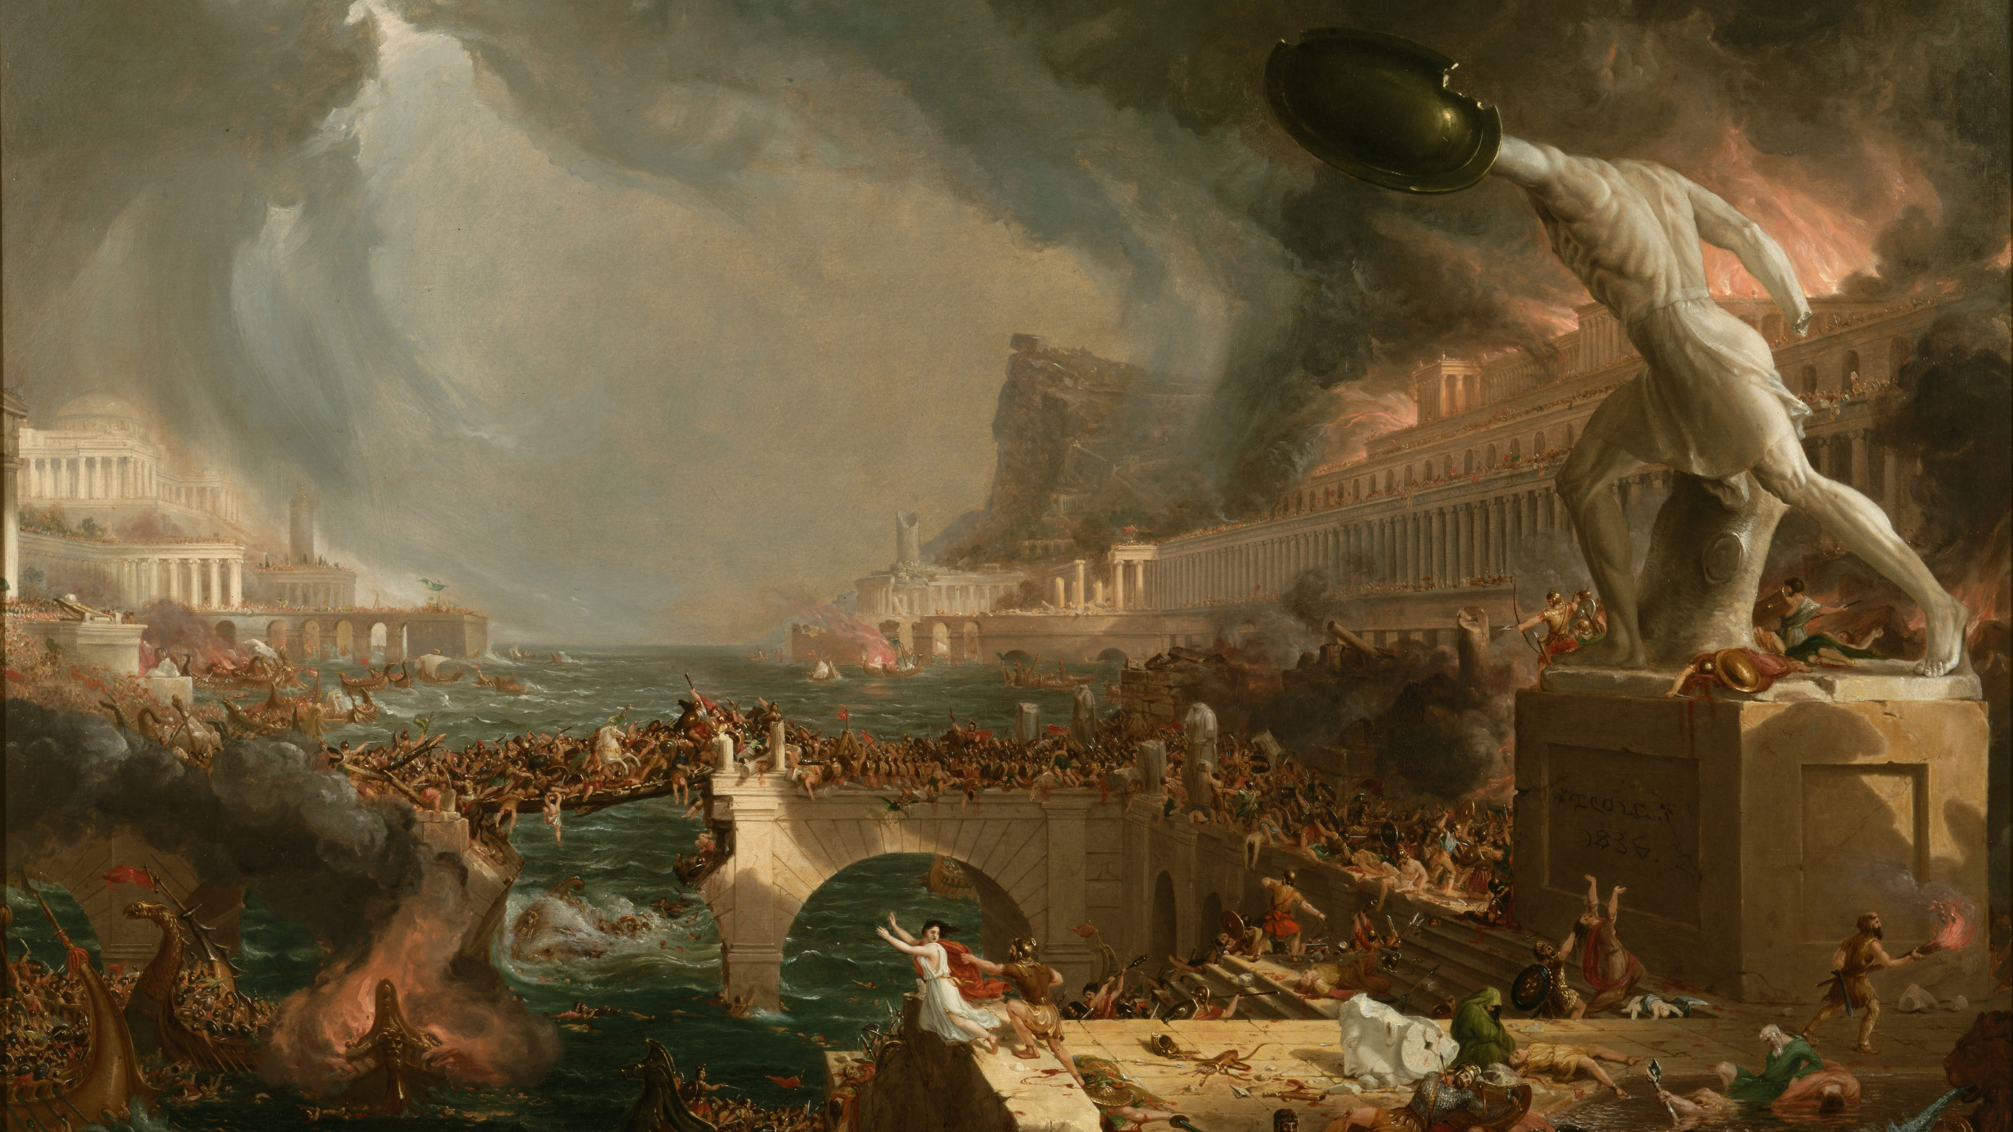
(yes, time to panic)

Slide 25
Lecture Outline
A history of computers
A history of subversion
Defenses

Slide 26

Stack Canaries
A history of subversion

Slide 27
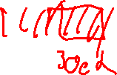
Stack Canaries
A history of subversion
Program instructions (binary sequences)
Program data & metadata
User data
f0ef7081e1539ac00ef5b761b4fb01b351308dd003cb4b8930e27195a6ef34ba476e80e53f2af0

Slide 28
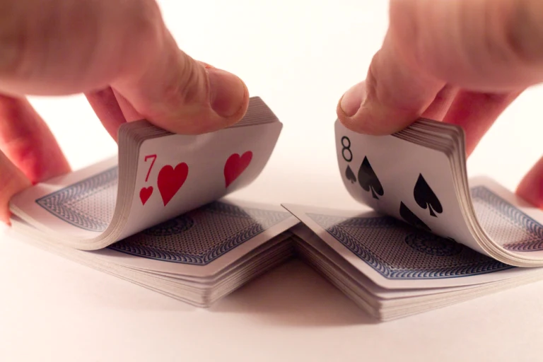
ASLR
A history of subversion

Slide 29

ASLR
A history of subversion
Program instructions (binary sequences)
Program data & metadata
User data
f0ef7081e1539ac00ef5b761b4fb01b351308dd003cb4b8930e27195a6ef34ba476e80e53f2af0

Slide 30
CFI
A history of subversion

Slide 31
Wrap-up

