Slide 1
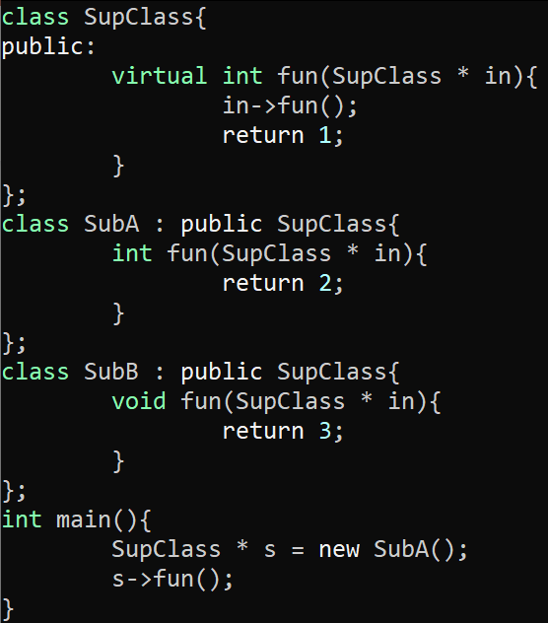
Exercise #20
Points-To Analysis Review
Write your name and answer the following on a piece of paper
Draw the exploded supergraph for the following program:

Slide 2
Administrivia and Announcements

Slide 3
Points-To Analysis
EECS 677: Software Security Evaluation
Drew Davidson

Slide 4
Class Progress
Analysis Underlying our enforcement needs

Slide 5
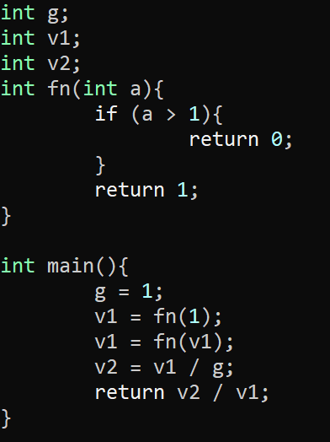
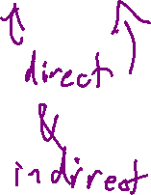
Last Time: Interprocedural AnalysiS
Review: Last Lecture
Consider the effect of multiple functions
Simplistic
Function overturn all global / aliased facts
Supergraph / Context String
1-CFA (use a call-chain of 1)
Summary Information
- Use GMOD and GREF to cut down on imprecision

Slide 6
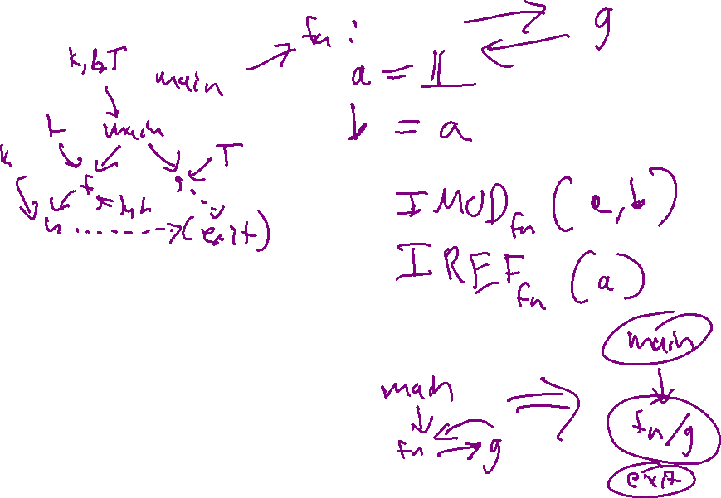
Last Time: Gmod & GREF Computation
Review: Last Lecture
Globals Only
Step 1
Compute IMOD and IREF
Step 2
Build (simple) call graph
Step 3
Collapse Cycles
Step 4
Solve a fixpoint problem
Add a new exit node (and add an edge n → exit
for each node n with no outgoing edge.
A lattice element is a set of (global) variables.
The lattice meet is set union.
The "initial" dataflow fact for both GMOD and GREF (the fact that holds at the exit node) is the empty set.
for all nodes n, the dataflow functions for n are:
GMOD: fn(S) = S U IMOD(n)
GREF: fn(S) = S U IREF(n)

Slide 7
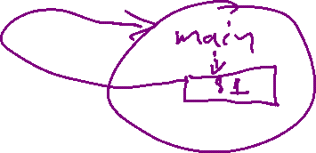
Last Time: Gmod & GREF Computation
Review: Last Lecture
Globals, Locals & Value-Passing
GREF will change, GMOD doesn’t need to change
Step 1
New IREF: include locals and formals
Step 2
Build call-site multigraph
Step 3
Collapse Cycles
Step 3
Solve a fixpoint problem
Init all node GREF sets to their IREF sets
Init all call site GREF sets to empty
Put all nodes and call sites on a worklist
Iterate until the worklist is empty.
Each time a node n is removed from the worklist, its current GREF set is computed. If that set doesn't match its previous value, then add all call sites to n to the worklist (if not already there).
Similarly, each time a call site s is removed from the worklist, its current GREF set is computed. If that set doesn't match its previous value, then the node that contains s is added to the worklist (if not already there).
GREF(n) = (U all GREF(s) s.t. s is a call site in n) U IREF(n)
GREF(s) = GREF(called node m) with all formals mapped back to the corresponding actuals

Slide 8
Last Time: Gmod & GREF Computation
Review: Last Lecture
Globals, Locals & Value-Passing
GREF will change, GMOD doesn’t need to change
Init all node GREF sets to their IREF sets
Init all call site GREF sets to empty
Put all nodes and call sites on a worklist
Iterate until the worklist is empty.
Each time a node n is removed from the worklist, its current GREF set is computed. If that set doesn't match its previous value, then add all call sites to n to the worklist (if not present).
Each time a call site s is removed from the worklist, its current GREF set is computed. If that set doesn't match its previous value, then the node that contains s is added to the worklist (if not present).

Slide 9

Last Time: Gmod & GREF Computation
Review: Last Lecture
Globals, Locals & Value-Passing
GREF will change, GMOD doesn’t need to change
void main() {
S1: call a(v1)
}
main
IREF = { }
s1
node or call site | GREF set
main | g2
a | g2, v3, v5
b | f3, g2
s1 | g2
s2 | v3, g2
s3 | v5, g2
s4 | g2
Init all node GREF sets to their IREF sets
Init all call site GREF sets to empty
Put all nodes and call sites on a worklist
Iterate until the worklist is empty.
Each time a node n is removed from the worklist, its current GREF set is computed. If that set doesn't match its previous value, then add all call sites to n to the worklist (if not present).
Each time a call site s is removed from the worklist, its current GREF set is computed. If that set doesn't match its previous value, then the node that contains s is added to the worklist (if not present).
void a( f1 ) {
S2: call b(v2, v3)
S3: call b(v4, v5)
}
a
IREF = { }
s2 s3
void b( f2, f3 ) {
print f3;
S4: call b(g1, g2)
}
b
IREF = {f3}
s4

Slide 10
Overview
We’ve seen the necessity of multi-function analysis in real-world programs
Time to consider how it is done

Slide 11
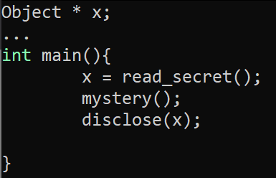
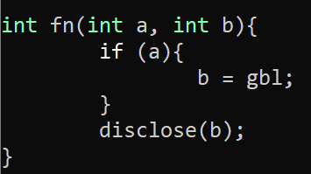

Back to Dataflow
Interprocedural Analysis
What are the (possible) values of a and gbl?
What is the effect of mystery on x’s taintedness?

Slide 12

Lecture Outline
May-point v Must-point
Andersen’s Analysis
Steensgard’s Analysis

Slide 13
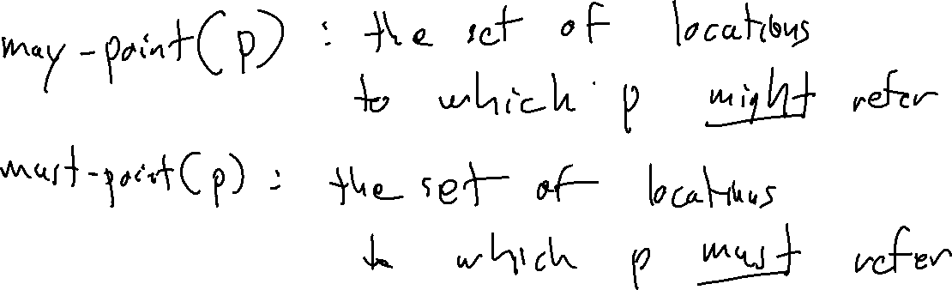
Pointers: Love to Hate ‘EM
MAY-POINT and Must-Point

Slide 14
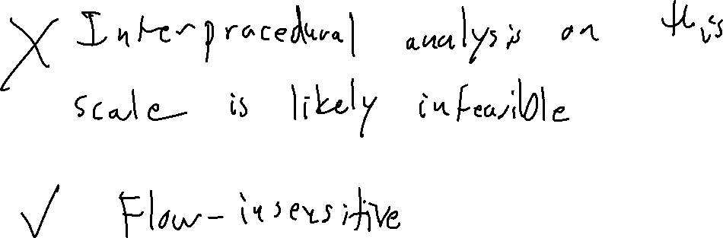
“Easy” Solution: Dataflow for May-Point
MAY-POINT and Must-Point

Slide 15
Lecture Outline
May-point v Must-point
Andersen’s Analysis
Steensgard’s Analysis

Slide 16
Subset Constraints
Andersen’s Analysis
A Flow-insensitive Algorithm
Each statement adds a constraint over the points-to sets
End up with a (solvable) system of constraints
Program
p = &a;
q = p;
p = &b;
r = p;

Slide 17
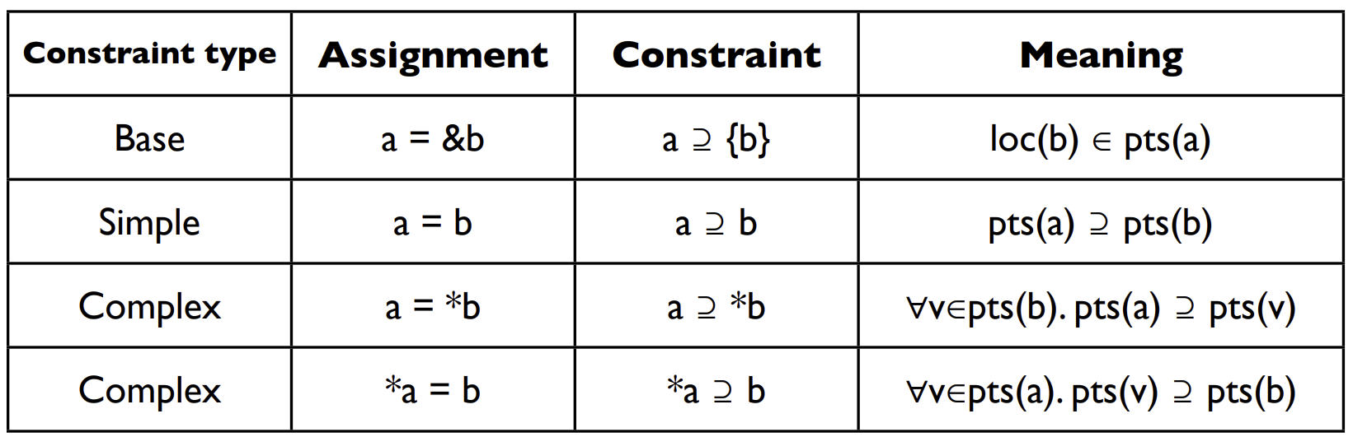
Subset Constraints
Andersen’s Analysis

Slide 18
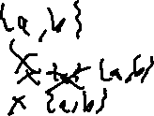
Subset Constraints
Andersen’s Analysis
A Flow-insensitive Algorithm
Each statement adds a constraint over the points-to sets
End up with a (solvable) system of constraints
Program
Constraints
Initial
Final
p = &a;
q = p;
p = &b;
r = p;
p ⊇ {a}
q ⊇ p
p ⊇ {b}
r ⊇ p
pts(p) = ∅
pts(q) = ∅
pts(r) = ∅
pts(a) = ∅
pts(b) = ∅
pts(p) = {a,b}
pts(q) = {a,b}
pts(r) = {a,b}
pts(a) = ∅
pts(b) = ∅

Slide 19
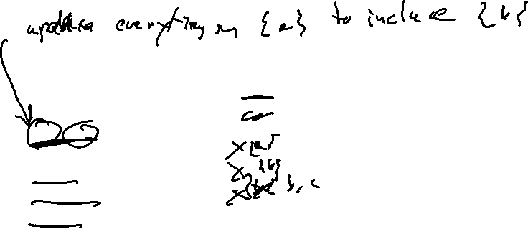
Another Example
Andersen’s Analysis
A Flow-insensitive Algorithm
Each statement adds a constraint over the points-to sets
End up with a (solvable) system of constraints
Program
Constraints
Initial
Final
p = &a
q = &b
*p = q;
r = &c;
s = p;
t = *p;
*s = r;
p ⊇ {a}
q ⊇ {b}
*p ⊇ q
r ⊇ {c}
s ⊇ p
t ⊇ *p
*s ⊇ r
pts(p) = { a }
pts(q) = { b }
pts(r) = { c }
pts(s) = ∅
pts(t) = ∅ pts(a) = ∅
pts(b) = ∅
pts(c) = ∅
pts(p) = { a }
pts(q) = { b }
pts(r) = { c }
pts(s) = { a }
pts(t) = { b, c }
pts(a) = { b, c }
pts(b) = ∅
pts(c) = ∅

Slide 20
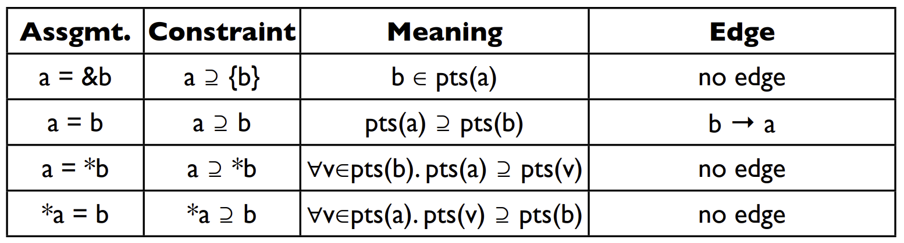
Solving Constraints
Andersen’s Analysis
Graph closure on the subset relation

Slide 21
Overhead
Andersen’s Analysis
Worst Case: Cubic Time
That’s not great
Optimization: Cycle elimination
Detect and collapse SCCs in the points-to relation

Slide 22
Lecture Outline
May-point v Must-point
Andersen’s Analysis
Steensgard’s Analysis

Slide 23
An alternative Approach
STeensGard’s Analysis
Aim for Near-Linear-time points-to Analysis
Going to require us to reduce our search-space somewhat
Intuition: Equality constraints
Do away with the notion of subsets

Slide 24
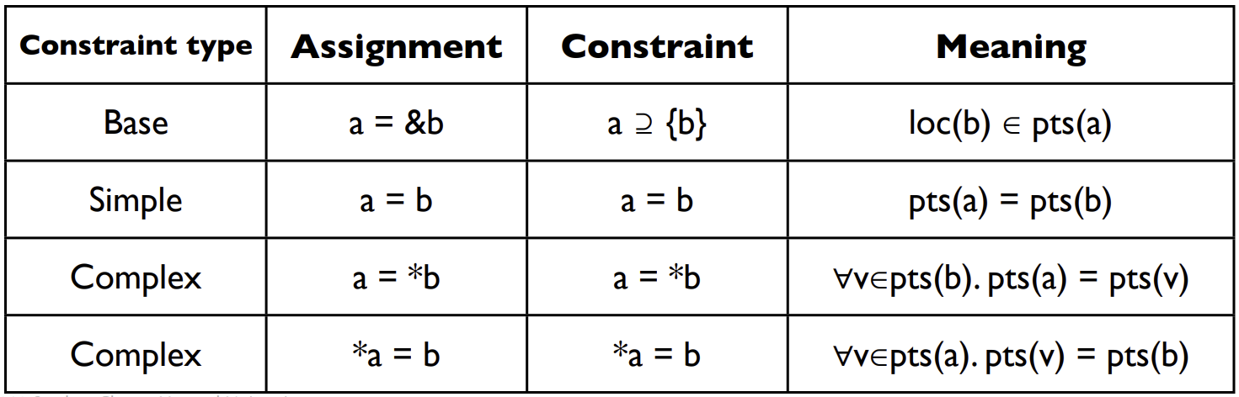
Equality Constraints
Steensgard’s Analysis

Slide 25
Equality Constraints
Steensgard’s Analysis
p = &a
p
a
p = &b
p
a,b
m = &p
m
p
a,b
r = *m
m
p
a,b
r
q = &c
m
p
a,b
r
q
c
m = &q
m
p,q
a,b,c
r

Slide 26
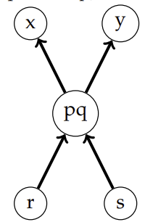
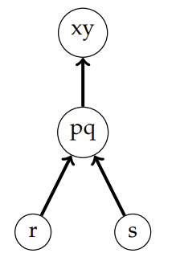
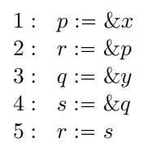
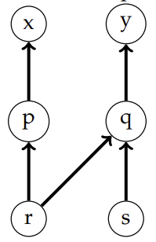
Equality Constraints
Steensgard’s Analysis
Andersen’s
Steensgard’s

Slide 27
Wrap-up

