Slide 1
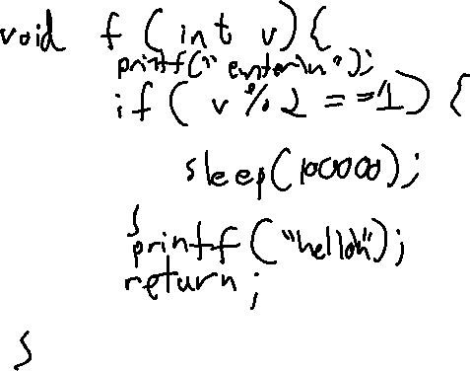
Exercise #15
SIDE Channel Review
Write your name and answer the following on a piece of paper
Provide an instance of a function with a sensitive argument v and leaks a bit of v via a timing side channel

Slide 2
Administrivia and
Announcements
Paper review due Sunday at 11:59 PM

Slide 3
Class Progress
Showing some applications of Static Dataflow
Described a particular type of evasion against explicit dataflow: side channels
Began to consider what we could do about it

Slide 4
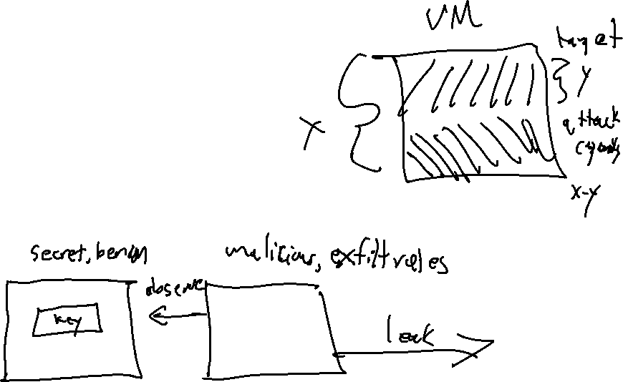
Last Time: SIDE Channels
Review: Last Lecture
Undetectable via (typical) static dataflow
General side-channel: using a predictable phenomenon outside of the semantics of the program
Covert channel: special instance of a side channel that is used intentionally by the program

Slide 5
Reference Monitors
EECS 677: Software Security Evaluation
Drew Davidson

Slide 6
Overview
Preventing bad stuff from happening in a program

Slide 7
Lecture Outline
Overview
Details
Instances

Slide 8

Limitations of Analysis
Reference Monitors: Overview
So far, our focus has been largely on detecting undesirable behavior
That’s valuable!
  Ask developers to correct their own mistakes
  Empower users to forgo running bad software

Slide 9

Limitations of Analysis
Reference Monitors: Overview
Detection might not be enough
May be in a position where we can’t run the analysis
Static Analysis
False positives
Scalability issues
Dynamic Analysis
False negatives
Run time issues

Slide 10

A Hands-on Alternative
Reference Monitors: Overview
Keep bad things from happening during system execution
Requires some sort of specification for “bad things”
Requires some sort of preventative capabilities

Slide 11

Preventative Capabilities
Reference Monitors: Overview
Simple form
Kill the program
Dataflow Form
Sanitize the data

Slide 12

The BiG Idea
Reference Monitors: Overview
Keep programs on the “straight and narrow”
- Articulate a policy for allowed behavior
- Keep a running record of security-relevant behavior
- Prevent a violation of the policy

Slide 13
Safety Policies
Reference Monitors: Instances
Execution of a process as a sequence of states
Policy is a predicate on sequence prefix
Policy depends only on the past of a particular execution – once violated, never “unviolates”
Incapable of handling liveness policies
“If this server accepts a SYN, it will eventually send a response”

Slide 14
Lecture Outline
Overview
Details
Instances

Slide 15
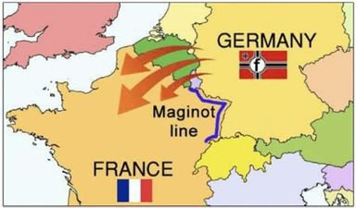
Consider the Reactive Adversary
Reference Monitors: Overview
Definition
Reactive Adversary: An adversary with the capability to understand the defense mechanism and an opportunity to avoid it
If a Defense can be avoided it hardly matters what the enforcement does
Recall the history of the Maginot Line

Slide 16
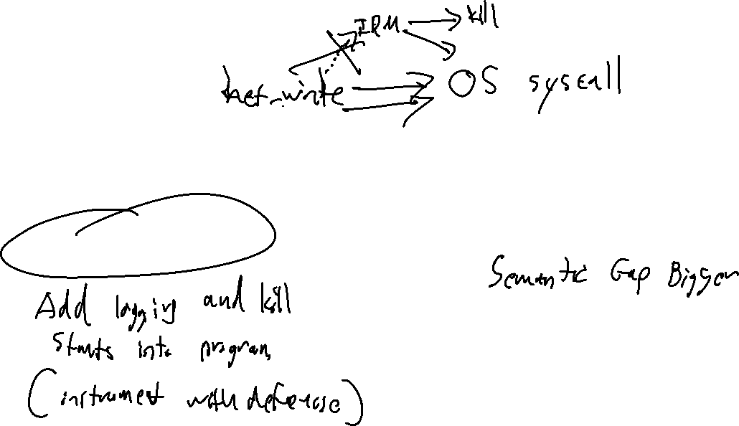
Security vs Precision
Reference Monitors: Overview
Program Proximity
Close
Far
Inline reference monitor
External reference monitor

Slide 17
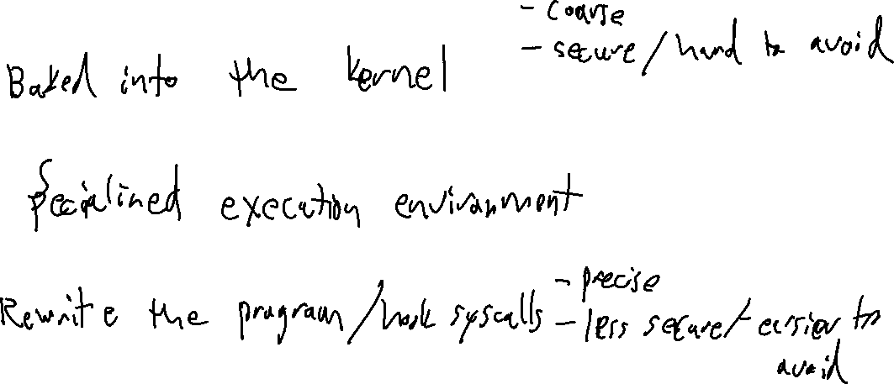
Reference Monitor Design
Reference Monitors: Instances
Kernelized
Wrapper
Inline

Slide 18
Properties we care about
Reference Monitors: Instances
Memory Safety
e.g. Programs respect aggregate type sizes, process boundaries, code v data
Type Safety
e.g. Functions and intrinsic operations have arguments that adhere to the type system
Control Flow Safety
e.g. All control transfers are envisioned by the original program

Slide 19
Lecture Outline
Overview
Details
Instances

Slide 20
OS as reference Monitor
Reference Monitors: Instances
Collection of running processes and files
Processes are associated with users
Files have ACLs
OS enforces various safety policies
- File access
- Process space write
Same policy for all processes of the same user

Slide 21
Software Fault Isolation (Sfi)
Reference Monitors: Instances
Isolate process faults on shared hardware
Each process is a logical fault domain
Ensure all memory references and jump is within the process fault domain

Slide 22
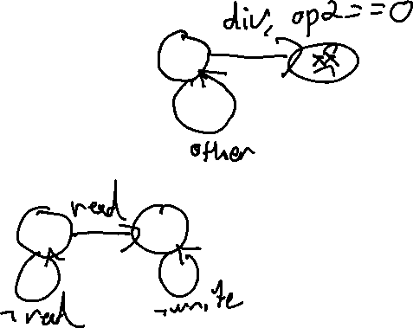
Inline Reference Monitors: SASI
Reference Monitors: Instances
Cornell project for inline policy enforcement
Change the program to enforce “any” safety policy
Express allowed behavior as an FSM
Examples:
- No division by zero
- No network send after file read

Slide 23
SASI: Cost
Reference Monitors: Instances
Attempts to minimize the number of checks
Looking at every instruction is incredibly expensive
Example: only need to check divide-by-zero before DIV instructions

Slide 24
Control Flow Integrity: CFI
Reference Monitors: Instances
Ensure the program control Flow is allowed by the CFG
In a sense, the policy is the control-flow graph
Why would we need to do this?

Slide 25
Wrap-up

