Slide 1
Exercise #37
supply Chain Security Review
Write your name and answer the following on a piece of paper
Describe what typosquatting is in language-based package ecosystems and why it is a threat vector.

Slide 2
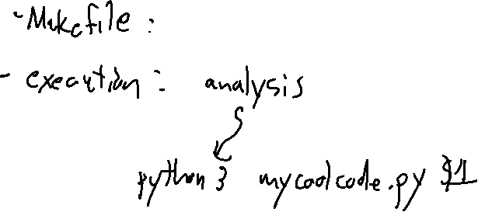
Administrivia and
Announcements
Coding Project Clarifications

Slide 3
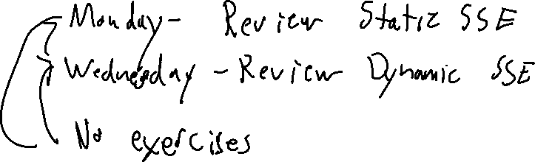
Administrivia and
Announcements
This is the last lecture on new material

Slide 4
(Anti)
Reverse Engineering
EECS 677: Software Security Evaluation
Drew Davidson

Slide 5
Where We’re At
Grab-bag topics!

Slide 6

Previously: Supply Chain Security
Lecture REview
Software Supply Chain Security
Supply chain overview
Threats
Defenses

Slide 7
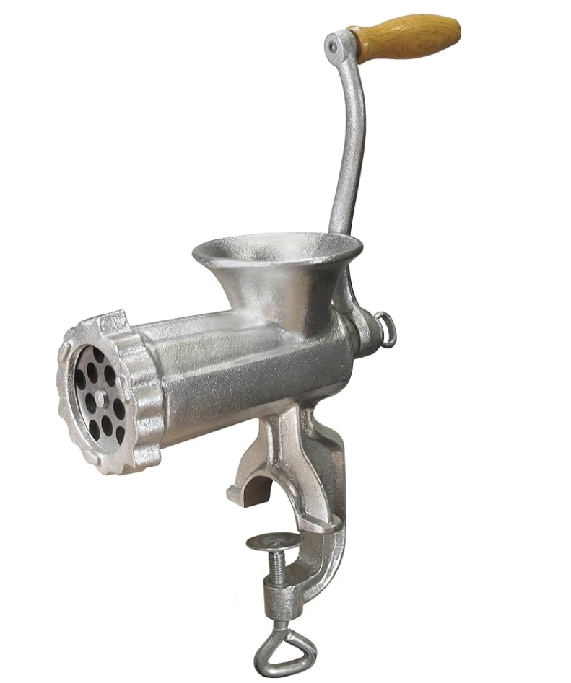

This lecture
Reverse Engineering
Reverse Engineering
Goals
Challenges
Tools
Evasion

Slide 8
Why do we need Reverse Engineering?
Overview
Simple Answer:
IP theft!
Possibly-legitimate Answer
IP theft… of malware
Answer that some people buy
Analysis of possibly-legitimate binary-only software

Slide 9
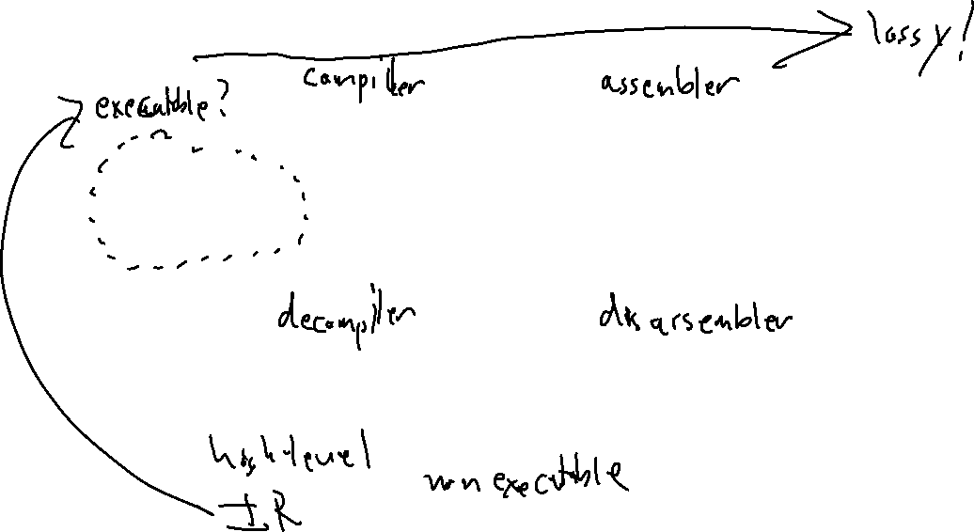
Purely static approaches
Challenges
Source
Code
Assembly
Text
Binary File
(Program, Library, etc.)

Slide 10
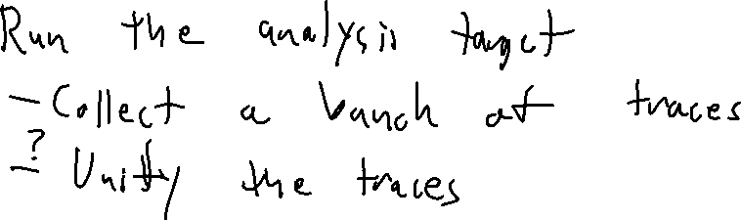
What about Dynamic Approaches?
Issues

Slide 11
Challenges
Overview

Slide 12
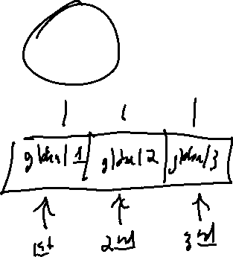
Focus on DIsassembly
Issues
Source
Code
Assembly
Text
Binary File
(Program, Library, etc.)
Why is this hard? Obfuscation!

Slide 13
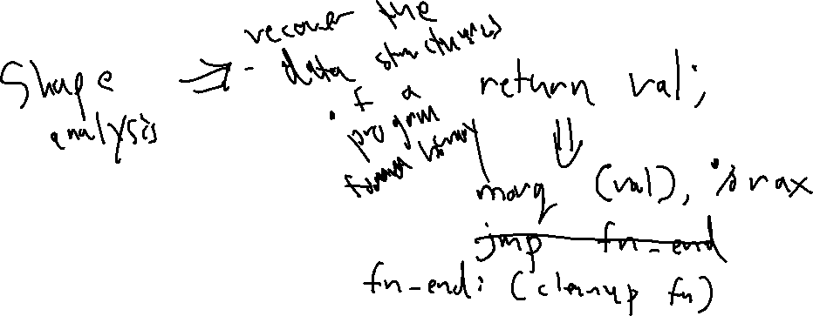
Fundamentally a losing Game
Issues
Execution needs less information than compilation, exacerbated by optimization
Implicit protocols are fine for execution, not for understanding

Slide 14
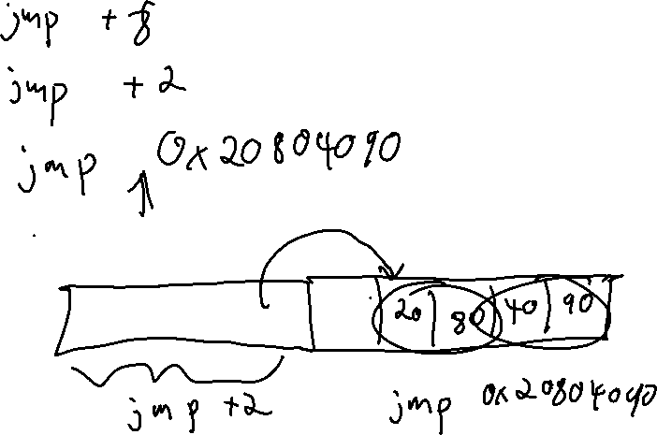
Instruction Re-interpretation
Challenges

Slide 15

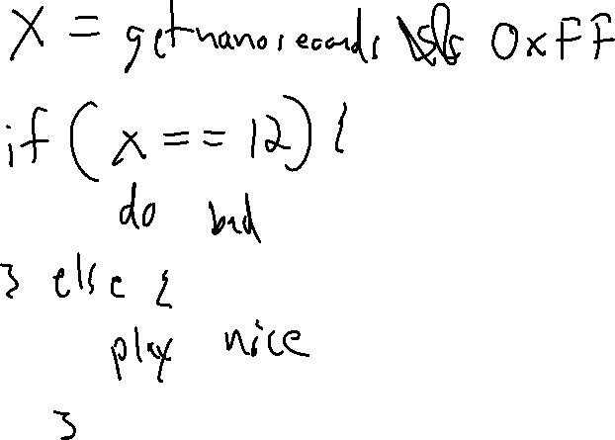
Time Bombs
Challenges

Slide 16

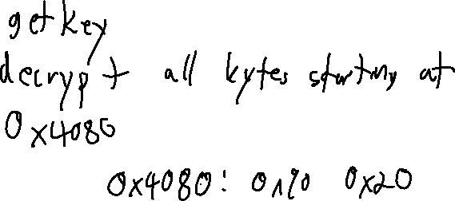
Packing
Challenges

Slide 17
Tools
tools
Old Answer
New Answer
Ida Pro + Hex Rays
Ghidra

Slide 18

Ghidra
Reverse EngineEring: tools

Slide 19
Ghidra: History
Reverse EngineEring: tools
Internal project by the NSA since at least 2017, likely used for much longer

Slide 20
Ghidra: Development
Reverse EngineEring: tools
Available from the NSA Github page
https://github.com/NationalSecurityAgency/ghidra/releases
C++ decompiler, frontend interface in Java+Swing
Facilities for both static reverse engineering and program exploration (i.e. debugging)

Slide 21
Wrap-Up
Software Supply Chains
Reverse Engineering is Hard!
Some heuristic techniques might be ok

Slide 22
That’s all folks!
Software Supply Chains
This marks the end of new material in the class

Slide 23
Thanks for your Questions!
Software Supply Chains
Special Thanks to everyone that posted on Piazza

