Slide 1
ExerCise #6
DataFlow Review
Write your name and answer the following on a piece of paper
Show the control-flow graph of the following function and indicate the value-sets at the beginning and end of each basic block according to the method discussed in class
y = 0;
if ( g ) {
x = 1;
x += y;
} else {
x = 3;
if (g2) {
x = y;
}
x = 4;
}
z = x;

Slide 2
Administrivia and Announcements

Slide 3
DataFlow Fixpoints
EECS 677: Software Security Evaluation
Drew Davidson

Slide 4
Class Progress
Exploring a form of Static analysis that summarizes how Control and Data flows across a program
manifest a Complete analysis by denoting sets of all values memory might contain (NB – this will end up being cumbersome!)

Slide 5
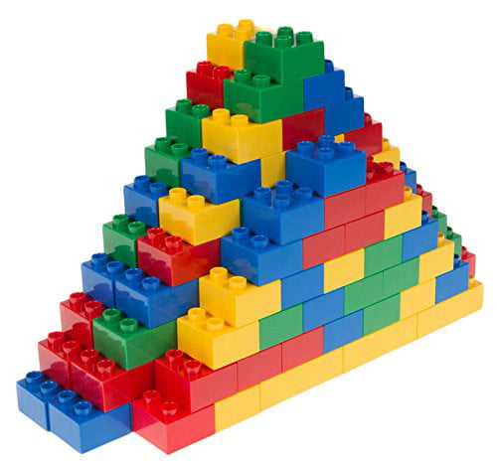
Last Time: Control-Flow Graphs
Review: Static Analysis
Set rules for Partitioning Functions into Basic Blocks
Leader instructions
Terminator instructions
Connected the Basic Blocks into a Control-Flow Graph
Edges indicate control flow transfers
Explored the “Big Idea” of Dataflow Anlaysis
Treat each instruction as a transfer function
Compose transfer functions to model blocks data flow
Merge block effects to get function’s data flow
Building something bigger out of basic blocks

Slide 6
Last Time: Flow Sensitive Value Sets
Review: Dataflow
Account for Program Flow, not paths
Necessarily Over-approximating states
Let’s do an example
1. int x = 0;
2. int y = 0;
3. if (g == true){
4. x = 10;
5. }
6. if (g == false){
7. y = 1 / (x – 10);
8. }
9. return;

Slide 7
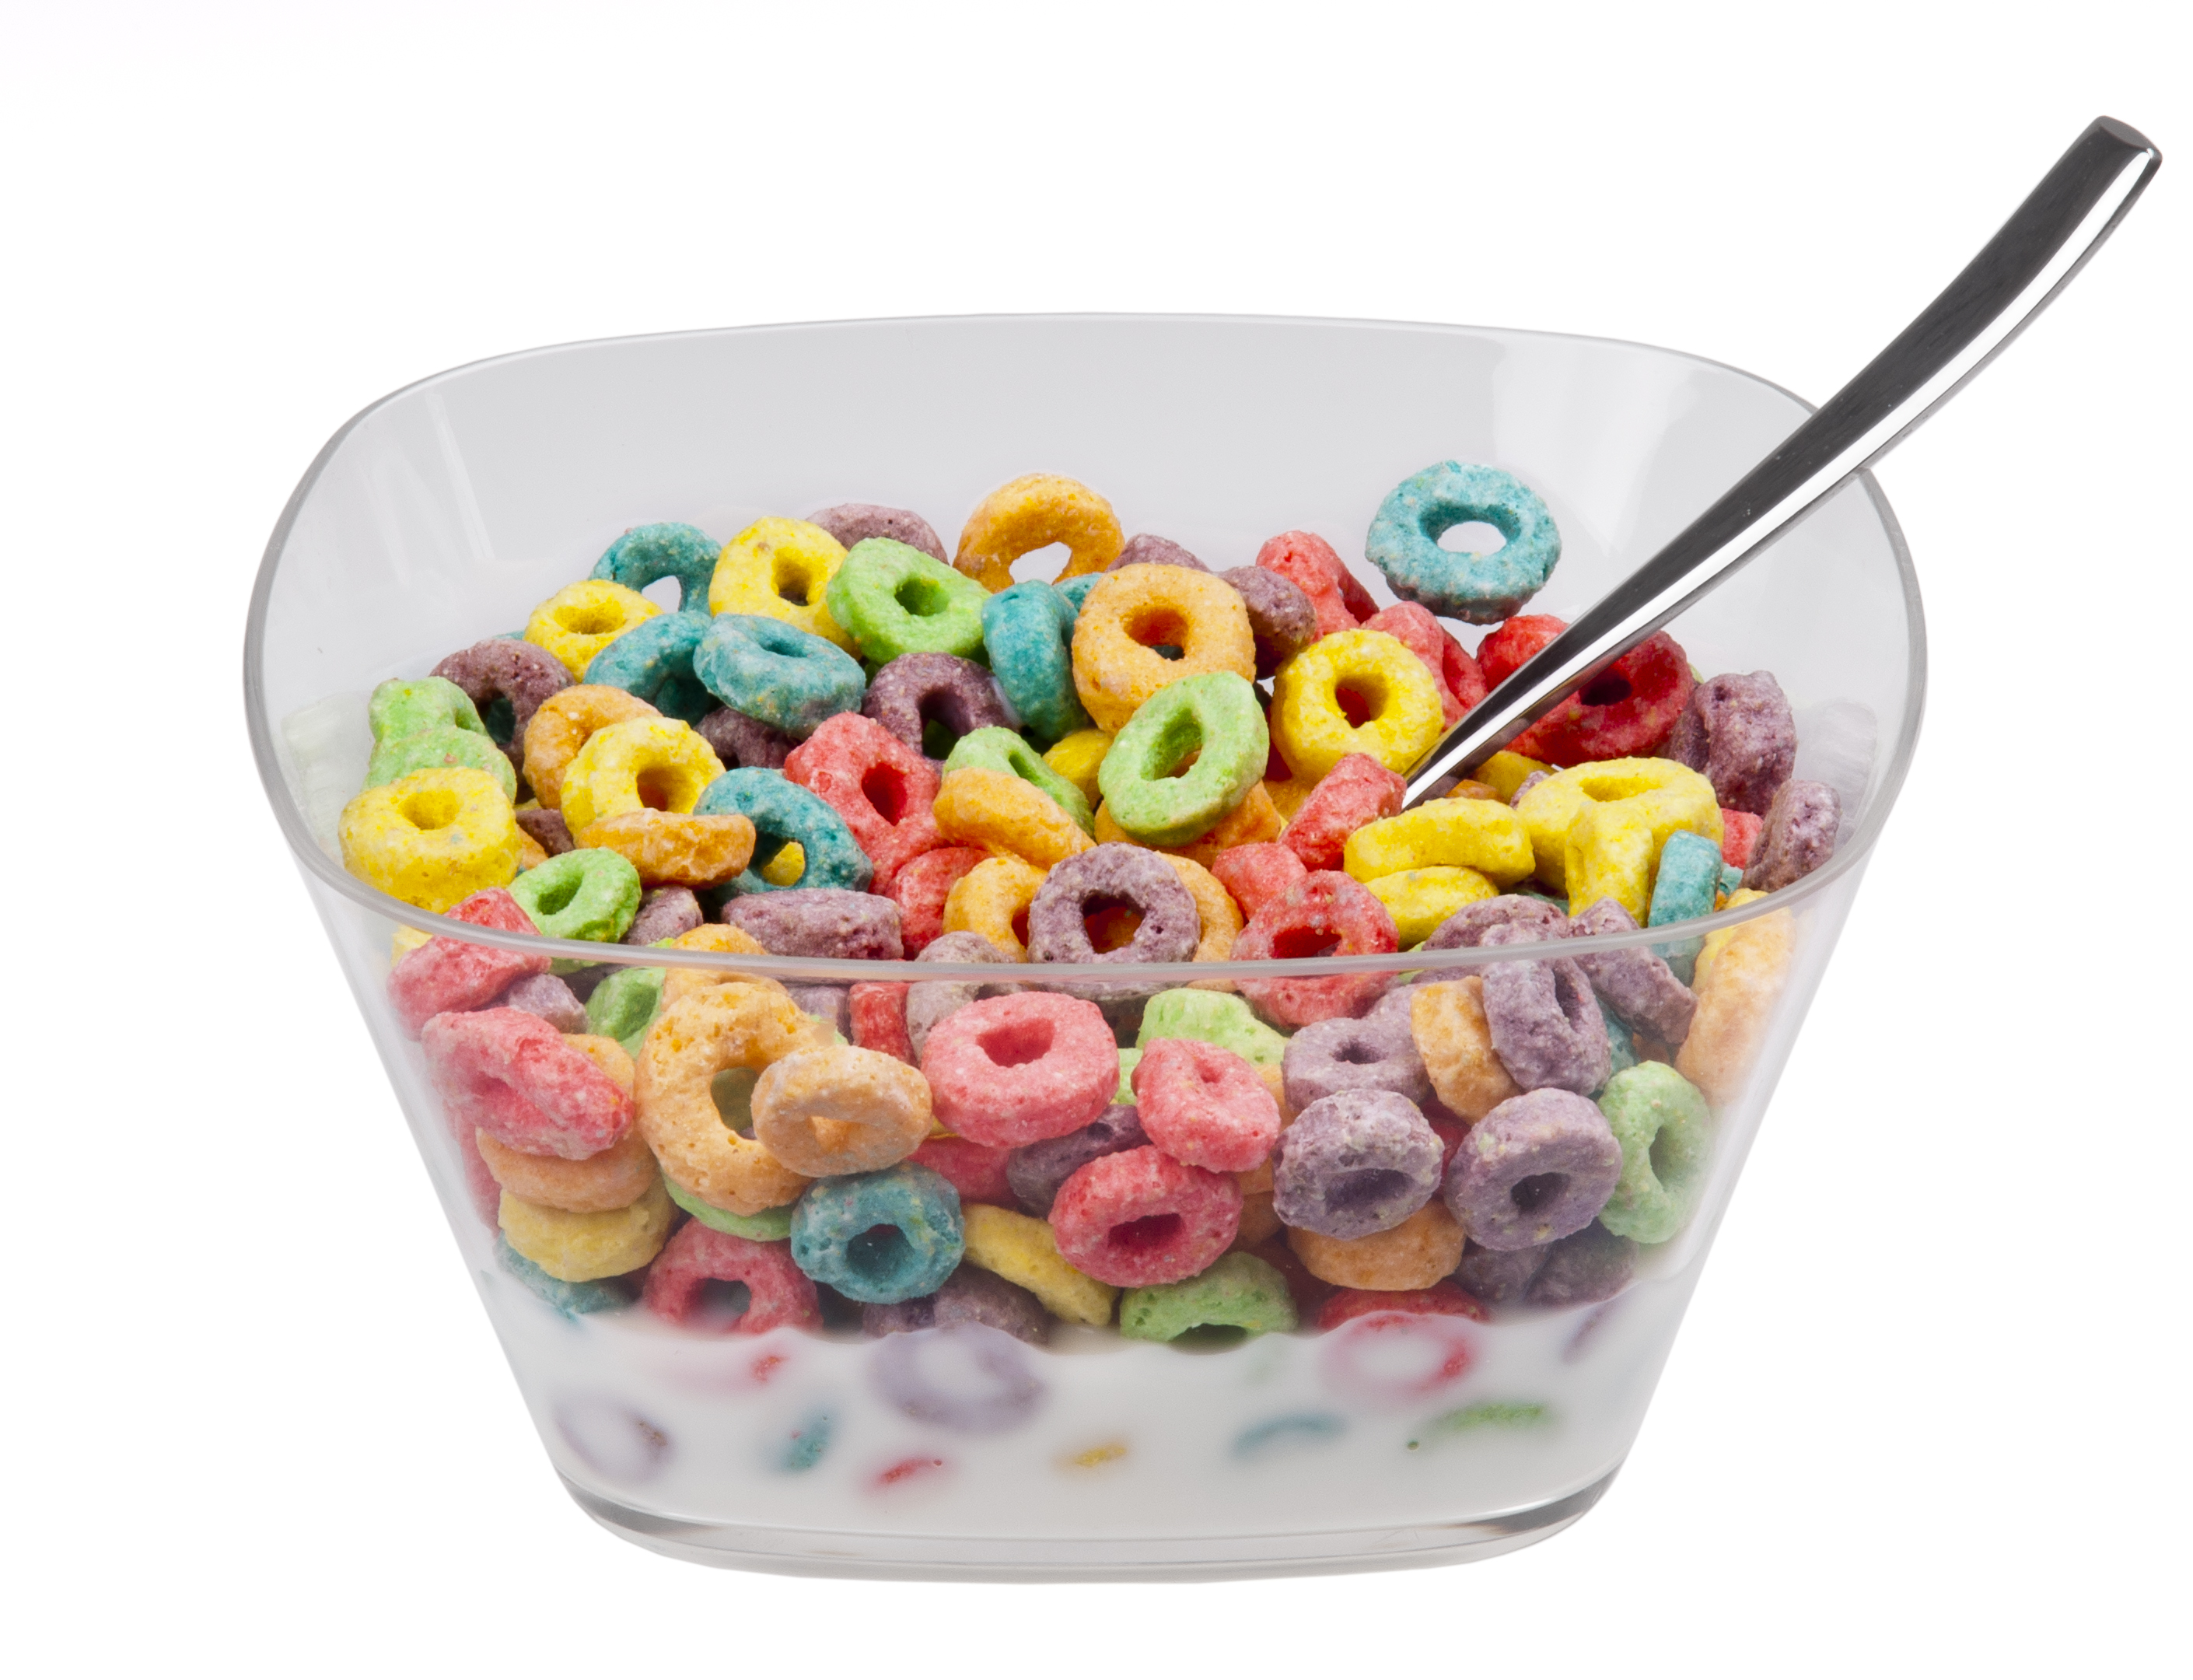
Loops Are Tough to Handle!
Review: Dataflow Analysis
Issues with Loops
Generate lots of paths
Cyclic data dependency

Slide 8
Lecture Outline
Breaking cyclic dependency
Termination
Handling large value sets

Slide 9
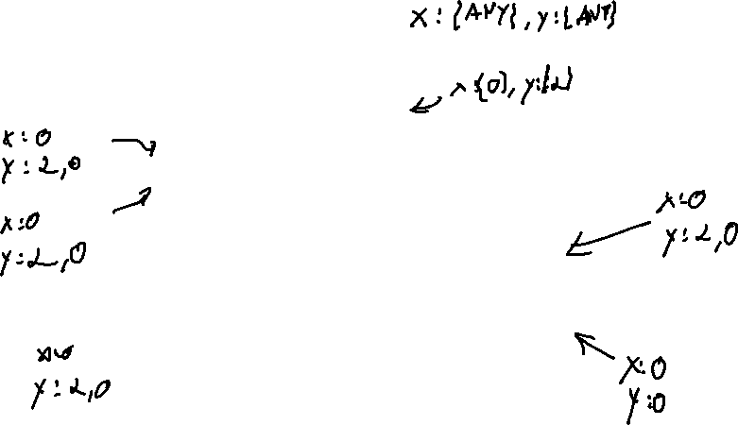
where to Start Analysis?
breaking Cyclic Dependency
1. int x = 0;
2. int y = 2;
1. int x = 0;
2. int y = 2;
3. while (INPUT){
4. x = 1 / y;
5. y = 0;
6. }
7. return;
3. while (INPUT){
true
false
4. x = 1 / y;
5. y = 0;
6. }
7. return;

Slide 10


Chaotic Iteration
Static Analysis: Control Flow Graphs
A Worklist algorithm
Chaotic
Iteration
Select the next worklist item in any order
Necessarily assumes progress towards some goal
Surprisingly, not a band with merch at Hot Topic

Slide 11
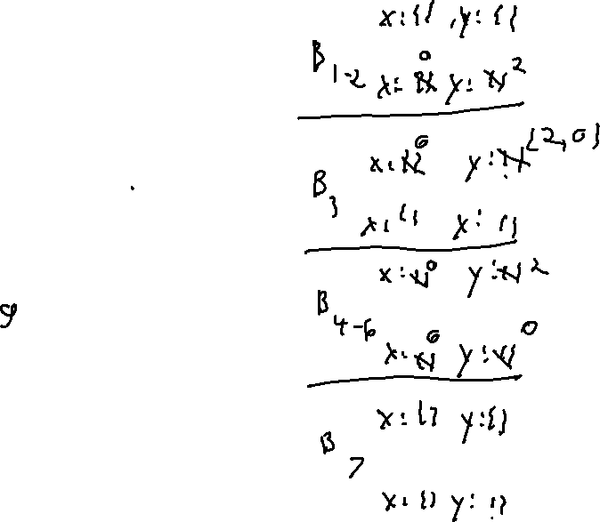
where to Start Analysis?
Static Analysis: Control Flow Graphs
1. int x = 0;
2. int y = 2;
3. while (INPUT){
true
false
4. x = 1 / y;
5. y = 0;
6. }
7. return;

Slide 12
Lecture Outline
Breaking cyclic dependency
Termination
Handling large value sets

Slide 13
where to StOP Analysis?
Static Analysis: Control Flow Graphs
1. int x = 0;
2. int y = 2;
3. while (INPUT){
true
false
4. x = 1 / y;
5. y = 0;
6. }
7. return;

Slide 14

Analysis Progress
Static Analysis: Control Flow Graphs
Analysis Ends when the fact sets reach saturation
No additional elements will ever be added
It sure would be nice if we could guarantee that this will happen!
When your fact sets couldn’t
possibly hold any more data

Slide 15
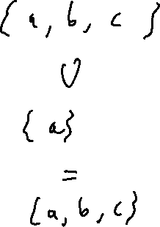
FixED-Points
Static Analysis: Control Flow Graphs
A Fixed-Point (AKA fixpoint, fixed point)
A value that does not change under a given transformation
Our value-set analysis WILL have Facts that reach a Fixed-point
Why?
Finite set of configurations over INT32s
Data transforms only add data to fact sets

Slide 16
Lecture Outline
Breaking cyclic dependency
Termination
Handling large value sets

Slide 17
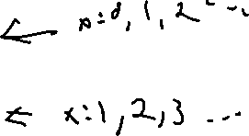
where to StOP THIS Analysis?
Analysis Termination
1. int x = 0;
2. int y = 2;
3. while (INPUT){
true
false
4. x = x++;
5. y = 0;
6. }
7. return y / x;

Slide 18
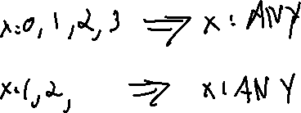
Widening
Analysis Termination
Accelerate progress towards Fix-Point
1. int x = 0;
2. int y = 2;
Lots of (over-approximate) ways to do this
1 simple idea: if we hit N values, immediately change the fact set to “All integers”
3. while (INPUT){
true
false
4. x = x++;
5. y = 0;
6. }
7. return y / x;

Slide 19
Lecture END!
Described some of the issues and Fixes for dataflow in the presence of loops

