Slide 1
Exercise #14
Practical InfoFlow Review
Write your name and answer the following on a piece of paper
Provide an instance of a program with an implicit information flow from a confidential source to a sink

Slide 2
Administrivia and Announcements

Slide 3
Class Progress
Showing some applications of Static Dataflow

Slide 4

Last Time: Dataflow Deployment
Review: Last Lecture
Using Dataflow in practical contexts
- Ex. - Looking for initialized variables

Slide 5
Side Channels
EECS 677: Software Security Evaluation
Drew Davidson

Slide 6
Overview
Contemplate other ways that Sneaky data flows can occur

Slide 7
Lecture Outline
Threat Models
Side Channels - Overview
Timing
A dataflow approach

Slide 8
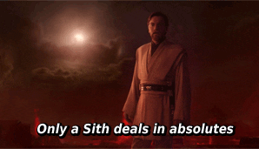
Thinking About Attacks
Threat Models
There’s no such thing as “Absolute Security”
It’s always possible to come up with SOME (potentially wacky) scenario where the adversary can subvert a system
Consider the various attack classes
Denial of Service: Availability is compromised
Exfiltration: Confidentiality policy is compromised
Compromise: Integrity policy is compromised

Slide 9
A Framework for Assumptions
Threat Models
A threat model is composed of:
Adversary Goals: What is the adversary attempting to do?
Adversary Capabilities: What resources can the adversary bring to bear to accomplish their goals?
Security means preventing goals from being accomplished, despite capabilities
Defender Capabilities: What resources MUST be brought to bear to defeat the threat model?

Slide 10
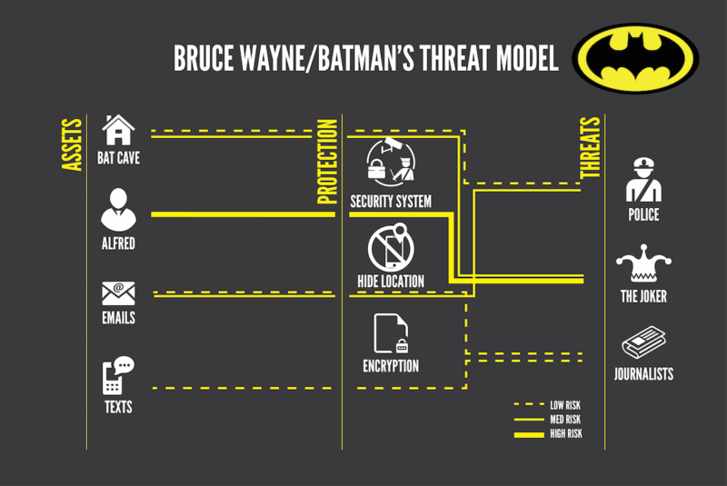
Thinking About Attacks
Threat Models

Slide 11

Lecture Outline
Threat Models
Side Channels - Overview
Timing
A dataflow approach

Slide 12
The Basic Idea of Side Channels
Side Channels
Abstraction is a key principle of Computer Science!
As a programmer, you shouldn’t need to know underlying details
As a security expert, these details might end up being important!
The way a program accomplishes its tasks are important, especially from a security aspect
- How long does it take for the program to do X ?
- How hot does it make the processor when X happens?
- How much power does it draw when X happens?

Slide 13
Side Channels – The Big Idea
Side Channels - Instances
Computation may have effects outside of program semantics
Some operations (internally) take longer based on aspects of the data

Slide 14
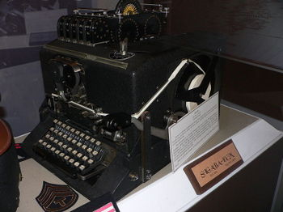
TEMPEST
Side Channels – History
Electromagnetic Leakage of keys
WWII: Bell Telephone discovers electromagnetic leakage in one-time pad teleprinters, detectable at 100-ft radius
1951: CIA rediscovers leakage, detectable at 200-ft radius
1964: TEMPEST shielding protocol established

Slide 15
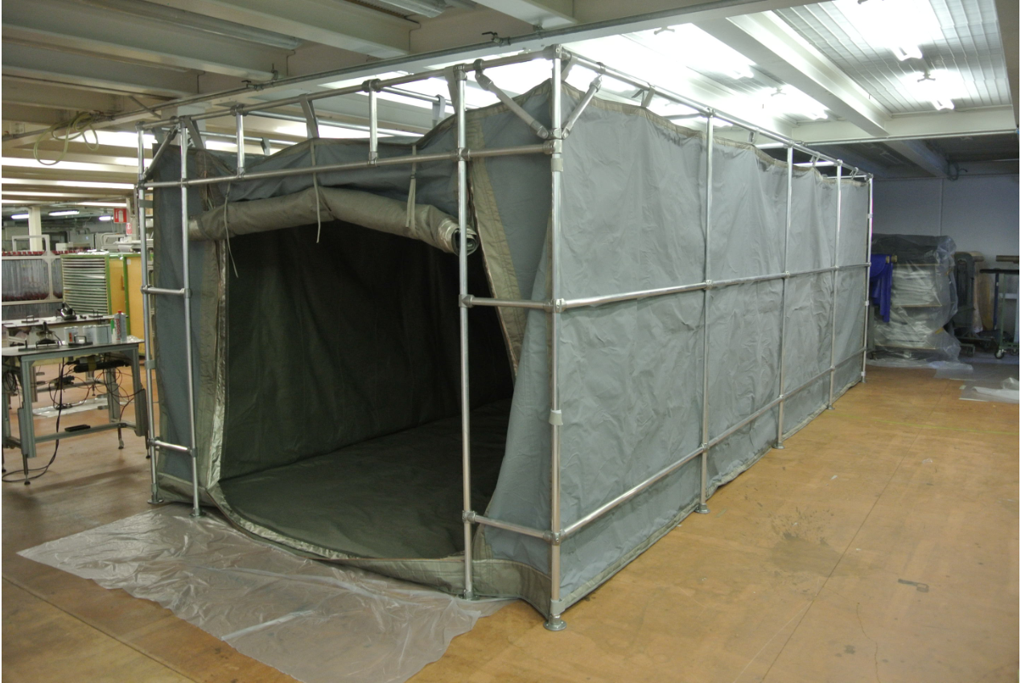
TEMPEST
Side Channels – History
Electromagnetic Leakage of keys
WWII: Bell Telephone discovers electromagnetic leakage in one-time pad teleprinters, detectable at 100-ft radius
1951: CIA rediscovers leakage, detectable at 200-ft radius
1964: TEMPEST shielding protocol established

Slide 16
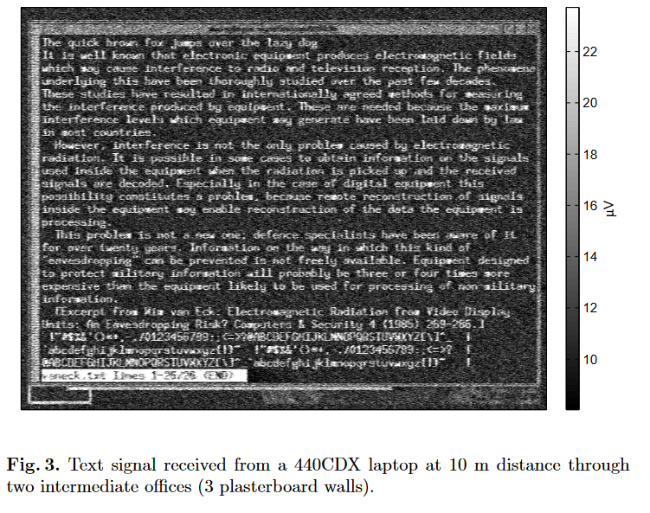
Van Eck Phreaking
Side Channels – History
Electromagnetic Leakage of Monitors
Pick up the monitor’s electromagnetic emanations that differ depending on how the screen lights up
Originally determined for CRT (1985), also discovered for LCD monitors (2004)

Slide 17

Side Channels – Partial Credit
Side Channels - Instances
Even “Hints” about secret data can be problematic
Assume you’re trying to guess a password
– knowing even 1 character massively reduces the search space
– knowing the length of the password reduces the search space

Slide 18
Covert Channels
Side Channels
Sometimes a Program Wants to Leak data
Exfiltration !

Slide 19
Lecture Outline
Threat Models
Side Channels - Overview
Timing
A dataflow approach

Slide 20
Timing Side Channels
Side Channels - Instances
Some computations take longer than others
Some operations (internally) take longer based on aspects of the data
bool checkPW(const char * given){
const char * expected = “12345”;
int len = min(5, strlen(given)); for (int i = 0; i < len, i++){
if (given[i] != expected[i]){
return false;
}
}
return true;
}

Slide 21
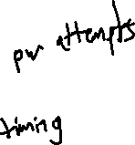
Timing Side Channels
Side Channels - Instances
Some computations take longer than others
Some operations (internally) take longer based on aspects of the data
Threat Model
Interactive, low-latency*, black-box access to the program, precise timer
Program
Adversary
*: May be overcome with more samples

Slide 22
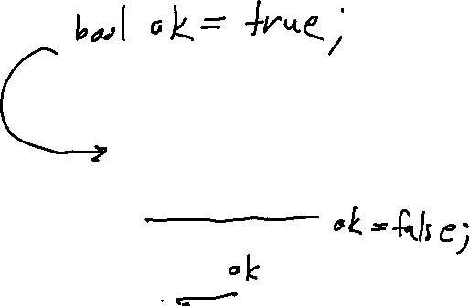
Timing Side Channels - Fix
Side Channels - Instances
bool checkPW(const char * given){
const char * expected = “12345”;
int len = min(5, strlen(given)); for (int i = 0; i < len, i++){
if (given[i] != expected[i]){
return false;
}
}
return true;
}
bool checkPW(const char * given){
const char * expected = “12345”;
int len = min(5, strlen(given)); for (int i = 0; i < len, i++){
if (given[i] != expected[i]){
return false;
}
}
return true;
}

Slide 23
Timing Side Channels - Fix
Side Channels - Instances
Limitations of Uniform Execution
- Necessarily slow down your computation to the worst case
- May require some pretty precise understanding of timing
- May not always be obvious what the worst-case even is

Slide 24
Lecture Outline
Threat Models
Side Channels - Overview
Instances
A dataflow approach

Slide 25
Timing Side Channels - Fix
Side Channels - Instances
Can we fix this issue with our dataflow approach?
- Instruction transformers: how much time that instruction takes
- Block composition: the sum total of instruction times
- Merge operation: some sort of check that all paths are of comparable time?

Slide 26
Wrap-up

