Slide 1
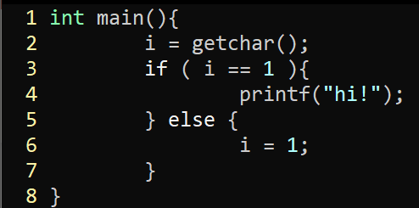
Exercise #22
Dependence Graph Review
Write your name and answer the following on a piece of paper
Draw the Control Dependence Graph for the following program

Slide 2
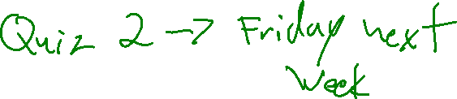
Administrivia and
Announcements

Slide 3
Program Slicing
EECS 677: Software Security Evaluation
Drew Davidson

Slide 4
Class Progress
Exploring Analyses Underlying our Evaluation/enforcement needs
Evaluation / Enforcement: IRM, Data Leakage, CFI
Analysis tools: CFGs, Points-to graphs, Interprocedural techniques
Scaling: CDGs, PDGs

Slide 5

Last Time: Dependence Graphs
Review: Last Lecture
Focus the analysis on what we care about
Control Dependence Graph (CDG)
Shows what program statements depend on each other
Program Dependence Graph (PDG)
A CDG enriched with use/def information

Slide 6
Overview
What we can do with the PDG

Slide 7
The “SUB-Program” Concept
Program Slicing
Big Idea: ignore “Irrelevant” functionality for a particular case
Control Dependence Graph (CDG)
Shows what program statements depend on each other
Program Dependence Graph (PDG)
At minimum: A CDG enriched with data dependence information

Slide 8
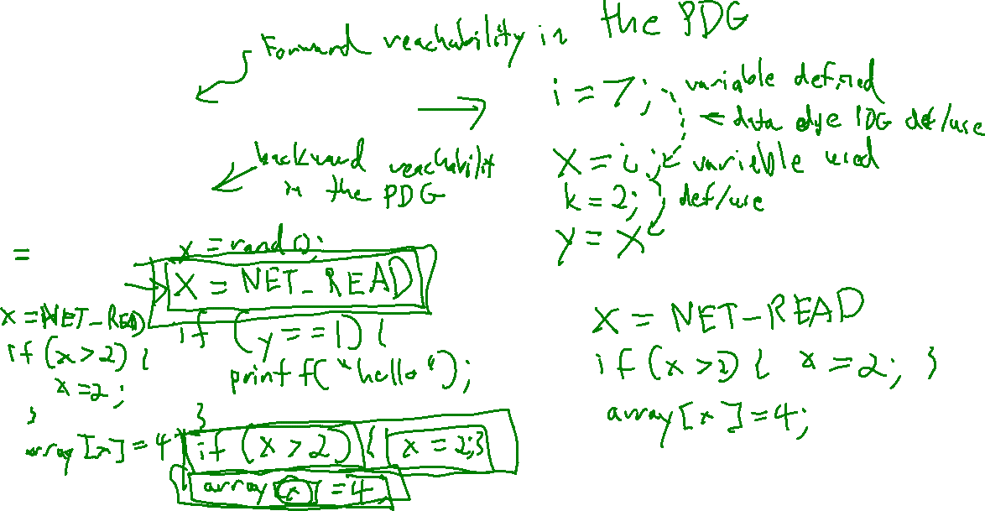
The Slice of the Program
Program Slicing
Forward Slice
Everything influenced by a target statement
Backwards Slice
Everything that influences a target statement

Slide 9
Slice Execution
Program Slicing
Do we need our sliced subprogram to BE Executable?
If so, we may need to include additional instructions

Slide 10
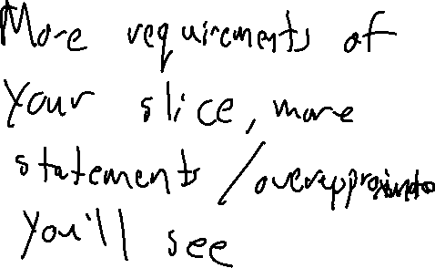
Output dependence
Program Slicing
Do we need our sliced subprogram to perform identically to the original?
If so, we’ll need additional output dependence edges

Slide 11

Slicing Summary
Program Slicing
Static Slicing has some promising applications
It’s not a one-size-fits-all scalability panacea
Any (sound) slicing is likely a benefit!
Some applications Beyond analysis
Automatic parallelization
Software metrics (how big of a change is this refactor?)

Slide 12

Analysis Tools
Switching Gears
We’ve Covered several popular analysis techniques for imperative programming
Let’s talk a bit about their tooling

Slide 13
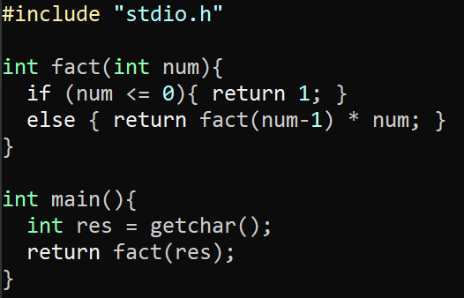
LLVM: Opt
Switching Gears
The LLVM Optimization module
Can formulate analysis and program transformation tasks as “optimization passes”
clang -c -S -emit-llvm factorial.c -o factorial.ll

Slide 14
LLVM: Opt
Switching Gears
The LLVM Optimization module
Can formulate analysis and program transformation tasks as “optimization passes”
clang -c -S -emit-llvm factorial.c -o fact.ll

Slide 15
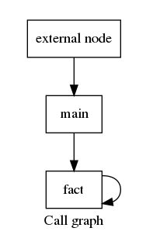
Opt: Callgraph building
Analysis Tools
opt fact.ll –dot-callgraph

Slide 16
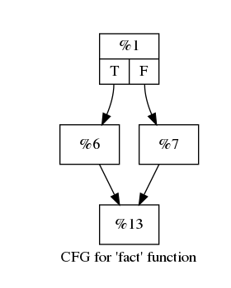
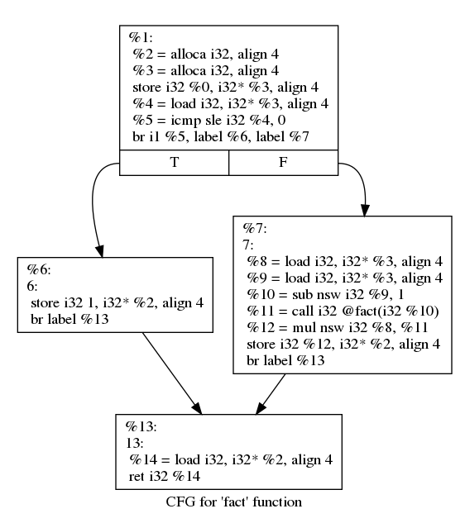
Opt: CFG building
Analysis Tools
opt fact.ll –dot-cfg-only
opt fact.ll –dot-cfg

Slide 17
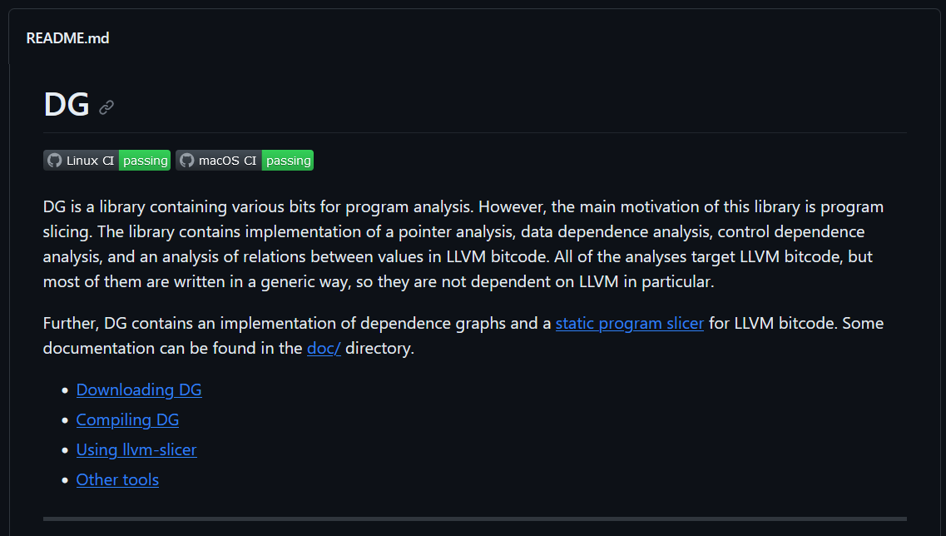
Opt: Static Slicing
Analysis Tools
https://github.com/mchalupa/dg

Slide 18

Module complete
Switching Gears

