Slide 1
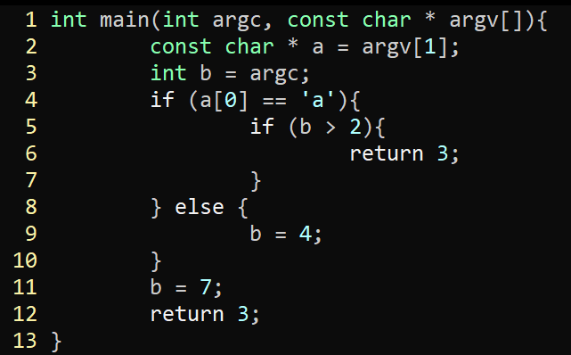
Exercise #23
Program Slicing Review
Write your name and answer the following on a piece of paper
Draw the forward slice from line 2 in following program:

Slide 2

Administrivia and Announcements

Slide 3
SSDLC
EECS 677: Software Security Evaluation
Drew Davidson

Slide 4
Class Progress
We’ve Explored formal techniques to GUARANTEE absence of certain exploits
In practice, these tools are part of a larger discipline of secure software development
We’ll (briefly) explore some of these concepts

Slide 5
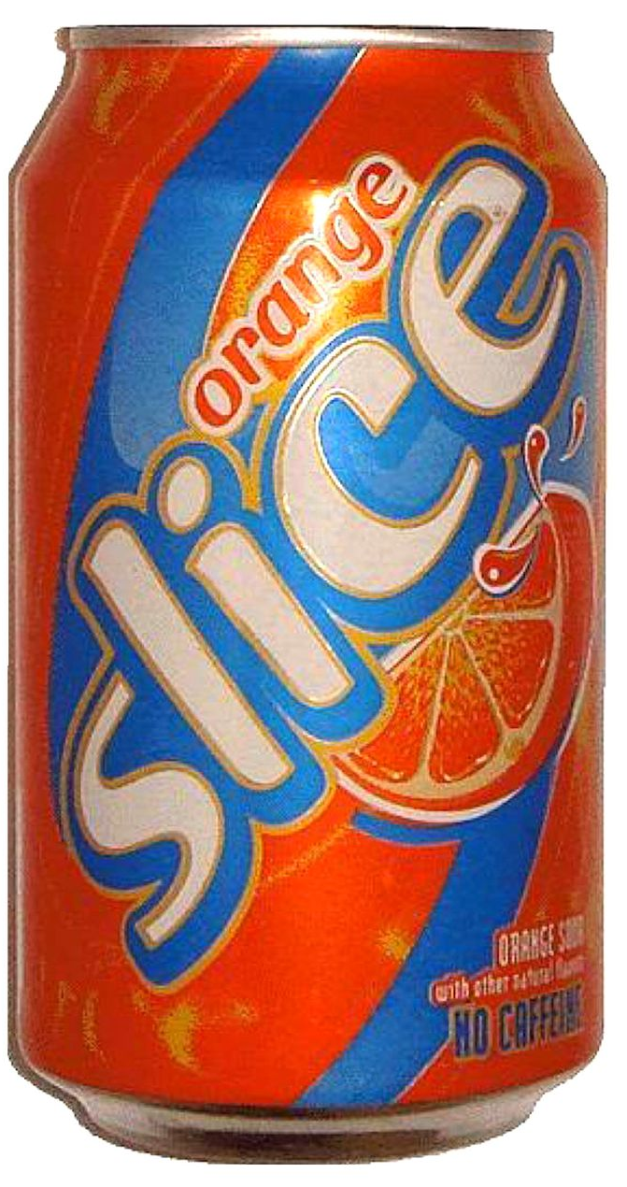
Last Time: Program Slicing
Review: Last Lecture
Extract a sub-program of interest based on one (or more) statements
Forward slice
Capture all code influenced by a given statement
Backwards slide
Capture all code that influences a given statement
program

Slide 6
Overview
We’ve seen the necessity of multi-function analysis in real-world programs
Time to consider how it is done

Slide 7
Lecture Outline
Human Factors of Security
Security as Process
The Secure Software Development Lifecycle

Slide 8

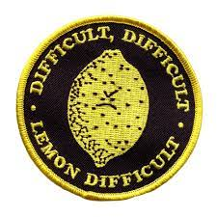

Securing software is hard!
Human Factors of Security
Surprising Threat Models
Security-deficient tooling

Slide 9

Bolt-on security
Lifecycles
Attempting to retrofit a security solution onto a legacy system
Sometimes necessary
Ideally avoided

Slide 10
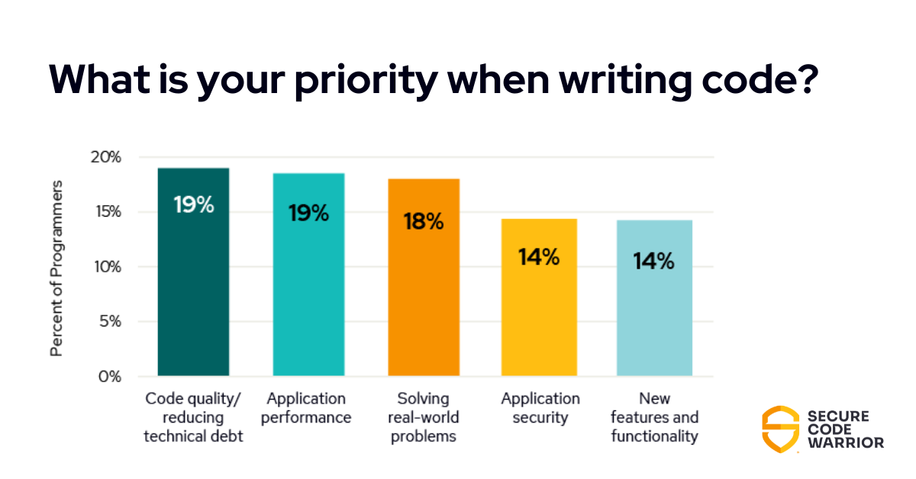
Vulnerabilities in the WilD
Human Factors of Security

Slide 11
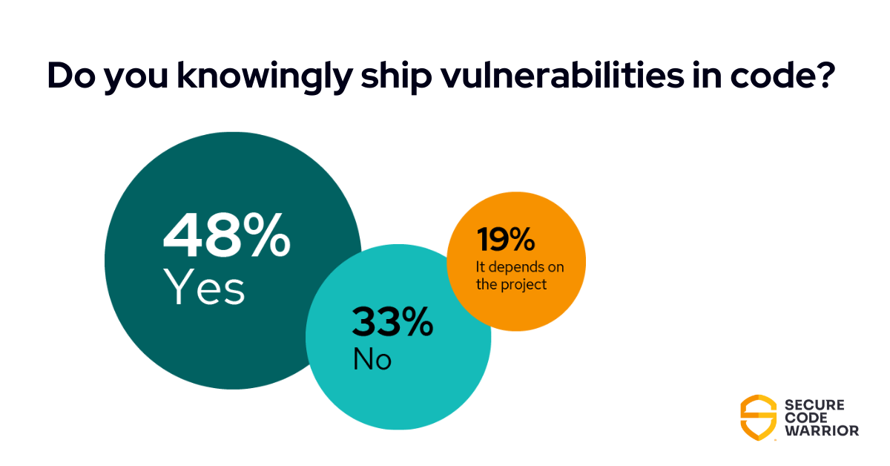
Vulnerabilities in the WilD
Human Factors of Security

Slide 12
Lecture Outline
Human Factors of Security
Security as Process
The Secure Software Development Lifecycle

Slide 13
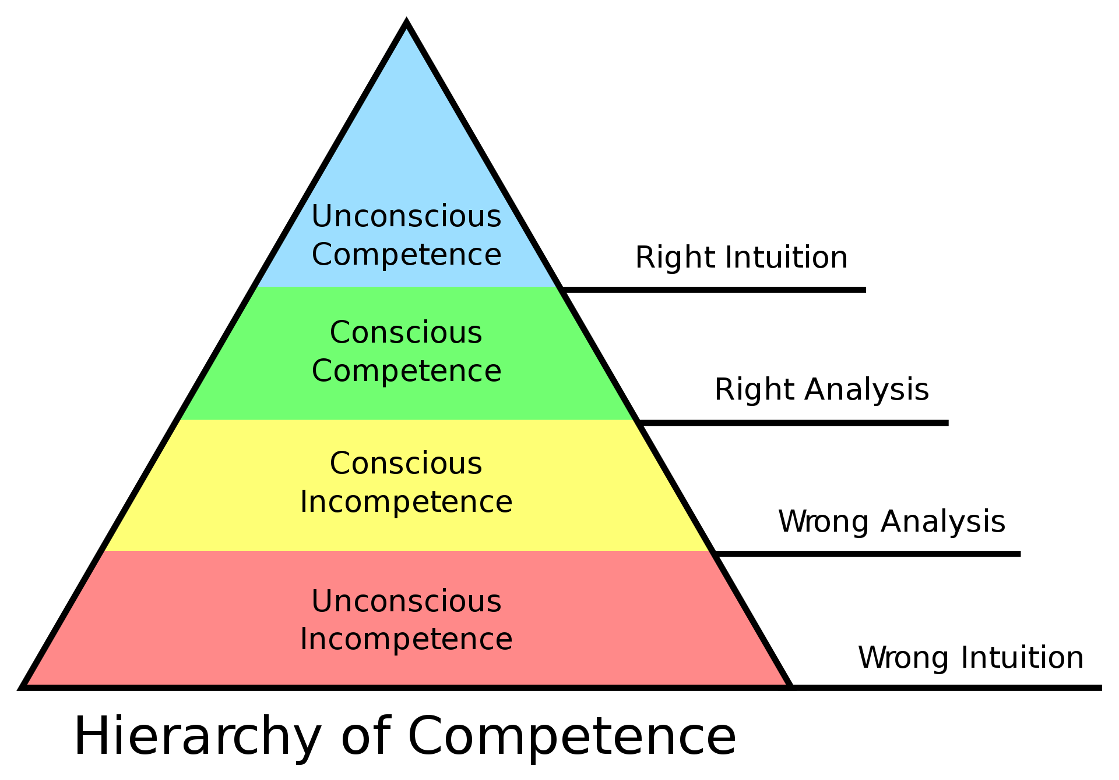
Process is Progress
Security as process

Slide 14
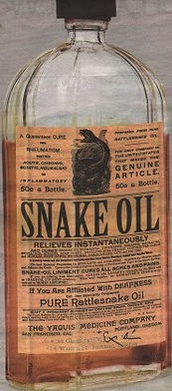
Corporate Snake Oil
Security as Process

Slide 15

Lifecycles

Slide 16

Security vs Usability
Security as Process
A fundamental tension
Occurs within the implementation of software, occurs within the processes guiding software development
Consider what we owe users
Negative externalities

Slide 17
Lecture Outline
Human Factors of Security
Security as Process
The Secure Software Development Lifecycle

Slide 18

The “Regular” SDLC
Lifecycles
Software Development Life Cycle
Requirement analysis
Design
Development
Testing and verification
Deployment
Maintenance and evolution
The circle of (software) life

Slide 19
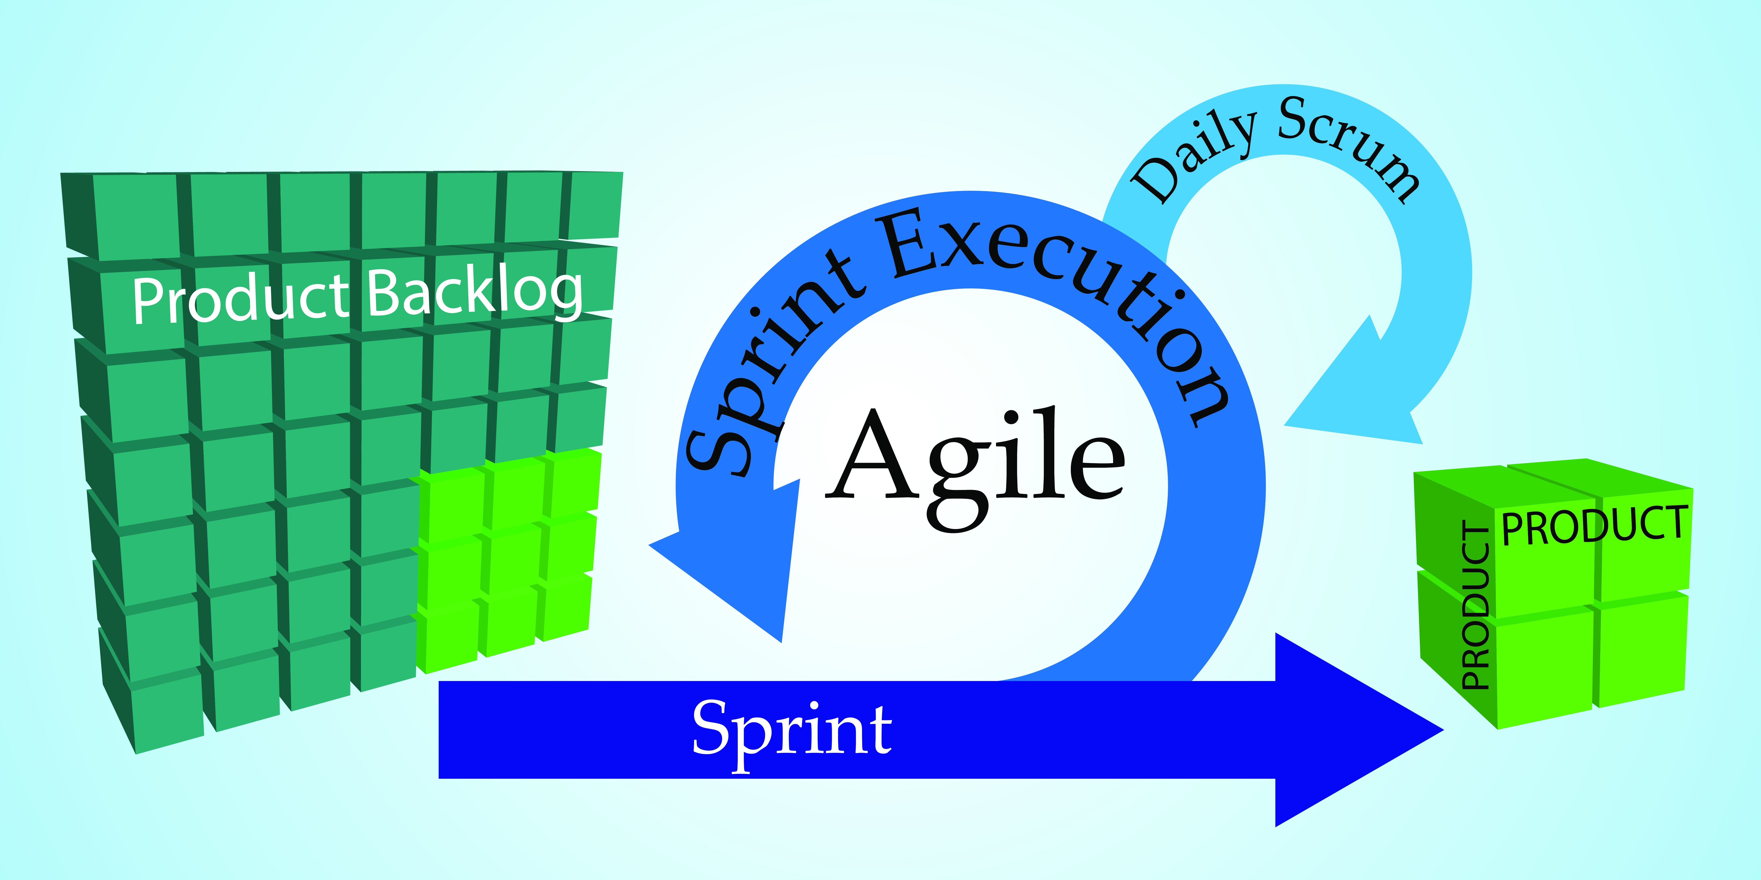
Agile Development
SDLC: Lifecycles

Slide 20
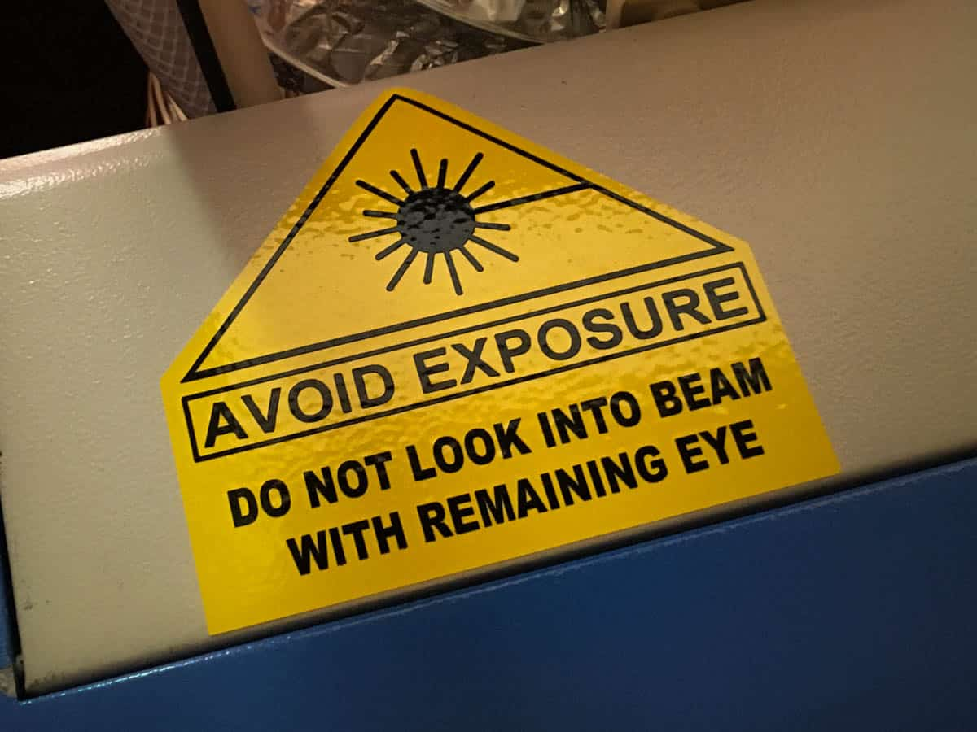
Risk Assessment and threat models
The SSDLC Components
Companion to Requirement Phase
Functional requirement: User must verify their own contact information
Security consideration: Mechanism misuse
- Users may attempt to access the contact information of others
- Users may attempt to subvert the verification mechanism for harassment

Slide 21

Security Design Review
The SSDLC COmponents
Companion to the Design Phase
Functional requirement: Page should retrieve user’s name, email, etc. from customer_info table in database
Security concern: Verify that user has a valid session token before retrieving information from database
Cancel my account
Destroy the database
Consider Security Design Principles
Principle of least privilege: Do entities in the system have exactly the privileges they need?
Bad design for a button panel

Slide 22
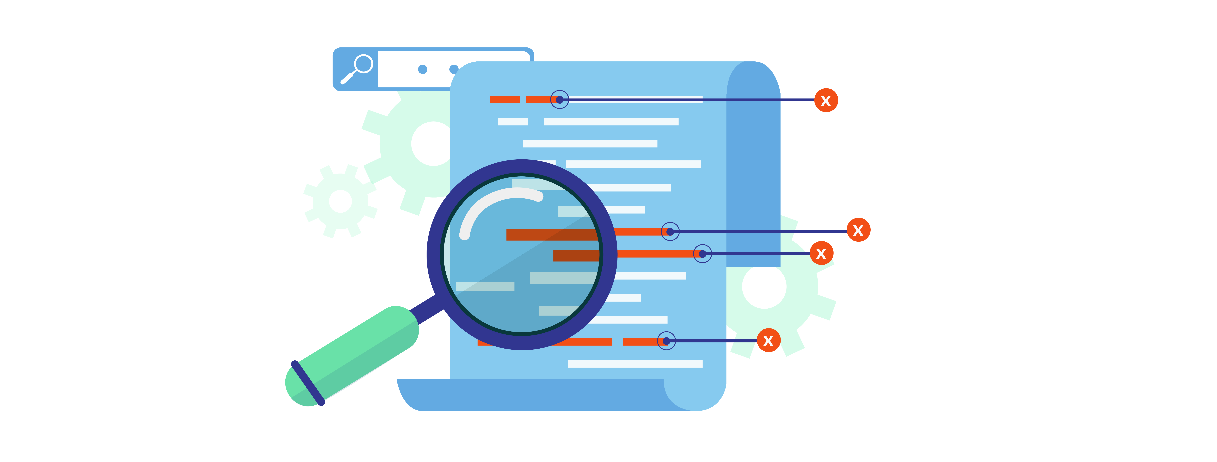
(Automated) Code Analysis
The SSDLC Components
Companion to Development
Apply best practices
- Accessing databases via read-only parameterized queries
- Validating user queries before processing them
- Chaos Engineering
Secure programming
- Assume a function might be misused
- Check arguments for reasonable values
- Canonicalize data

Slide 23

Security Testing And Code Review
The SSDLC Components
Companion to Verification
Ensure proper use of APIs
- Crypto library invocations
- Holistic audits
Test the test suite:
- Evaluate the coverage of your suite
- Ensure treatment of critical functionality
Value automation:
- Repeatability / reproducibility
- Static analysis!
- Monkey testing

Slide 24

Security Assessment And Configuration
The SSDLC Components
Companion to Maintenance and Evolution
Logging – Capture the behavior of the system (expected AND unexpected)
Metrics – Articulate needs of the system, measure expectations against reality
Auditing – Periodic retrospective analysis over codebase and configuration

Slide 25
Wrap-up
Human Factors of Security
Security as Process
The Secure Software Development Lifecycle

Slide 26
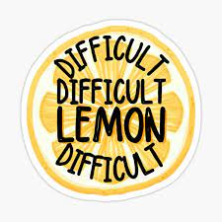


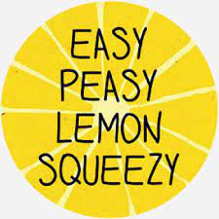
Chaos Monkey
The SSDLC Components

