Slide 1
Exercise #26
Program Instrumentation Review
Write your name and answer the following on a piece of paper
What is the difference between static and dynamic program instrumentation?

Slide 2
Administrivia and
Announcements

Slide 3
Static Instrumentation
EECS 677: Software Security Evaluation
Drew Davidson

Slide 4
Where We’re At
Exploring Program Instrumentation
An approach to dynamic analysis

Slide 5
Previously: Program Instrumentation
Review: Last Lecture
Inserting measurement probes into a program
Notable analysis tools
Lint – The original analysis tool
Splint – Security analysis tool

Slide 6
This Lesson: Static Instrumentation
Review: Last Lecture
Inserting measurement probes into a program Before it is run
More closely associated with proactive software evaluation – (why?)

Slide 7
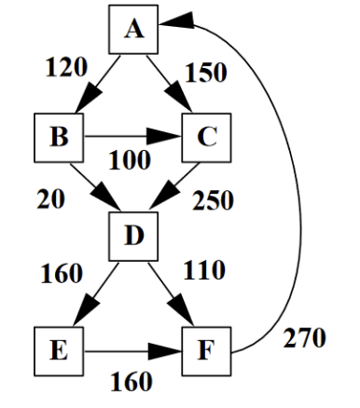
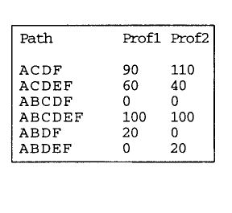
Path Frequency
Review: The Problem

Slide 8
Static Instrumentation Tools
Program Instrumentation: Approach
Often built right into compiler
LLVM Coverage tools
GCC Coverage tools
Sometimes built upon optimizer
Google’s closure compiler
https://github.com/google/closure-compiler

Slide 9
Example: LLVM Coverage Instrumentation
Program Instrumentation: Approach
Big Idea: Inject Basic Block Counters
LLVM Coverage tools

Slide 10
Example: LLVM Coverage Instrumentation
Program Instrumentation: Approach
Let’s take it to the terminal!

Slide 11
Custom Instrumentation
Program Instrumentation: Approach
The Previous Example took advantage of pre-existing instrumentation
What if we wanted to make our own custom instrumentation?

Slide 12
Custom Instrumentation
Program Instrumentation: Approach
Getting started
1) Reference the LLVM API
2) Build our own (trivial) analysis pass
3) Hook into the LLVM opt infrastructure
4) Run our analysis pass
Going Further
Insert more full-featured functionality
(https://llvm.org/doxygen/classllvm_1_1IRBuilder.html)

Slide 13
Tutorial: Custom LLVM Instrumentation
Program Instrumentation: Approach
Let’s take it to the terminal!

Slide 14
Wrap-up
We’ve Described 2 forms of altering the Program
More heuristic by nature

