Slide 1
ExerCise #4
Dynamic Analysis Review
Write your name and answer the following on a piece of paper
Give a function and multiple input sets that collectively exercise 100% branch coverage on that function but less than 100% path coverage

Slide 2
Static Analysis
EECS 677: Software Security Evaluation
Drew Davidson

Slide 3
Administrivia and
Announcements
Quiz dates are now posted
Quiz 1 is NEXT FRIDAY (in class)

Slide 4

Last Time: Dynamic Analysis
Review: Dynamic Analysis
High-Level Overview of a classic auditing technique: testing
Try the program, see what happens!
A sound analysis: if you saw it, it happened
Challenge: exercising all behavior

Slide 5
Lecture Outline
Static Analysis
Control Flow Graph

Slide 6
Beyond Testing
Intro: Static ANalysis
What if we didn’t have to “guess” at an input?
Extract the “rules” of the program
Examine the effect of the program without providing explicit values

Slide 7
Some Forms of STATIC Analysis
CATEGORIZING ANALYSES
Syntax Analysis
Model Checking
Dataflow Analysis

Slide 8
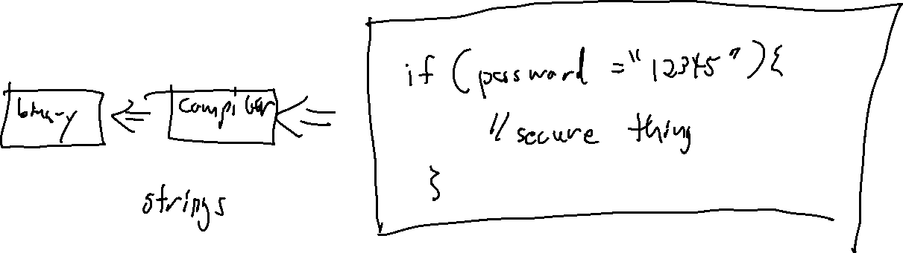
Syntax Analysis
OverView: Static Analysis
Some troubling behavior of a program may be discoverable via simply observing syntactic structure

Slide 9
Model Checking
OverView: Static Analysis
Extract a (finite) state system that approximates the analysis target
Example:
States: configuration of the system
Edges: transitions within the system
Check if the system can violate some correctness property
Each state indicates the value of a memory bit

Slide 10

Model Checking
Static Analysis - Model Checking
State space
(artist’s rendition)
State space explosion!

Slide 11
(Symbolic) Model Checking
Static Analysis – Model Checking
Extract a (finite) state system that approximates the analysis target
States: configurations of the system
Edges: transitions within the system
Check if the system can violate some correctness property
Each state indicates a set of values
or the truth of some abstract predicate

Slide 12
CEGAR
Static Analysis – Model Checking
Counterexample-guided abstraction refinement
Begin with a coarse, over-approximate abstraction of the system
Check system correctness
If a violation is reported, verify it!
  If its a true positive – report it
  If it’s a false positive – refine the model to exclude it and check the new model

Slide 13
DataFLOW Analysis
OverView: Static ANalysis
Capture the effect of each statement on the program’s data
Compose the statements together to determine the aggregate effect of the program

Slide 14
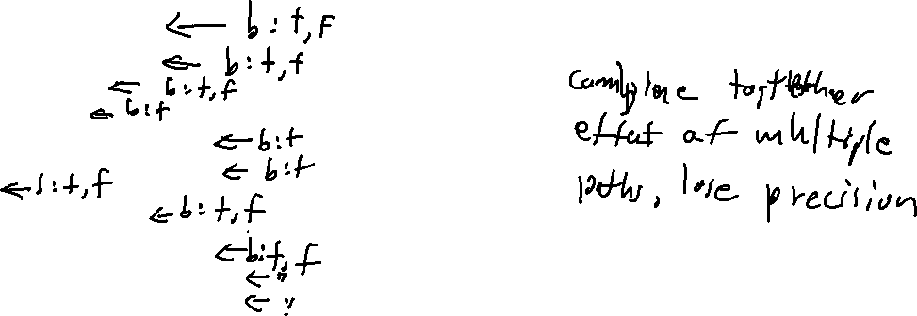
Analysis SPecificity
Static Analysis: Dataflow
int f(bool b) {
Obj * o = null;
int v = 2;
if (b) {
o = new Obj ();
v = rand_int();
}
if (v == 2){
o->setInvalid()
}
return o->property();
}
Flow Sensitive

Slide 15
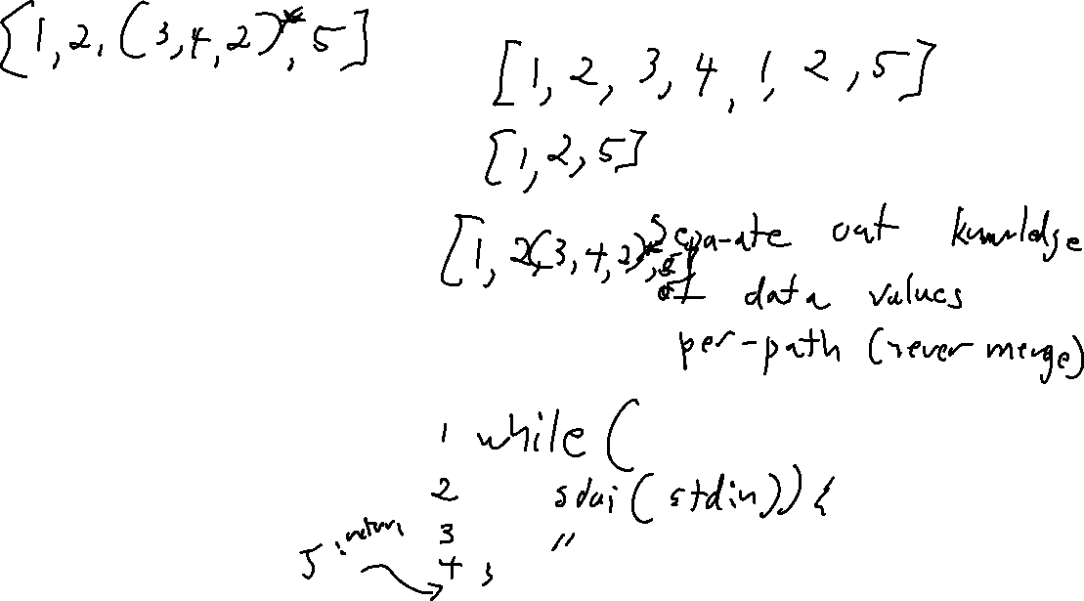
Analysis SPecificity
Static Analysis: DataFlow
int f(bool b) {
Obj * o = null;
int v = 2;
if (b) {
o = new Obj ();
v = rand_int();
}
if (v == 2){
o->setInvalid()
}
return o->property();
}
Path Sensitive

Slide 16
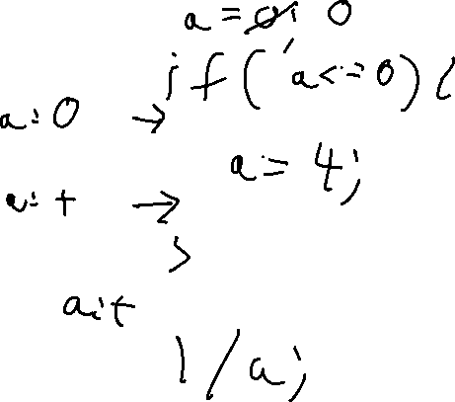
Abstract Interpretation
Categorizing Analyses
(Over)approximate the state of the program
(Over)approximate the domain of values

Slide 17
Abstract Interpretation
Categorizing Analyses
(Over)approximate the state of the program
(Over)approximate the domain of values
Anything that isn’t crystal clear to a static analysis tool probably isn’t clear to your fellow programmers, either. The classic hacker disdain for “bondage and discipline languages” is short-sighted – the needs of large, long-lived, multi-programmer projects are just different than the quick work you do for yourself
- John Carmack

Slide 18
Overview Done!
Categorizing Analyses
We’ll cover many of these techniques (and more!)
Next up:
Start looking at toolsets to build our analyses
Looking at the kinds of program flaws that can cause problems

Slide 19
Lecture Outline
Static Analysis Overveiw
Control Flow Graphs

Slide 20
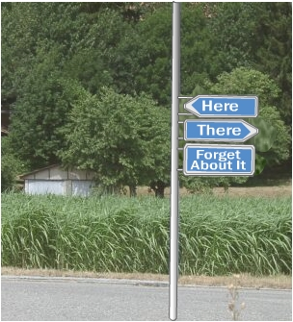
Control Flow Graphs
Static Analysis: Control Flow Graphs
Program analysis relies heavily on two questions
(How) can we get to a particular program point?
What is the program configuration at a given point?
Helpful to structure program instructions as a graph
Visualize transfer of control
Avail ourselves of graph analyses (e.g. reachabilty)

Slide 21
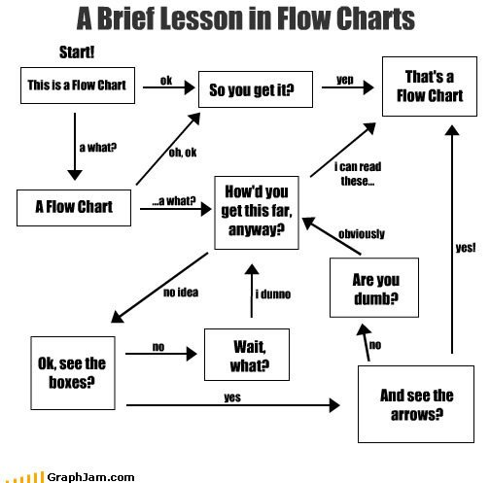
FlowCharts
Static Analysis: Control Flow Graphs
Notation
Nodes are instructions
Edges go to successor nodes under appropriate condition
Operation
Execute current instruction
Proceed to the right successor

Slide 22
CODE FlowCharts
Static Analysis: Control Flow Graphs
Notation
Nodes are instructions
Edges go to successor nodes under appropriate condition
Operation
Execute current instruction
Proceed to the right successor
source code
Instruction Flowgraph
a = 7;
if (a < 4){
a = 7;
}
a += 2;
a = 7
a < 4
true
false
a = 7
a += 2

Slide 23
FlowCharts: Visualizing Control
Static Analysis: Control Flow Graphs
void funk(int a, int b){
if (a < b){
if (a < 10){
a = a + b;
}
}
if (b < 3){
a = 1;
}
return;
}
if a < b
if a < 10
a = a + b
if b < 3
a = 1
return

Slide 24
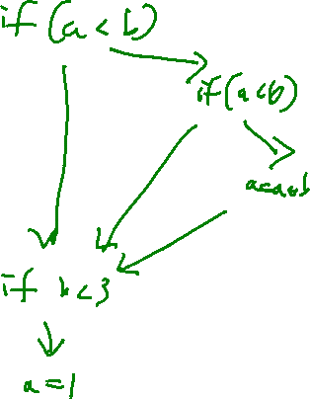
FlowCharts: Visualizing Control
Static Analysis: Control Flow Graphs
void funk(int a, int b){
if (a < b){
if (a < 10){
a = a + b;
}
}
if (b < 3){
a = 1;
}
return;
}
if a < b
if a < 10
a = a + b
if b < 3
a = 1
return

Slide 25

FlowCharts: A Useful TOOL
Static Analysis: Control Flow Graphs
Maybe this is how you learned to think about code!
It’s a nice way to visualize the control flow of the program
We can extend this intuition for program analysis
Analysis

Slide 26

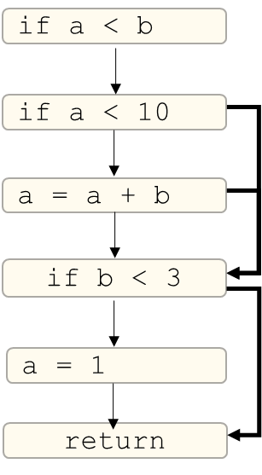
Compacting The Flow Chart
Static Analysis: Control Flow Graphs
From Flowcharts to Control Flow Graphs
This graph is needlessly verbose
Too many nodes that communicate nothing
Fwhat if we Eliminate the 1 instruction per Node Constraint?
Attempt to use as few edges as possible

Slide 27


Basic Blocks
Static Analysis: Control Flow Graphs
Definition: Sequence of instructions guaranteed to execute without interruption

Slide 28


Basic Blocks Boundaries
Static Analysis: Control Flow Graphs
Two Distinguished Instructions in a Block (may be the same Instruction)
Leader: An instruction that begins the block
Terminator: An instruction that ends the block

Slide 29
Basic Blocks Boundaries
Static Analysis: Control Flow Graphs
Two Distinguished Instructions in a Block (may be the same Instruction)
Leader: An instruction that begins the block
The first instruction in the procedure
The target of a jump
The instruction after an terminator
Terminator: An instruction that ends the block
The last instruction of the procedure
A jump (ifz, goto)
A call (We’ll use a special LINK edge)

Slide 30
Lecture END!
Static Analysis
Control Flow Graphs

Slide 31
Next TiME
Explore the USE of the Control flow graph for FINDING vulnerabilities
Show additional program abstractions TO simplify Analysis, in particular SSA Form

