Slide 1
Exercise #35
Bug Isolation Review
Write your name and answer the following on a piece of paper
Cooperative Bug Isolation (CBI) avoids the use of a periodic global counter to report bugs. It also avoids the use of a random test at each report point. Why?

Slide 2
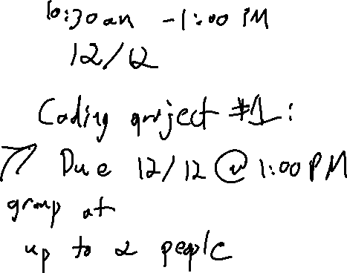
Administrivia and Announcements

Slide 3
Supply Chain Security
EECS 677: Software Security Evaluation
Drew Davidson

Slide 4
Where We’re At
Grab-bag topics!

Slide 5

Previously: Bug Isolation
Last Lecture Review
Isolating Cause-Effect Chains in program misbehavior
Why we isolate bugs
How we isolate bugs
Bug

Slide 6
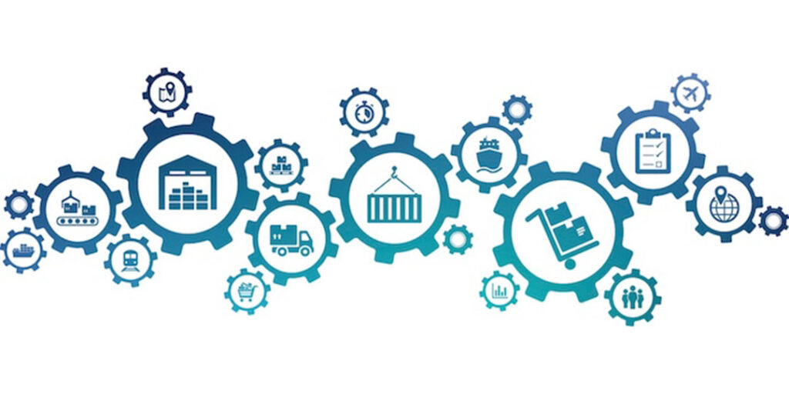
This lecture
Bug Isolation
Software Supply Chain Security
Supply chain overview
Threats
Defenses

Slide 7
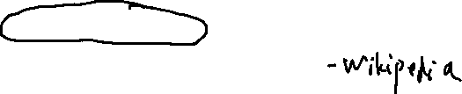
What is A Software Supply Chain?
Software Supply Chains: Overview
Definition
The components, libraries, tools, and processes used to develop, build, and publish a software artifact.
Related Terminology
(somewhat inspired by traditional supply chains)
Software Bill of Materials (SBOM) – A declaration of the the inventory of components used to build a software artifact

Slide 8
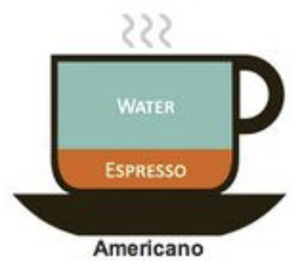
Software Supply Chain - Impact
Software Supply Chains: Overview
3rd party-code
65 – 95%
Your code
5 – 35%

Slide 9
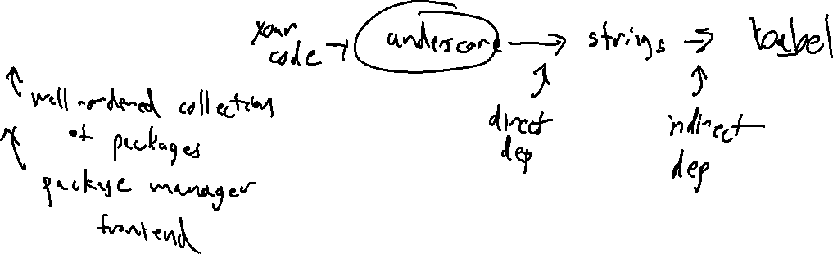
Modern software Ecosystems
Software Supply Chains: Overview
LBEs (Language-Based ecosystems)
The enabling infrastructure for delivering software supply chains
- Packages
- Dependencies
- Repositories

Slide 10
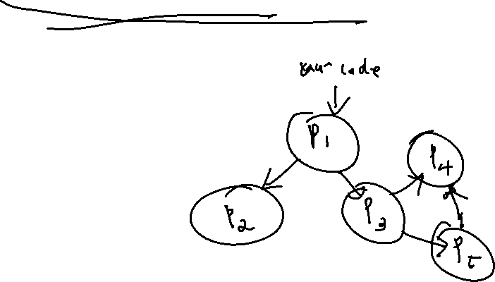
Dependency webs
Software Supply Chains: Overview
Dependencies… have Dependencies!
The components, libraries, tools, and processes used to develop, build, and publish a software artifact.

Slide 11
Package Managers Frontends
Software Supply Chains: Overview
Vastly simplify the task of dependency management
Finding, fetching and installing the dependency web

Slide 12

Benign-model Challenges
Software Supply Chains: Threats
Even lacking malicious intent, Supply chain security challenges arise
The components, libraries, tools, and processes used to develop, build, and publish a software artifact.
Software rot – The world changes, software needs to change with it
Incompatibilities – A dependency might change

Slide 13

Who uploads packages?
Software Supply Chains: Threats
Anybody!
Most package repositories are completely free to use
Allow pseudonymous identification

Slide 14
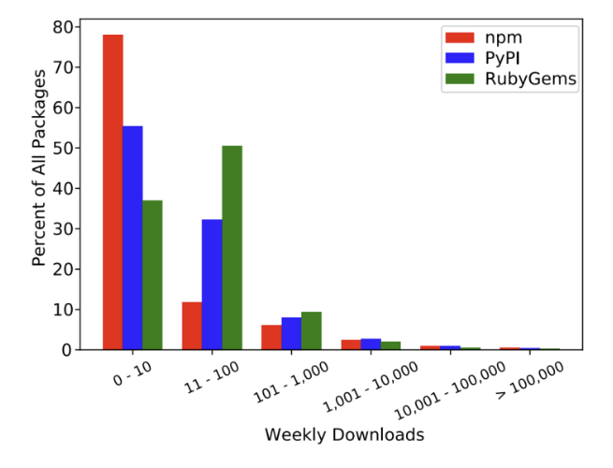

The Sea of Garbage
Software Supply Chains: Threats
Most packages are never installed

Slide 15
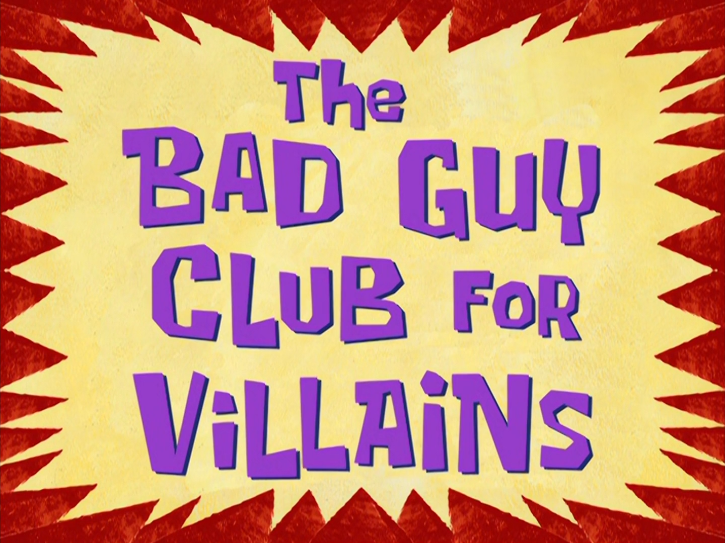
Malicious-model Challenges
Software Supply Chains: Threats
Anybody can upload… despite their intent
Very little vetting on whether the package is ok

Slide 16
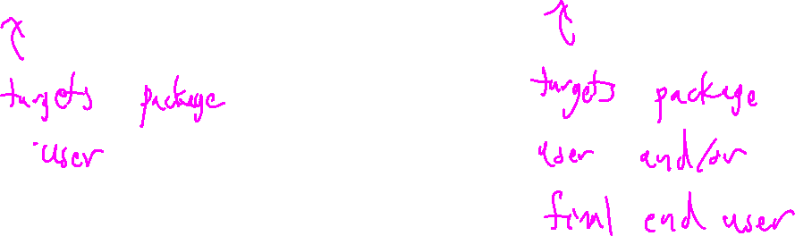
Threat vectors
Software Supply Chains: Threats
Install-time attacks
run-time attacks
Insert bad code that impacts your installation
Insert bad code that impacts your users

Slide 17
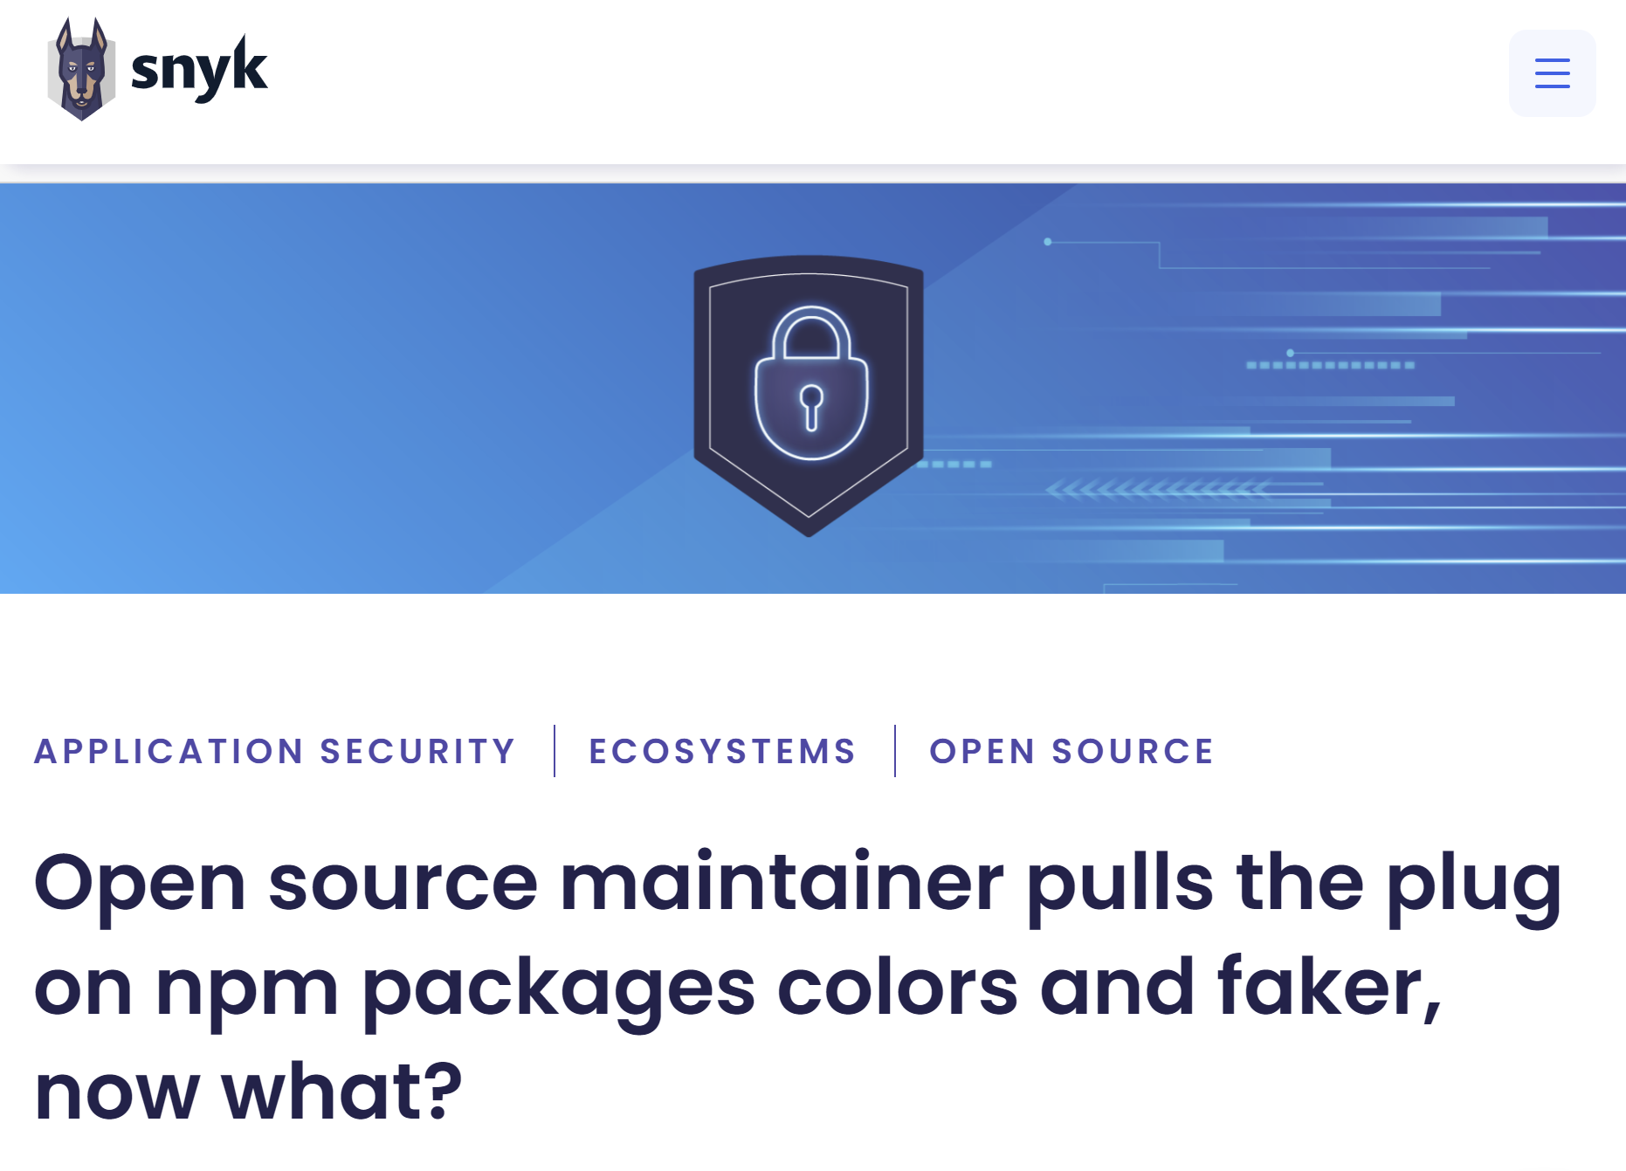
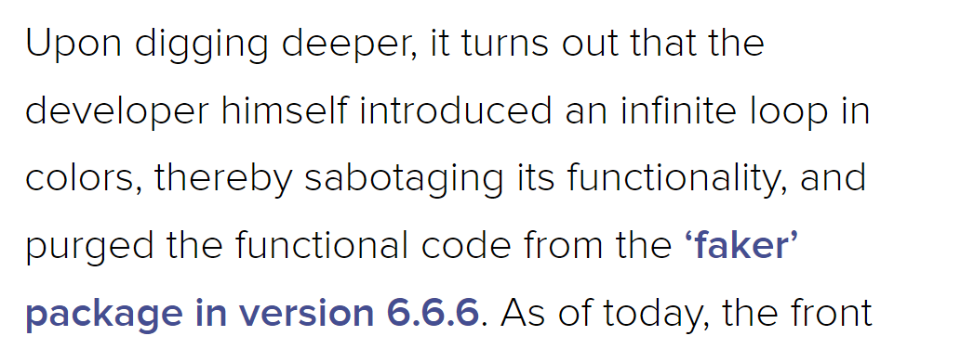
Protestware
Software Supply Chains: Threats

Slide 18
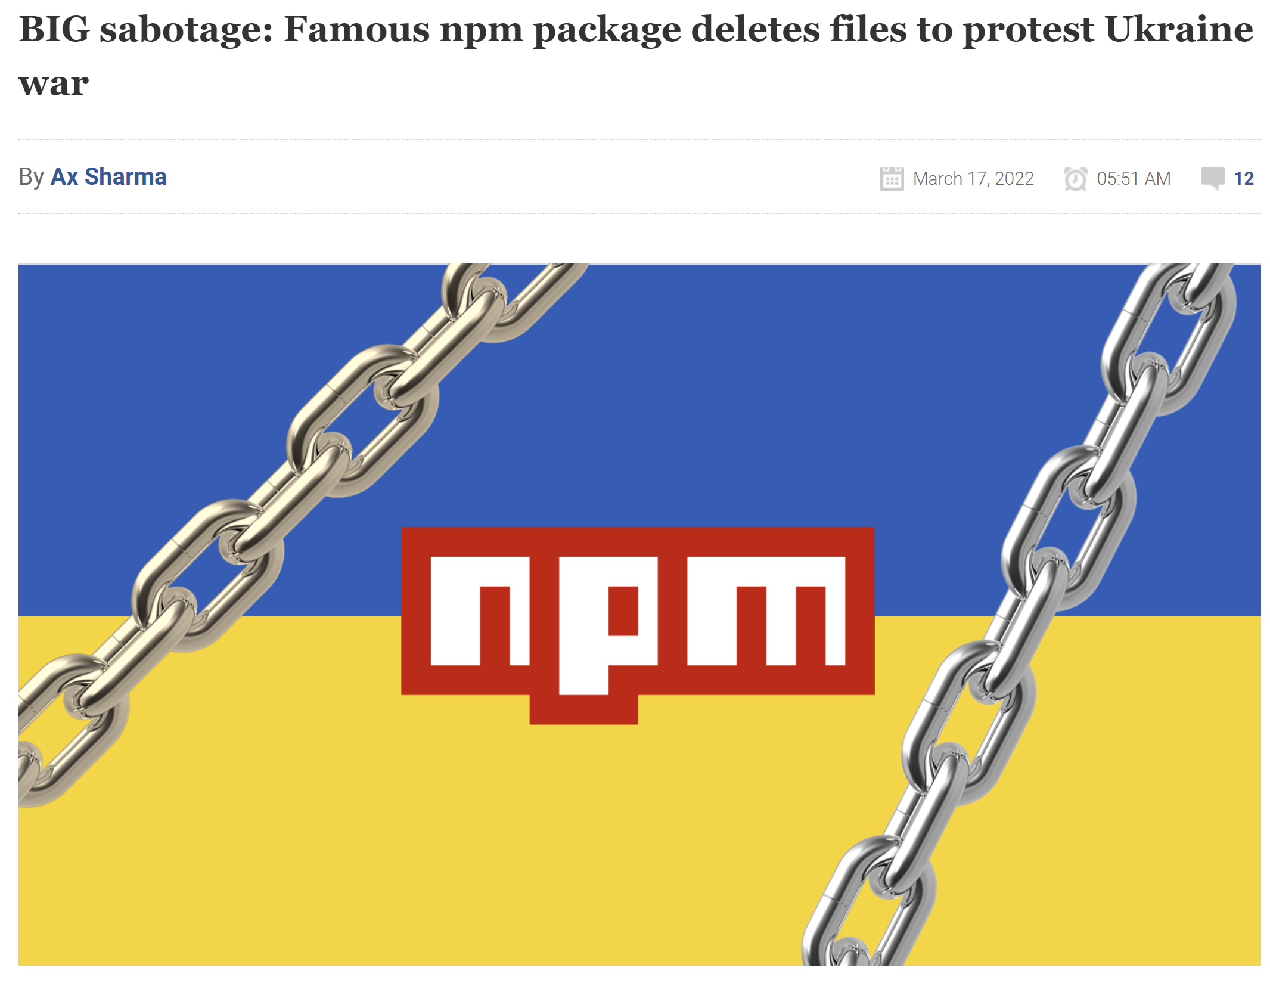
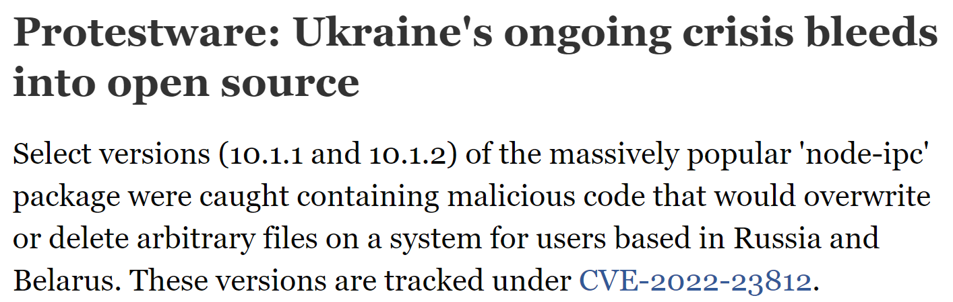
Protestware
Software Supply Chains: Threats

Slide 19
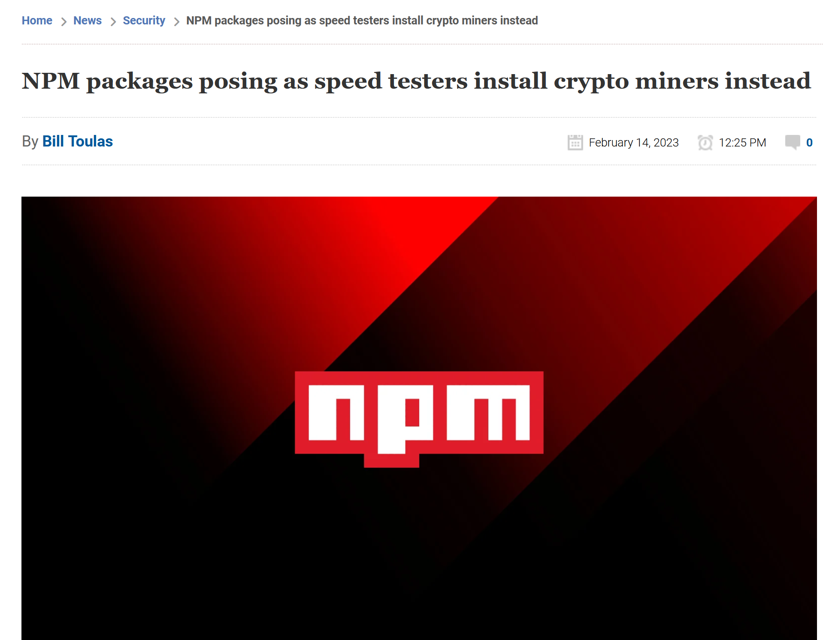
Malware / Spyware
Software Supply Chains: Threats

Slide 20
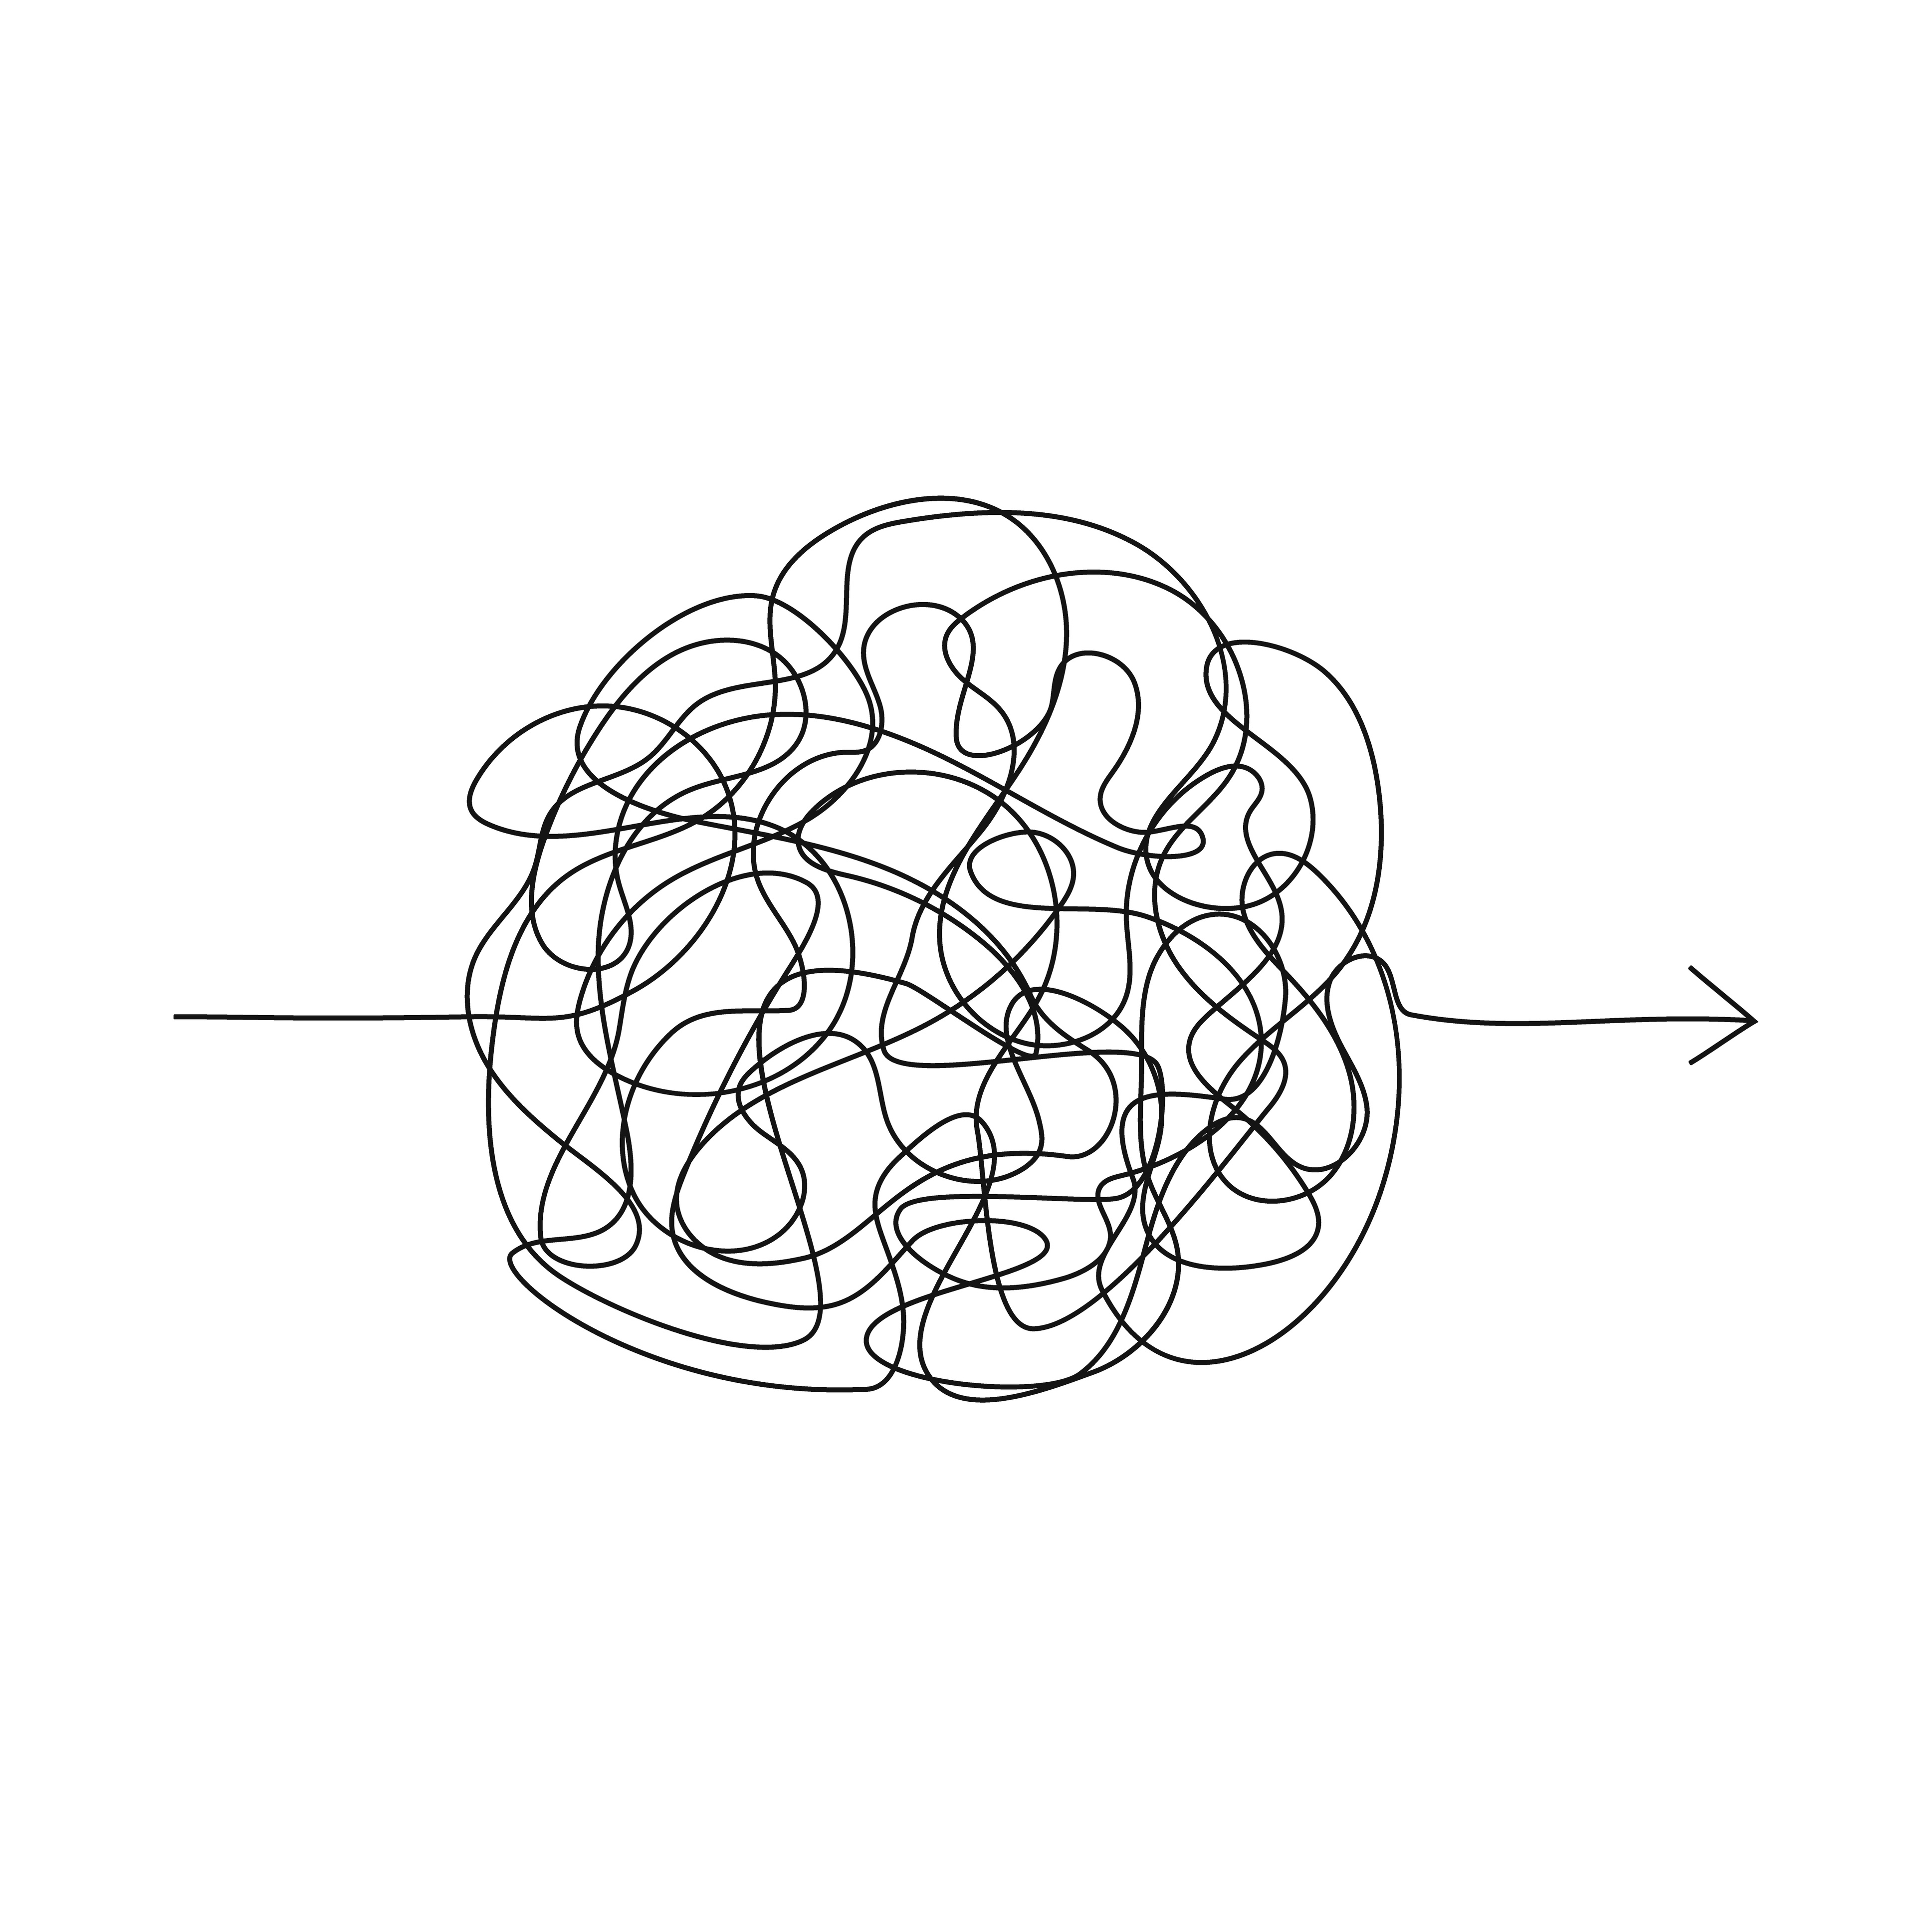
Confusion Attacks
Software Supply Chains: Threats
How do you get malicious packages installed
Trick the user!

Slide 21
This lecture
Bug Isolation
Software Supply Chain Security
Supply chain overview
Threats
Defenses
What are we supposed to do about all this trouble?

Slide 22
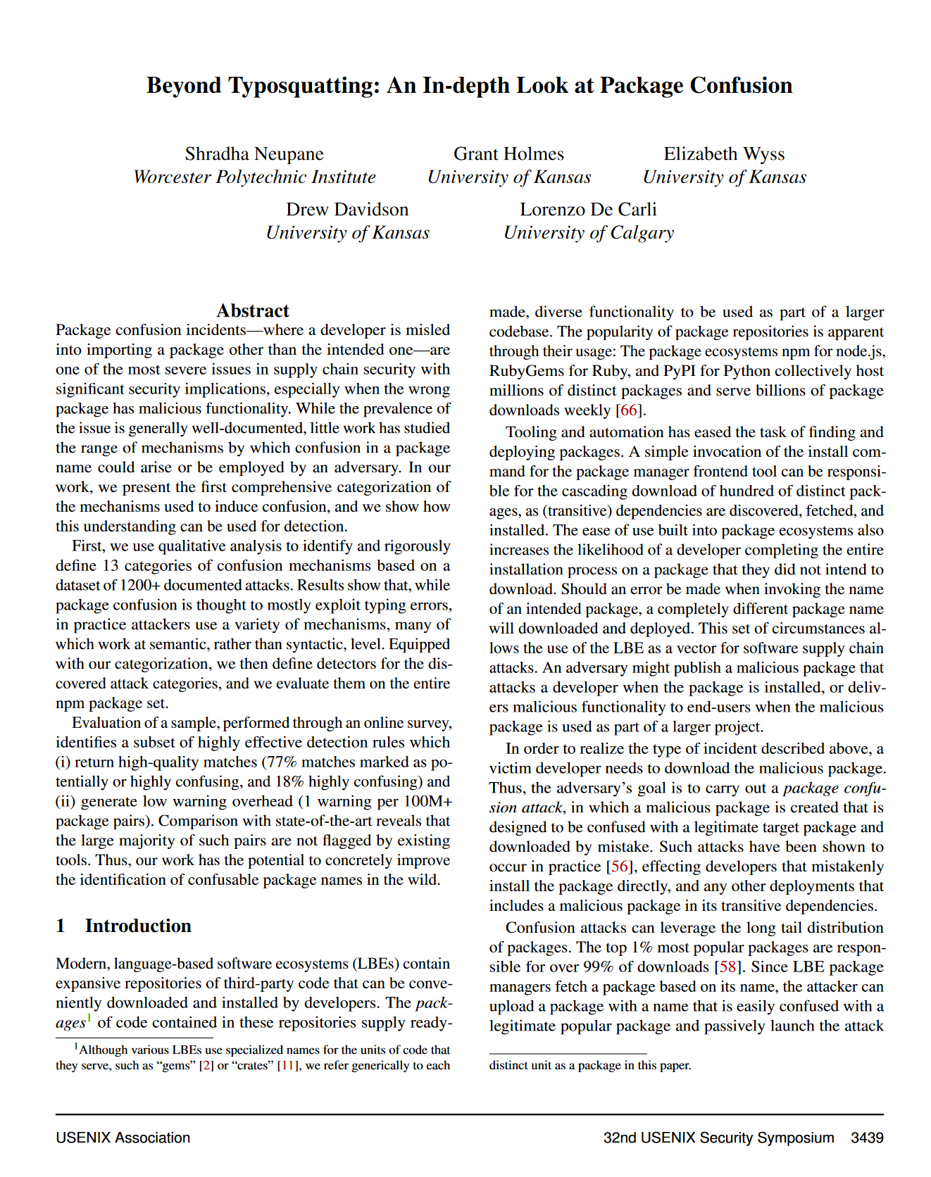
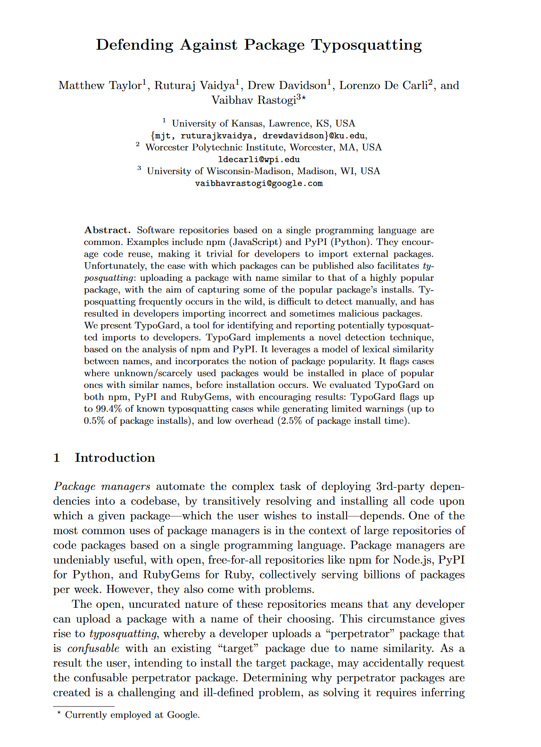
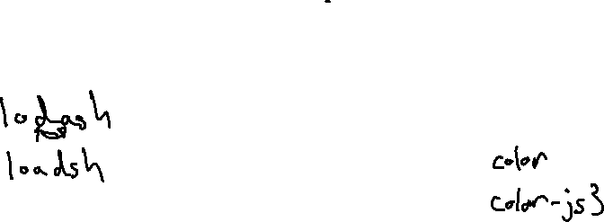
Preventing Confusion: package names
Software Supply Chains

Slide 23
Scrutiny
Software Supply Chains: Defenses
Can we tell if a package is being vetted?

Slide 24
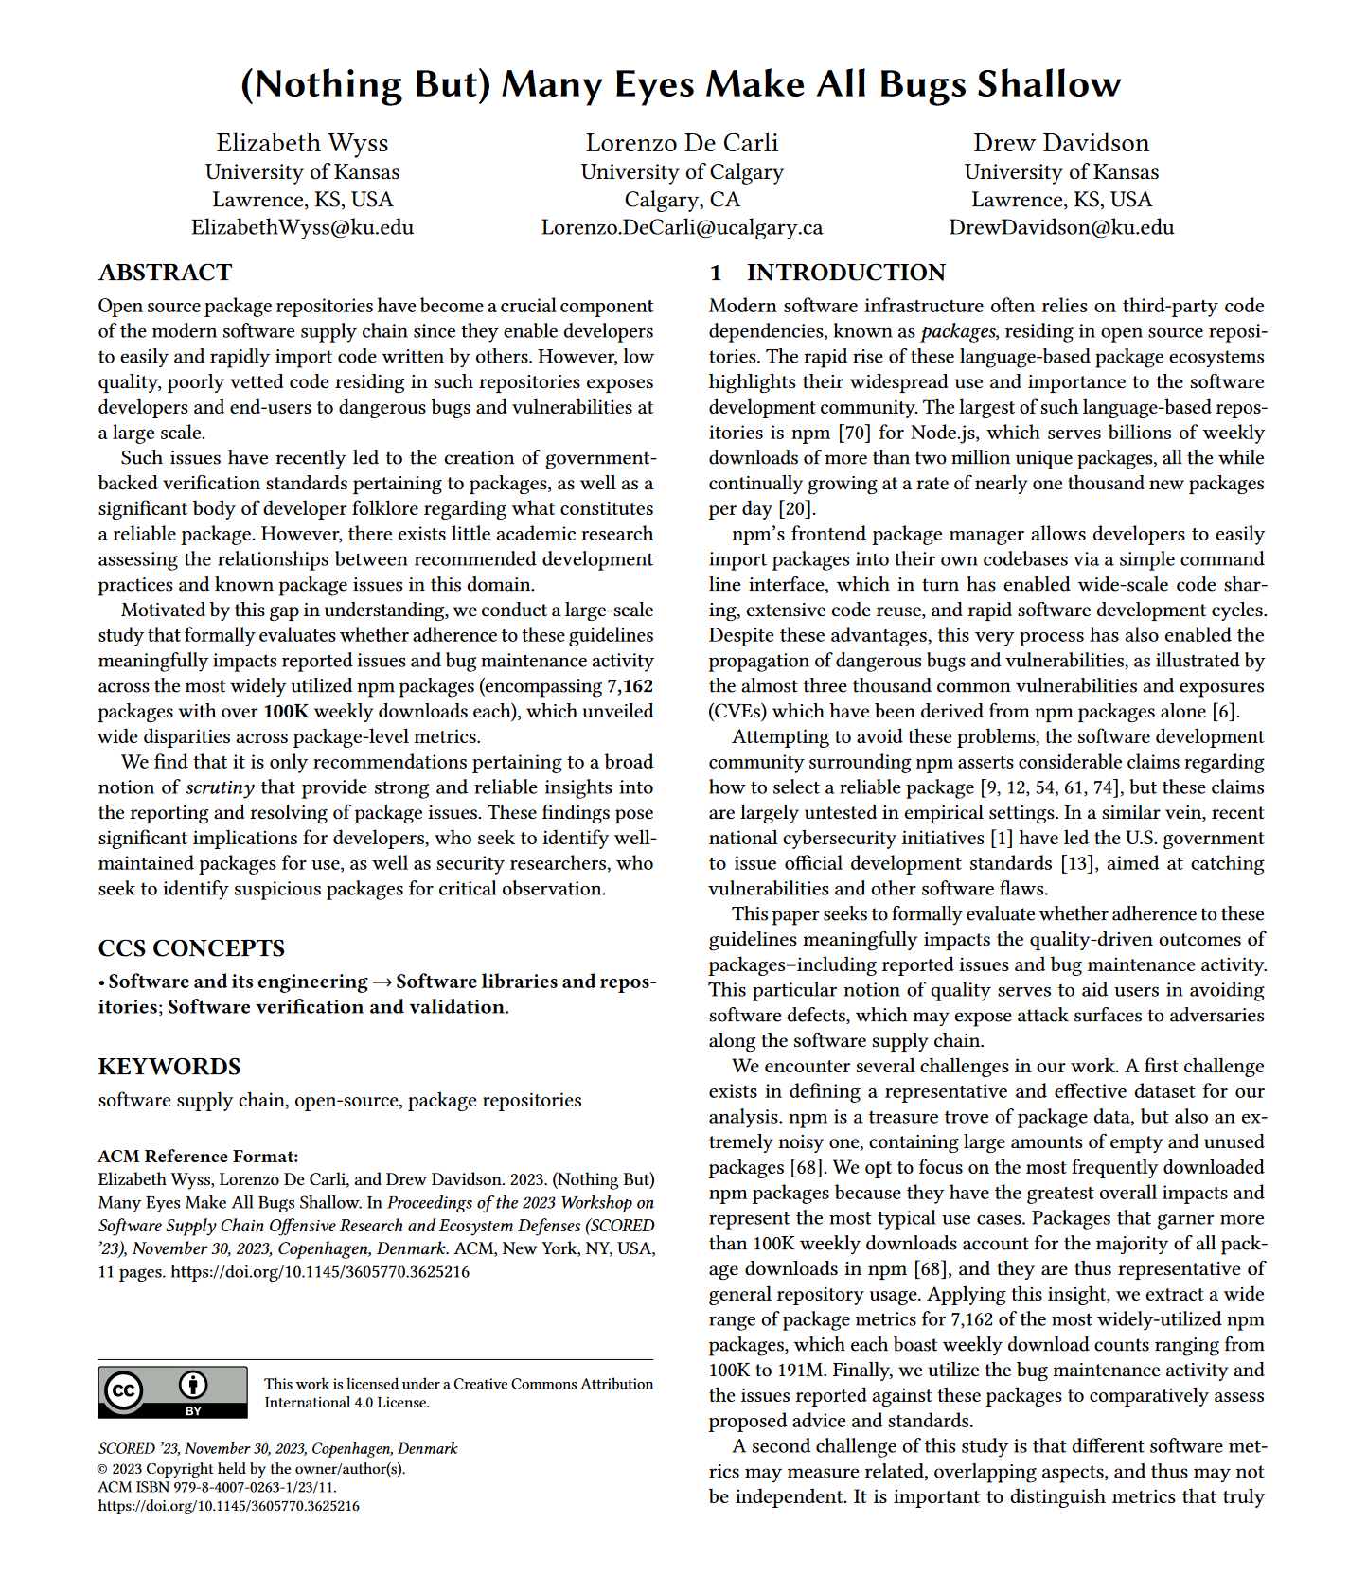
Scrutiny
Software Supply Chains
Can we tell if a package is being vetted?

Slide 25
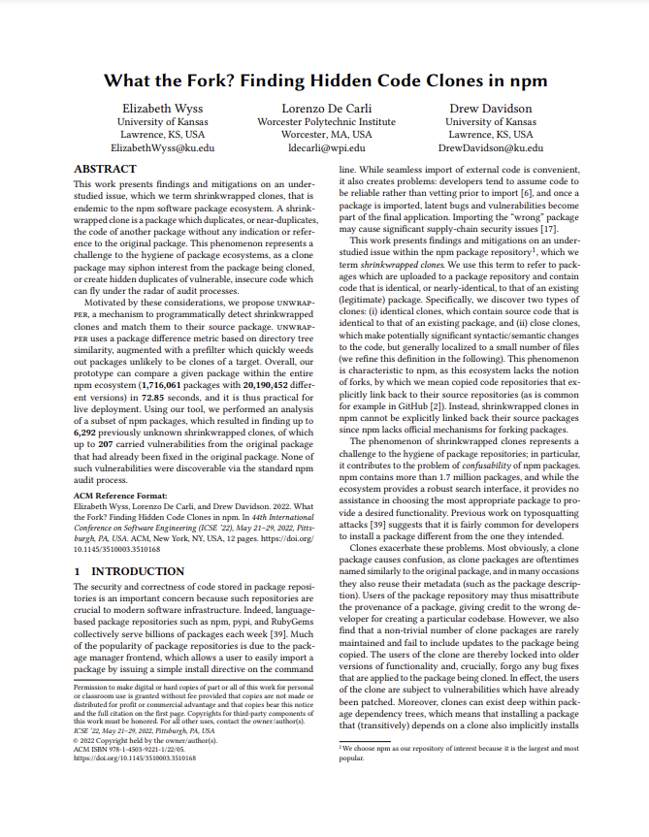
Preventing Confusion: Clones
Software Supply Chains

Slide 26
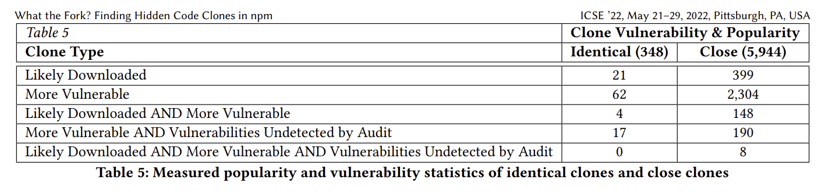
Preventing Confusion: Clones
Software Supply Chains

Slide 27
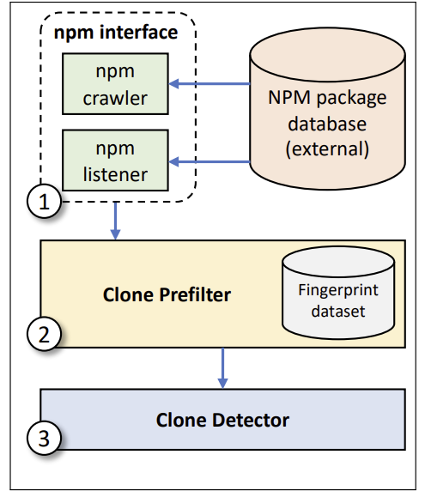
Preventing Confusion: Clones
Software Supply Chains

Slide 28
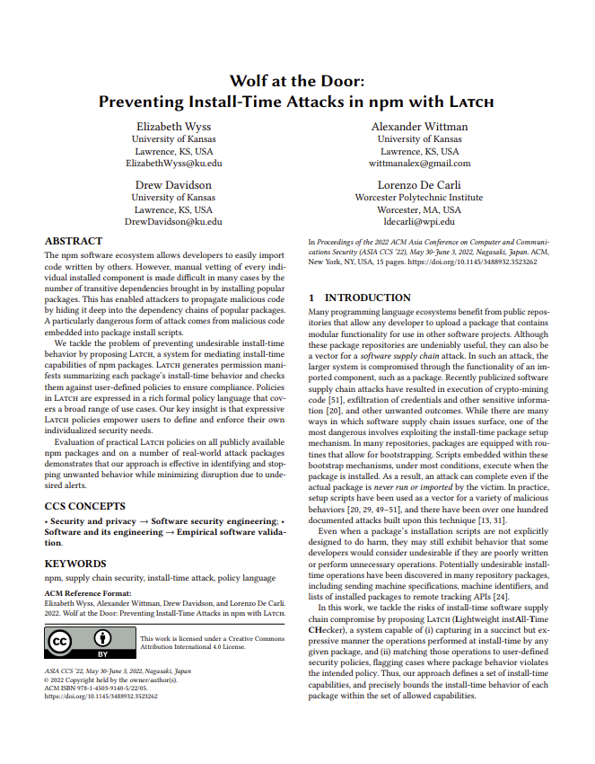
Preventing install-time exploits
Software Supply Chains
Allow package users and repository maintainers to specify acceptable install-time behavior

Slide 29
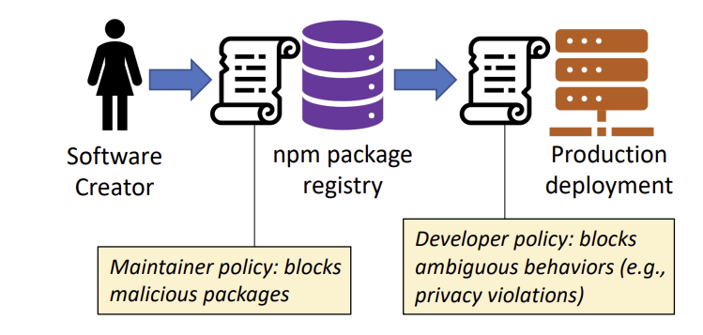
Preventing install-time exploits
Software Supply Chains

Slide 30
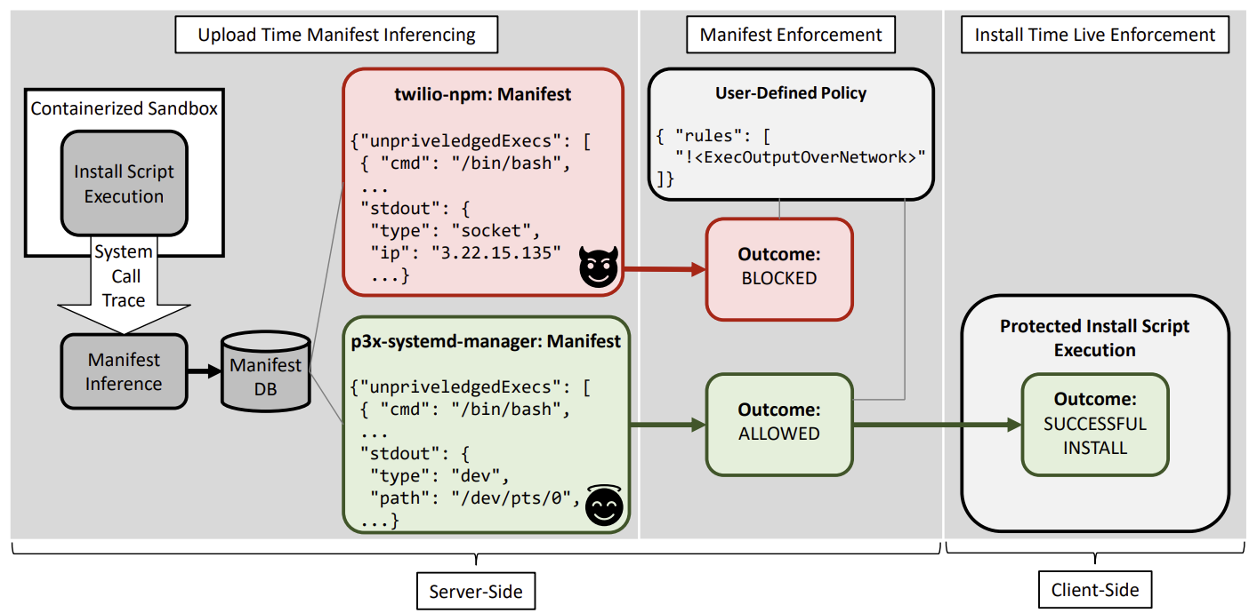
Preventing install-time exploits
Software Supply Chains

Slide 31
Wrap-Up
Software Supply Chains
An application is more than your code
Likely mostly somebody else’s code!
- Very little vetting
- Very little protection

