Slide 1
Exercise #29
Fuzzing Review
Write your name and answer the following on a piece of paper
In fuzzing, it is easy to generate additional test cases for an analysis target. What are some of the strategies for prioritizing which test case to run next?

Slide 2
Administrivia and
Announcements

Slide 3
Symbolic Execution
EECS 677: Software Security Evaluation
Drew Davidson

Slide 4
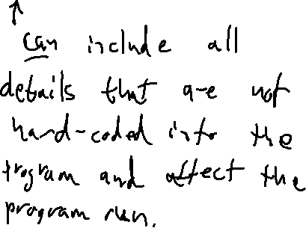
Where We’re At
Dynamic Analysis
Generating test cases

Slide 5

Previously: Fuzzing
Outline / Overview
Generating Random test cases
Surprisingly effective in practice
Main challenge is exploring “new” behavior
The random “fuzz” of white noise

Slide 6

Research Direction: “Gunking”
Fuzzing
Fuzzing as adversarial recon
Fuzzing is so good at finding bugs that even the bad guys do it
Perhaps a program should deploy Anti-Fuzzing tech
What would that look like?

Slide 7
This Lecture: Symbolic Execution
Outline / Overview
A methodical approach to “abstract” execution

Slide 8
Recall: Test case generation
Symbolic Execution

Slide 9
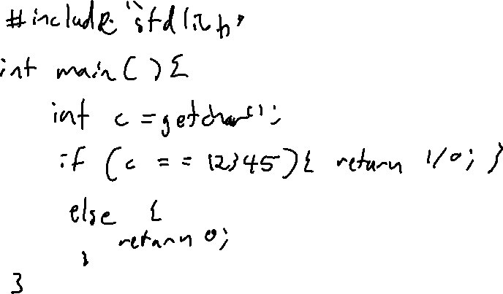
The problem of coverage
Symbolic Execution

Slide 10
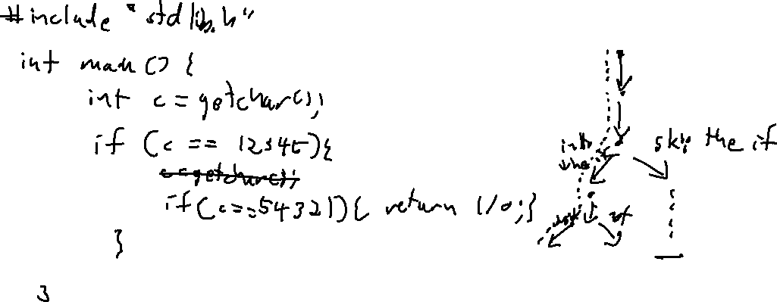
Predicates get in the way!
Symbolic Execution

Slide 11
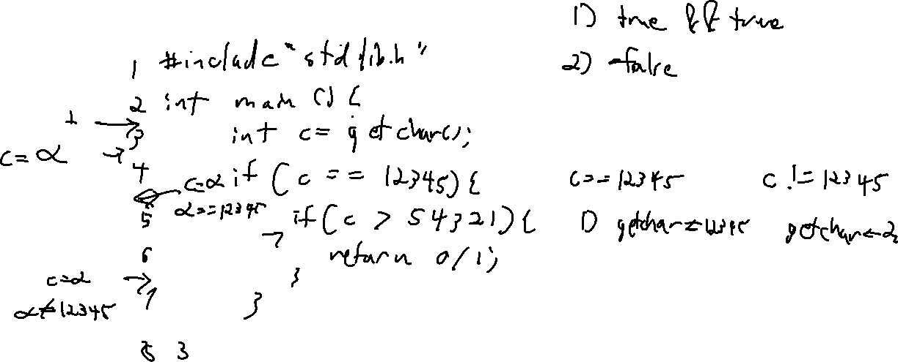
Eliminating Infeasible Paths
Symbolic Execution

Slide 12
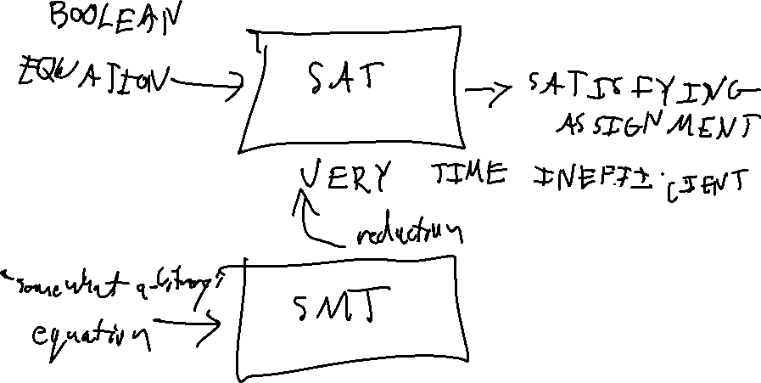
The magic of the solver
Symbolic Execution

Slide 13
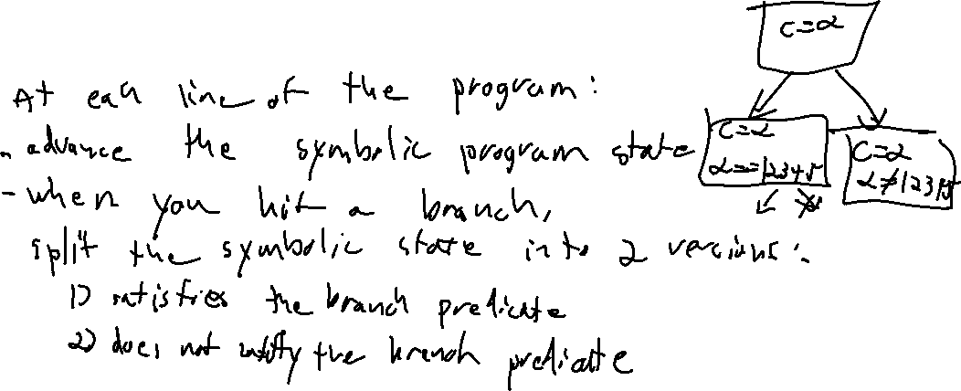
The symbolic execution Tree
Symbolic Execution

Slide 14
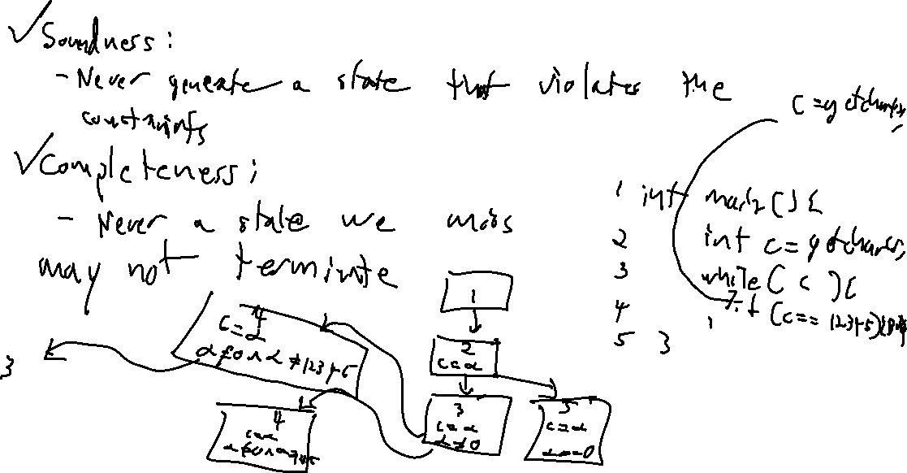
Soundness / Completeness
Symbolic Execution

Slide 15
Wrap-up
Symbolic execution
A simple, elegant idea

